Slide 1

SEC285 Course Project:
Fundamentals of Information System Security
Presented By: Eric O.

Slide 2
Introduction

Slide 3
This course explains the fundamentals to analyze internal and external security threats and be able to set security mechanisms. I examined network and internet security issues to be able to produce security solutions, I also learned in this course to design information systems security policies, troubleshoot networks, and implement digital signatures.

Slide 4
Module 2
Asymmetric Key Encryption

Slide 5
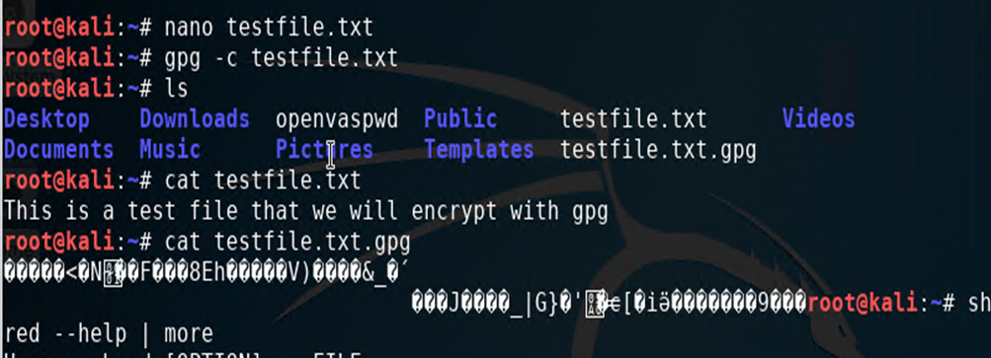
File Encryption
This slide shows a plaintext file as well as its encrypted self

Slide 6
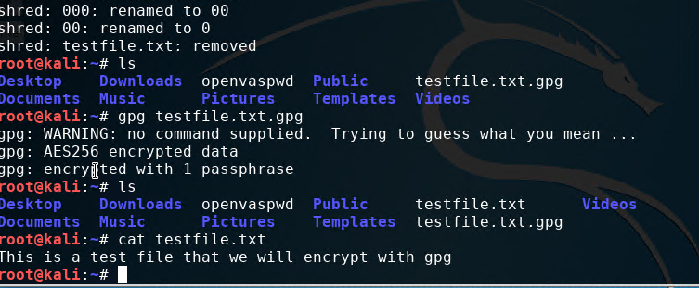
File Decryption
This slide shows the encrypted file listed by itself, the decrypting process, as well as the original plaintext file listed.

Slide 7
Module 3
Stateful Firewall

Slide 8
Question: What effect does the sudo iptables --policy INPUT DROP command have on the access to computing resources?
Answer:
if an incoming packet does not match a set of rules, it will be dropped. Also, iptables is a default firewall in ubuntu the sudo iptables --policy INPUT DROP is used when we want to block the web traffic that is coming to the system

Slide 9
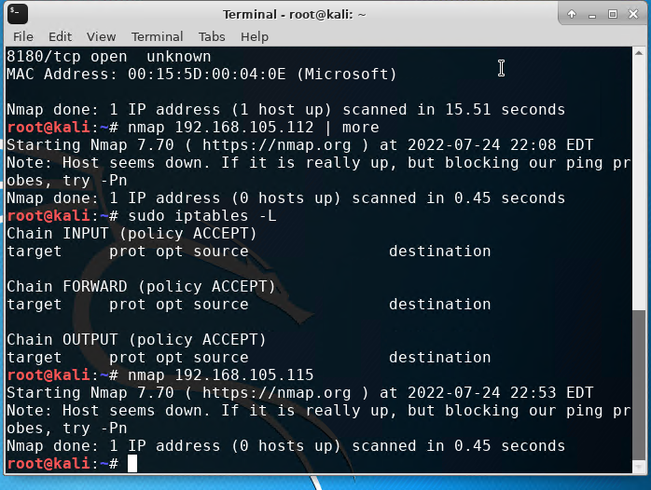
Nmap Scan
This slide shows the results of a Nmap scan of the Linux server VM

Slide 10
Module 4
Bring Your Own Device (BYOD)
Security Policy

Slide 11
BYOD Security Policy
This slide contains a security policy I completed and the full policy in a word doc.

Slide 12
Module 5
Multifactor Authentication (MFA)

Slide 13
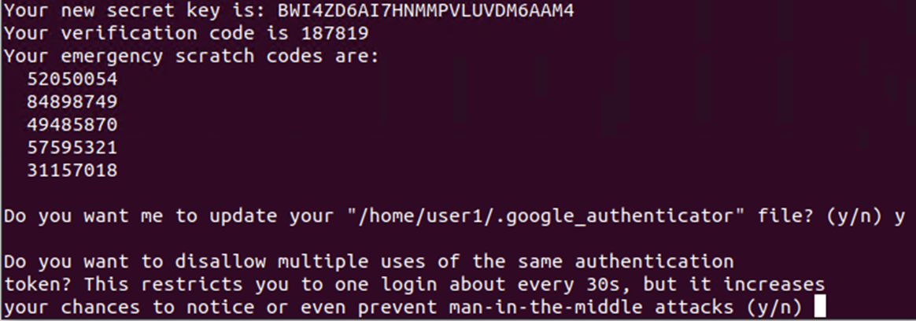
Common-auth Configuration File
This slide shows the entry that indicates I used Google Authenticator for a login

Slide 14
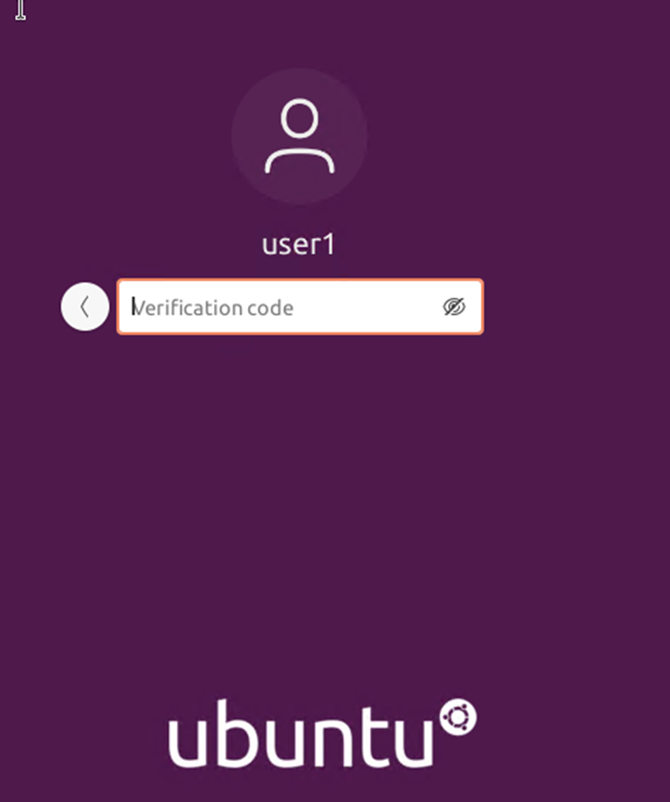
MFA Login Screen
This slide shows the login screen where the verification code is required

Slide 15
Module 6
Vulnerability Assessment

Slide 16
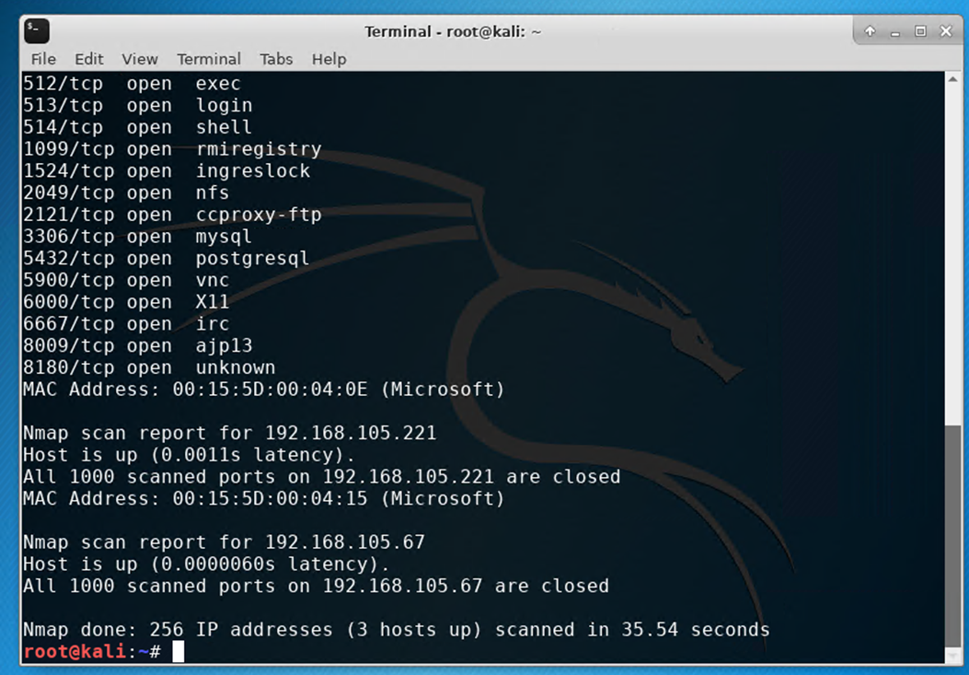
Nmap
This slide shows a Nmap scan of both kali and Linux Server VMs

Slide 17
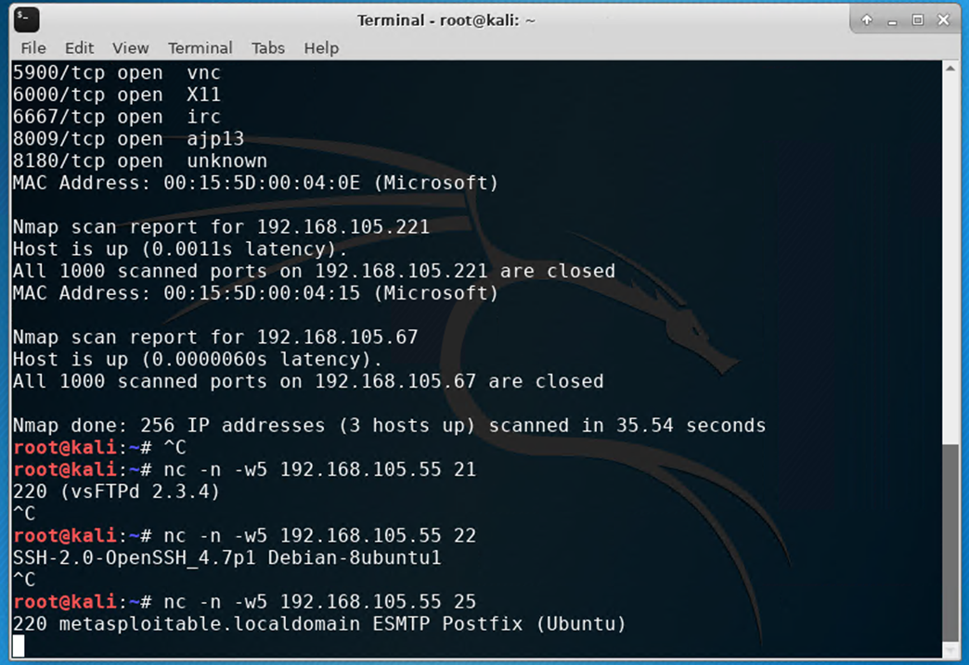
NetCat
This slide shows a NetCat scan of both kali and Linux Server VMs

Slide 18
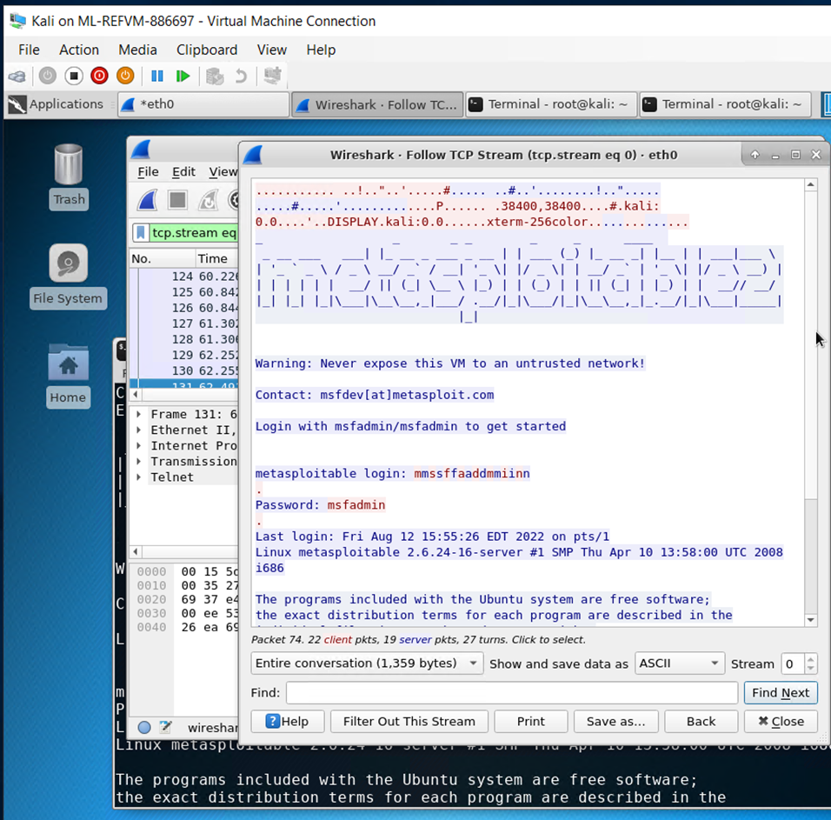
Wireshark
This slide shows Wireshark- follow TCP stream window showing the telnet user and password on Kali

Slide 19
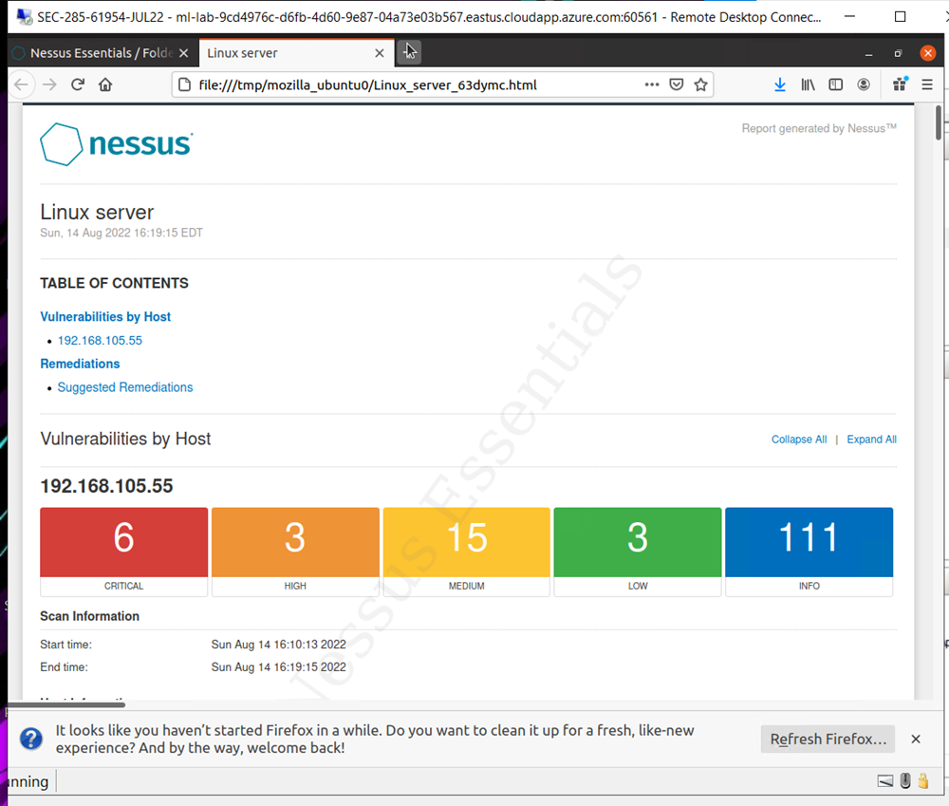
Nessus
This slide shows a high-level view of the Nessus vulnerability scan report (showing categories of vulnerability in different colors).

Slide 20
Challenges in project

Slide 21
A challenge I had with this course was mostly having to manually type long inputs into the VMs

Slide 22
Career Skills

Slide 23
I learned to set up google authenticator and use it to sign into an account
I learned how to do a security test for any vulnerability in a VM
I learned to do Nmap scans and use Netcat

Slide 24
Conclusion

Slide 25
In conclusion, I learned an abundance of attacks and ways to defend against them through this course and hope to learn even more about attack prevention and security.

