Slide 1

NETW310 Course Project:
Wired, Optical and Wireless Communication with Lab
Presented By: Eric O.

Slide 2
Introduction

Slide 3
This course explains the various types of media commonly used to connect computing and digital devices to networks and the significance of their planning for a secure system. All major media are discussed including copper, coax cable, fiber optic cable, wireless, and microwave media. Physical and virtual systems are analyzed, implemented, and secured through this course

Slide 4
Module 2
Baseband Signals and AM/FM Signals

Slide 5
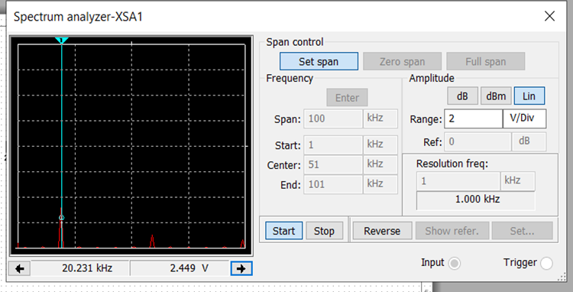
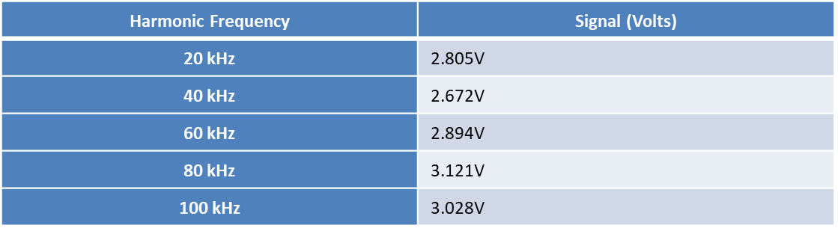
Baseband Signals
This slide shows the spectrum analyzer displaying the signal’s harmonic spectrum and its panel settings as well as the signal voltage at each of the frequencies in the table.

Slide 6
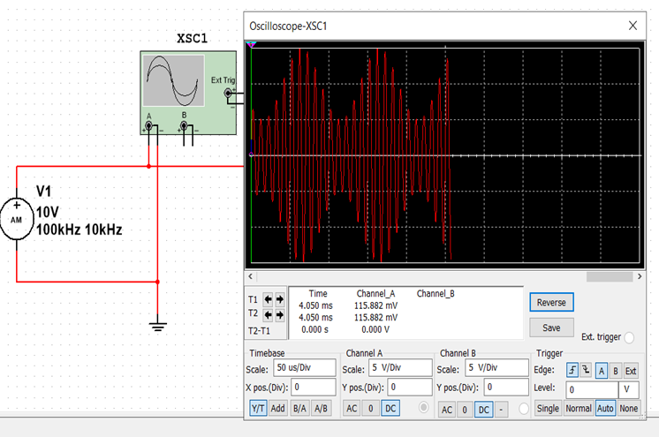
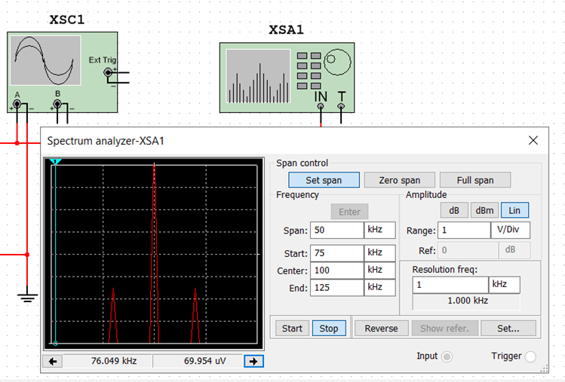
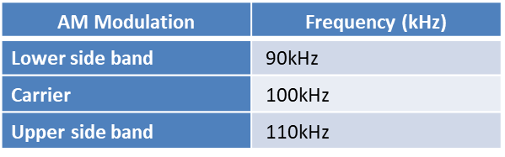
AM Signals
This slide shows the Oscilloscope including the signal and the panel settings of the oscilloscope. Also showing a screenshot of the Spectrum Analyzer including the signal and the panel setting of the analyzer.

Slide 7
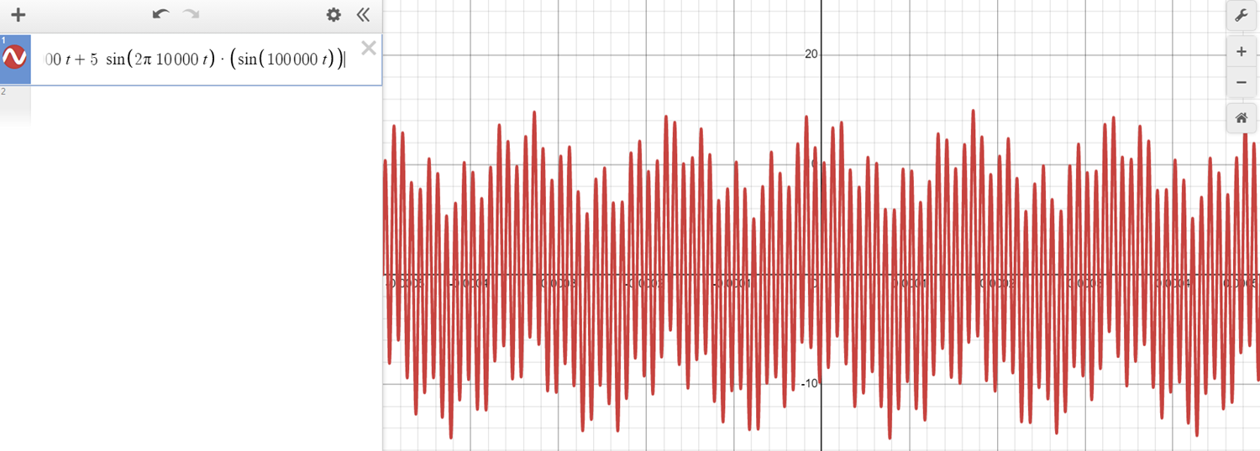
AM Signals Cont.
This slide shows equations for the carrier and modulating signals and plots of the equation for the composite modulated signal VAM
(10v)sin2𝜋(100khz) + (5v)sin2𝜋(10khz)𝑡(sin2𝜋(100khz)𝑡)

Slide 8
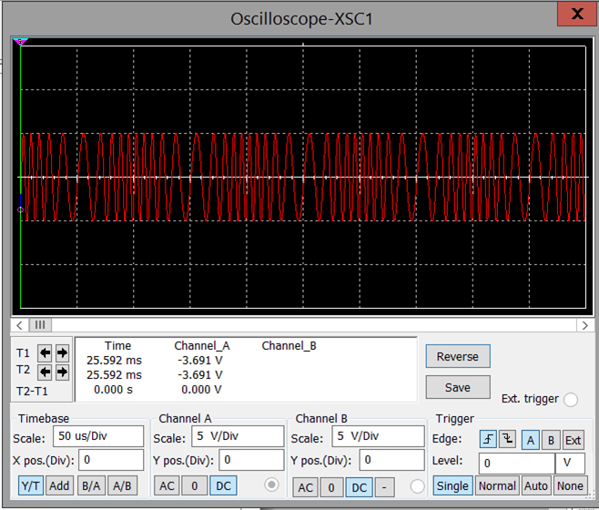
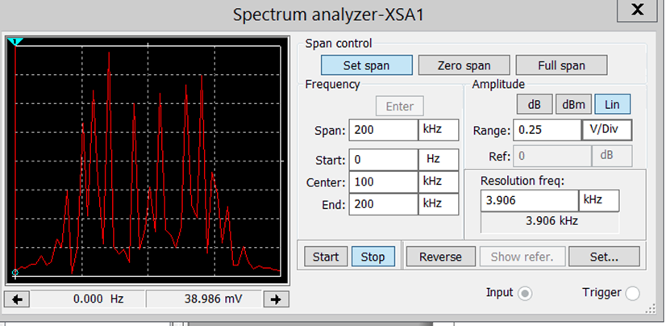
FM Signals
This slide shows the Oscilloscope including the signal and the panel settings of the oscilloscope. The screenshot also shows the Spectrum Analyzer including the signal and the panel setting of the analyzer.
The carrier frequency
566.780 mV

Slide 9
Module 3
Pulse Code Modulation (PCM) and Line Codes

Slide 10
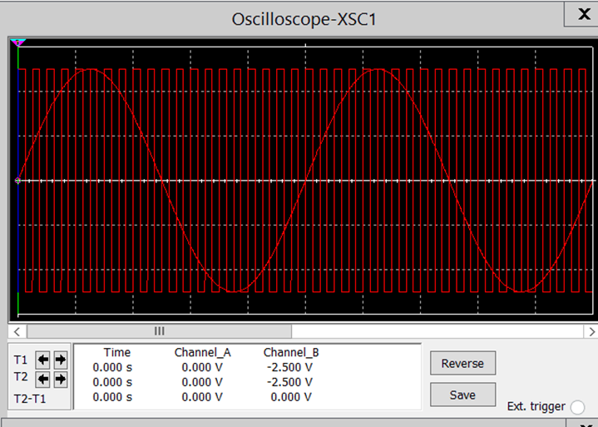
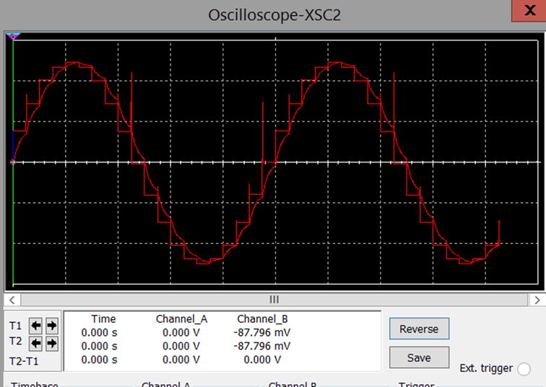
Pulse Code Modulation (PCM)
This slide shows the Oscilloscope-XSC1 display with the analog input signal and sampling clock at the input to the ADC. The second screenshot shows the Oscilloscope-XSC2 display with the output of the DAC.

Slide 11
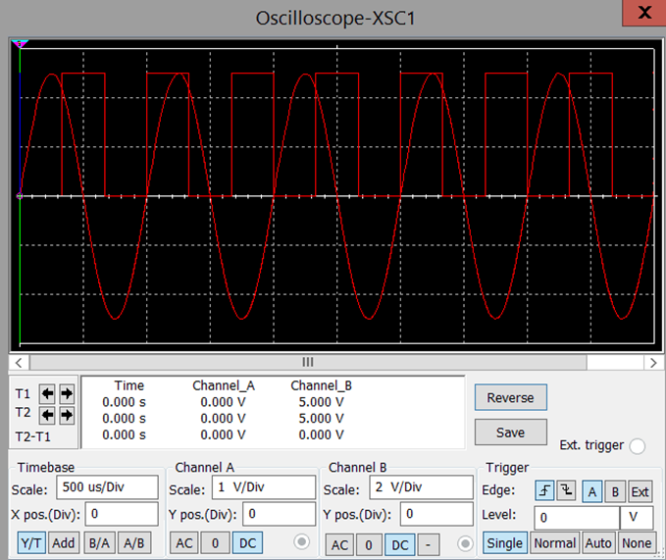
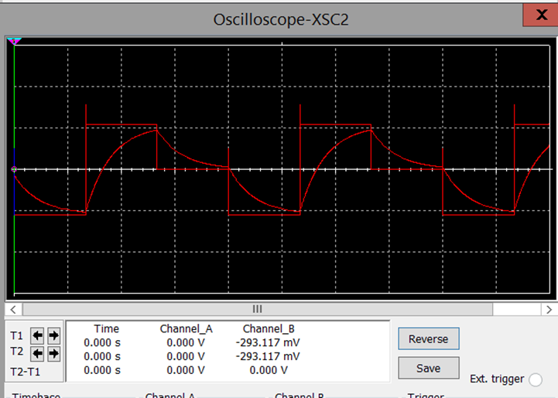
Pulse Code Modulation (PCM)
This slide shows the Oscilloscope-XSC1 display with the analog input signal and sampling clock at the input to the ADC. The second screenshot shows the Oscilloscope-XSC2 display with the output of the DAC
the effects of increasing or decreasing the sampling rate are that By increasing the sample rate we get a wider spacing between each wave on the Oscilloscope

Slide 12
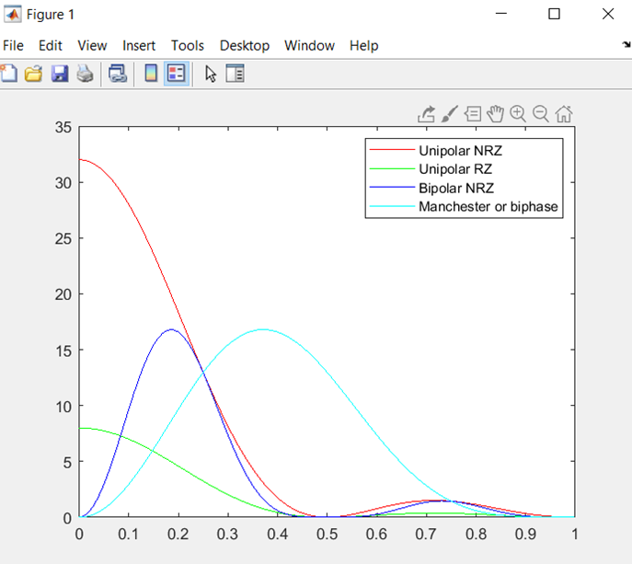
Line Codes
This slide shows the power spectral densities of four-line codes: NRZ-Polar, NRZ-Unipolar, NRZ-Bipolar, and Manchester-Polar
The unipolar NRZ needs more bandwidth compared to the Manchester polar code as it only has 0 to 0.5 bits while the Manchester polar code goes from 0 to 0.9 bits.

Slide 13
Module 4
Cables and Structured Cabling

Slide 14
1. Why must the twisting in the individual wires be maintained in a UTP cable?
Answer:
This is done to reduce electromagnetic interference, which can affect network performance
2. How many inches should the UTP cable be separated from 110 volts electrical cable?
Answer:
12 inches away from the electrical cables
3. Horizontal cabling connects what areas to each other?
Answer:
backbone cabling connects facilities, equipment rooms, and communication rooms while Horizontal cabling connects communication rooms to individual outlets throughout the building's floors and should not be wired between floors

Slide 15
4. What is a plenum-rated cable?
Answer:
A special insulated cable that has low smoke and low flame characteristics meaning when on fire does not spread faster than non-plenum rated cable and when burned does not produce a lot of harmful smoke.
5. What is a riser tube used for?
Answer:
A riser tube is used to go in spaces between multiple floors of buildings connecting cable to all floors
6. Is the grounding of equipment mostly a safety or a performance concern?
Answer:
Grounding a piece of equipment means the current will not pass through the person using it but through the ground keeping them safe. The grounding of equipment is a safety concern

Slide 16
Module 5
Antenna Gain and Free Space Path Loss

Slide 17
Antenna Gain
What is the maximum theoretical antenna gain of a common dish antenna at the 2.4 GHz band?
Answer:
22.379
2. What is the maximum theoretical antenna gain of a common dish antenna at the 5 GHz band?
Answer:
29.079
3. Given the same sized reflector, which signals, high-frequency, or low-frequency, can be more efficiently focused by a common dish antenna (i.e., result in a higher antenna gain)?
Answer:
high-frequency
4. What is the maximum theoretical antenna gain of the dish antenna used in the VLA radio telescopes in New Mexico at the 5 GHz band?
Answer:
63.059
5. Given the same signal frequency, which dish antennas, large-sized or small-sized, are more efficient at focusing the signal (i.e., result in a higher antenna gain)?
Answer:
large-sized dish antennas

Slide 18
Free Space Path Loss
1. What is the free space path loss in dB at the 2.4 GHz band?
Answer:
-80.4
2. What is the free space path loss in dB at the 5 GHz band?
Answer:
-87.2
3. How does the free space path loss at a higher frequency (e.g., the 5 GHz band) compare with that at a lower frequency (e.g., the 2.4 GHz band)? [5 points]
Answer:
The higher the frequency will result in a bigger free space loss in dB
4. What is the free space path loss in dB over 20 meters at the 2.4 GHz band?
Answer:
-66.421
5. What is the free space path loss in dB over 40 meters at the 2.4 GHz band?
Answer:
-72.441
6. What is the free space path loss in dB over 80 meters at the 2.4 GHz band?
Answer:
-78.462
7. When the distance doubles, how does free space path loss in dB change approximately?
Answer:
Approximately -6.021

Slide 19
Free Space Path Loss Cont.
8. Use a scientific calculator to calculate Delta 𝐿_𝑓𝑆 for D1 = 20 meters and D2 = 40 meters.
Delta 𝐿_(𝑓𝑆 )= -6.02059991328
9. Is your calculation approximately the same as the result from Part 1 Step 2?
Answer:
My approximation was fairly the same as my result just rounded up

Slide 20
Module 6
Bit Error Rate of Fading Channels

Slide 21
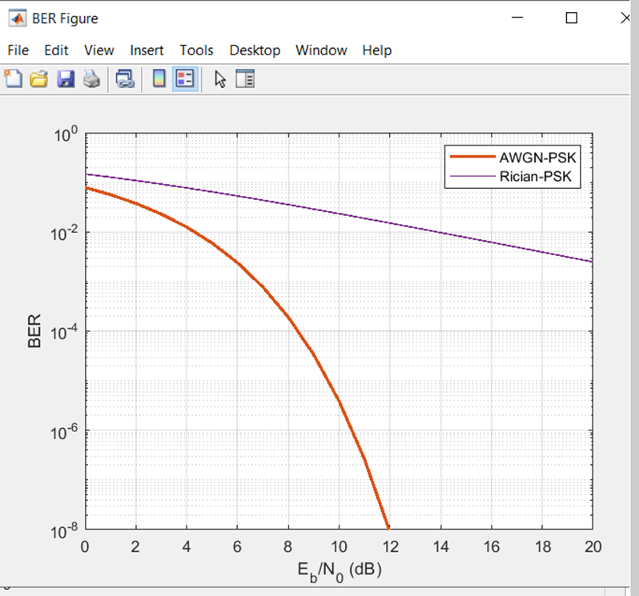
AWGN Channel and Rician Channel
This slide shows show the bit rate error performance of both AWGN and Rician fading channels.

Slide 22
AWGN Channel and Rician Channel
Compare and contrast the BER performance of PSK over a noise-limited (AWGN) transmission channel to the performance of PSK over a Rician channel at 5- and 10-dB Signal to Noise Ratio (Eb/N0), respectively.
Is there a significant difference in the BER performance of PSK between the AWGN channel and the Rician channel?
Answer:
AWGN-PSK 2*10-2 at 5dB
Rician-PSK 2*10-2 at 5dB
While
AWGN-PSK 5*10-6 at 10dB
Rician-PSK 5*10-2 at 10dB
Meaning at 10 dB AWGN has 5 bits of error over every million versus Rician with 5 bits of error every 100 bits transmitted

Slide 23
Challenges in project

Slide 24
A challenge I had with this course was in my second project where I had to graph equations for the carrier and modulating signals and plotting of the equation for the composite modulated signal VAM, through Professor Nabeel Khan’s guidance I was able to push through and complete this course.

Slide 25
Career Skills

Slide 26
I learned various types of media commonly used to connect computing and digital devices to networks
I learned how to map a spectrum analyzer as well as an Oscilloscope
I learned about cabling and cabling safety

Slide 27
Conclusion

Slide 28
In conclusion, I learned about major media such as copper, coax cable, fiber optic cable, wireless, and microwave media. I also learned that free space path loss of dB increases as the distance increases. This course was very engaging and allowed me to learn things I normally would not have learned outside of these classes.

