Slide 1

CEIS101 Course project smart home automation and security system
Presented by: Eric O.

Slide 2
Introduction
This course introduces physics concepts such as the fundamental laws of mechanics as well as force and motion, energy and energy conversion, magnetism, and light. Lastly, this course is on physics concepts accomplished through practical application.

Slide 3
Inventory of Parts and Software

Slide 4
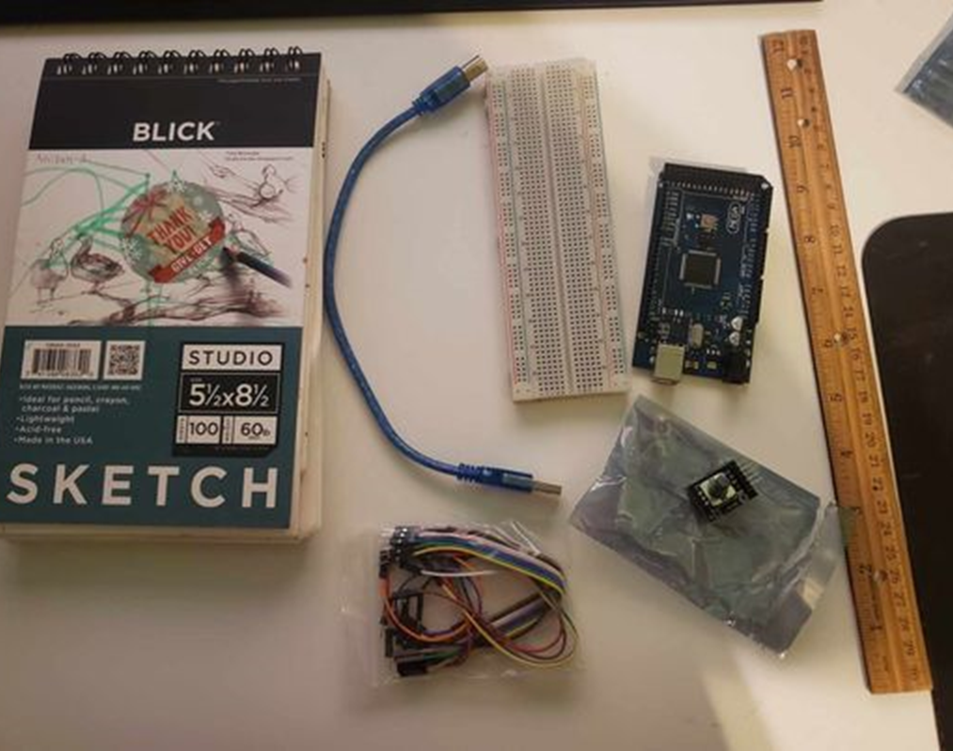
Arduino Mega 2560
Ultrasonic sensor HC-SR04
Male to Male Wires
Breadboard
USB cable to connect Arduino
Ruler or tape measurer
Object to act as an obstacle and undergo free-fall

Slide 5
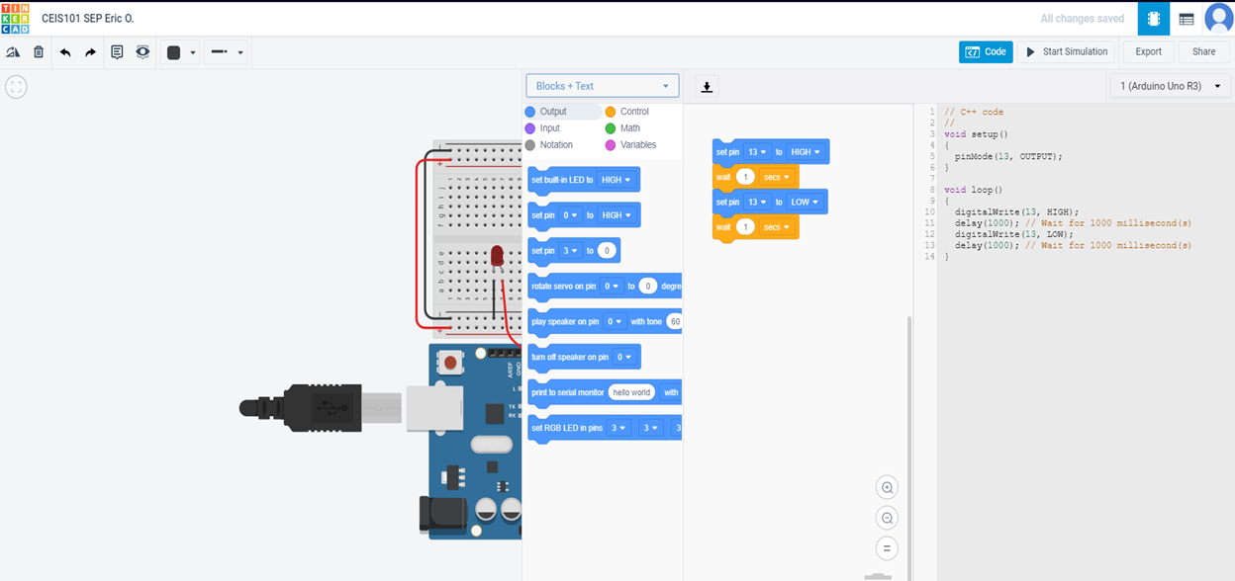

Slide 6
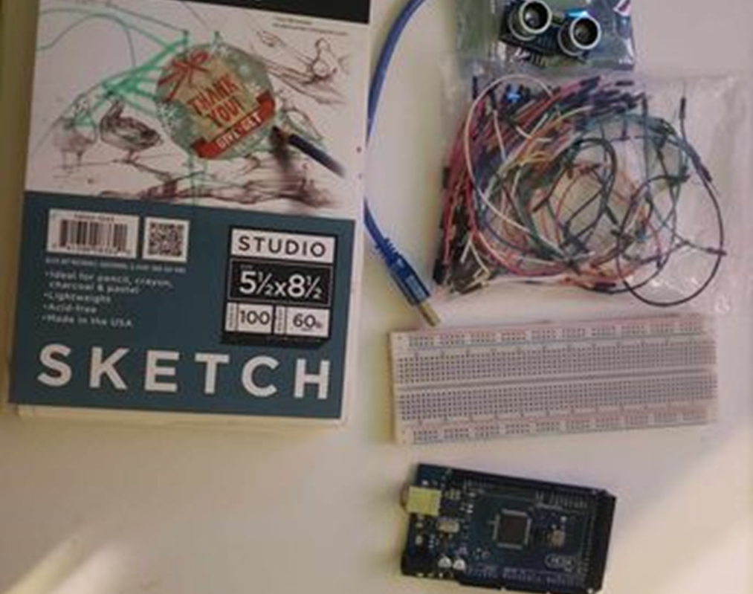
• Arduino Mega 2560
Rotary Encoder Part KY-040
Male to Female Wires
USB cable to connect Arduino
Object to attach onto rotary encoder
Ruler or tape measurer

Slide 7
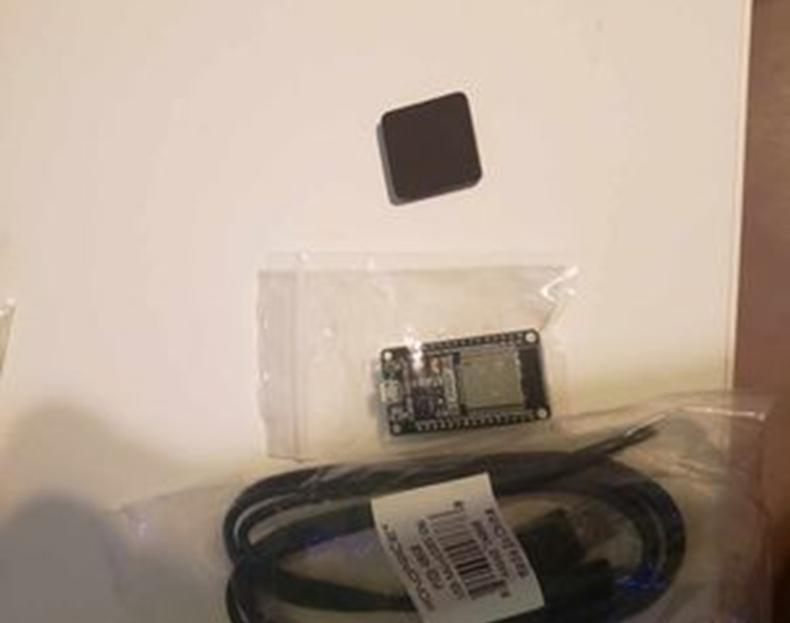
• ESP32 microprocessor
Micro-USB cable
Magnet

Slide 8

Microsoft Excel installed and running on my computer

Slide 9
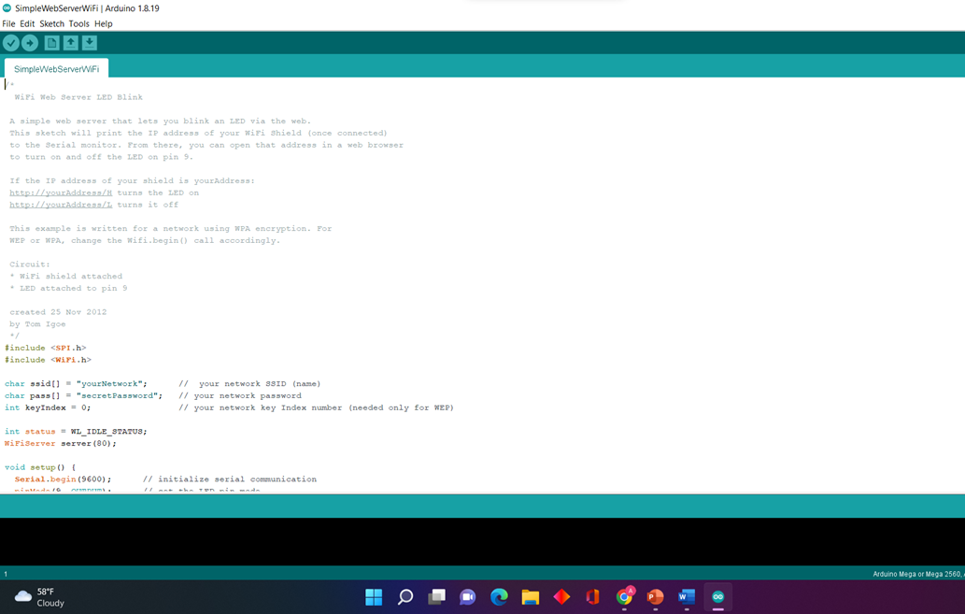
Arduino IDE installed and running on your computer

Slide 10
Precision of the Ultrasonic Sensor

Slide 11
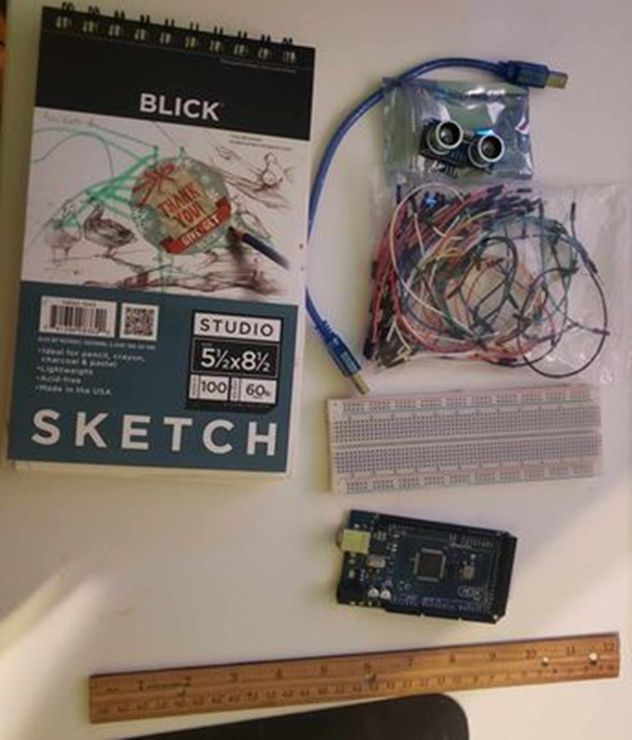
Materials List:
Mega 2560 Board
Ultrasonic sensor HC-SR04
Male to Male-to-male wires
Breadboard
Ruler or tape measurer
Object to act as an obstacle

Slide 12
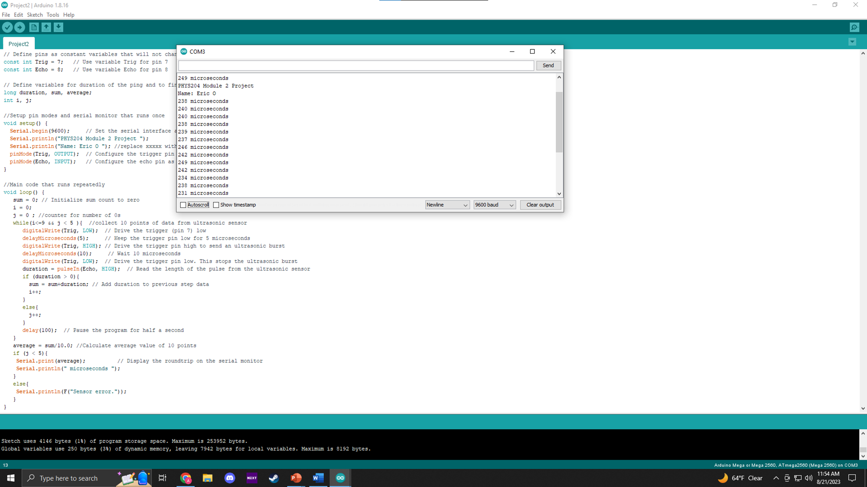
Screenshot of Serial Monitor from Arduino IDE showing raw data.

Slide 13
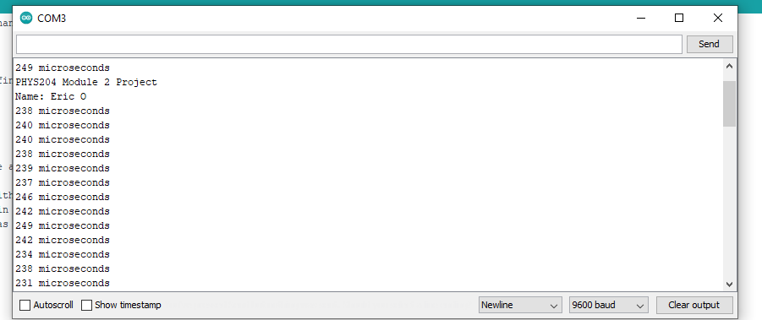
My name displayed on the serial monitor.

Slide 14
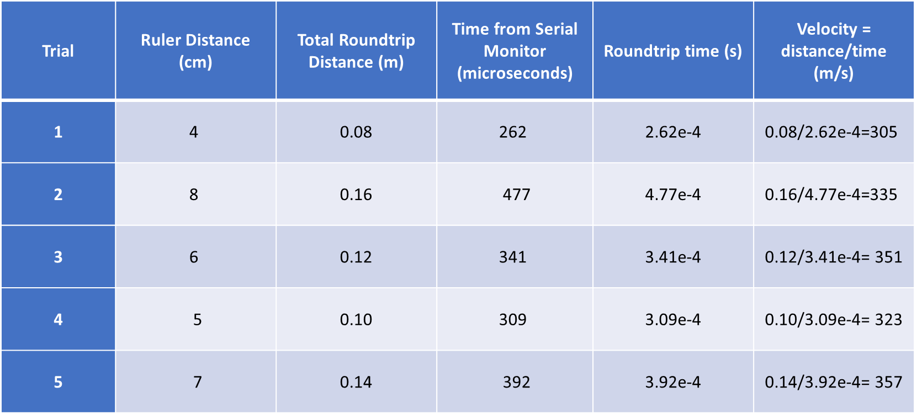
Data Collected

Slide 15

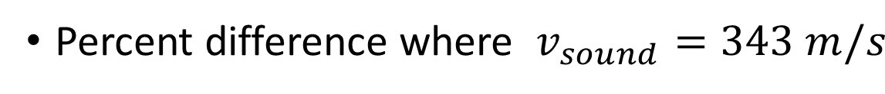

Data Analysis
Average velocity from table

Slide 16
The results and comments on the source of errors.
  Answer: I had issues getting the sensor to read back numbers. I found that my connections were a little loose and obviously not connecting to the sensor properly.
What is the dependence of temperature, humidity, and atmospheric pressure on the speed of sound?
  Answer: The speed of sound in air is influenced by various factors, including temperature, humidity, and atmospheric pressure. These factors affect the density and elasticity of the air, which in turn affect how quickly sound waves can travel through the medium. the relationships between temperature, humidity, atmospheric pressure, and the speed of sound can be summarized as follows:
  Temperature: Higher temperatures lead to a higher speed of sound, and lower temperatures lead to a lower speed of sound.
  Humidity: Increased humidity generally leads to a slightly lower speed of sound due to decreased air density caused by the presence of water vapor.
  Atmospheric Pressure: Higher atmospheric pressure increases the speed of sound, while lower atmospheric pressure decreases it.
  these factors interact in many ways, and they can oftentimes offset each other. Including, the speed of sound in other mediums, such as liquids and solids, can be affected by many different factors.

Slide 17
Gravitational Acceleration of Free-Falling Object

Slide 18
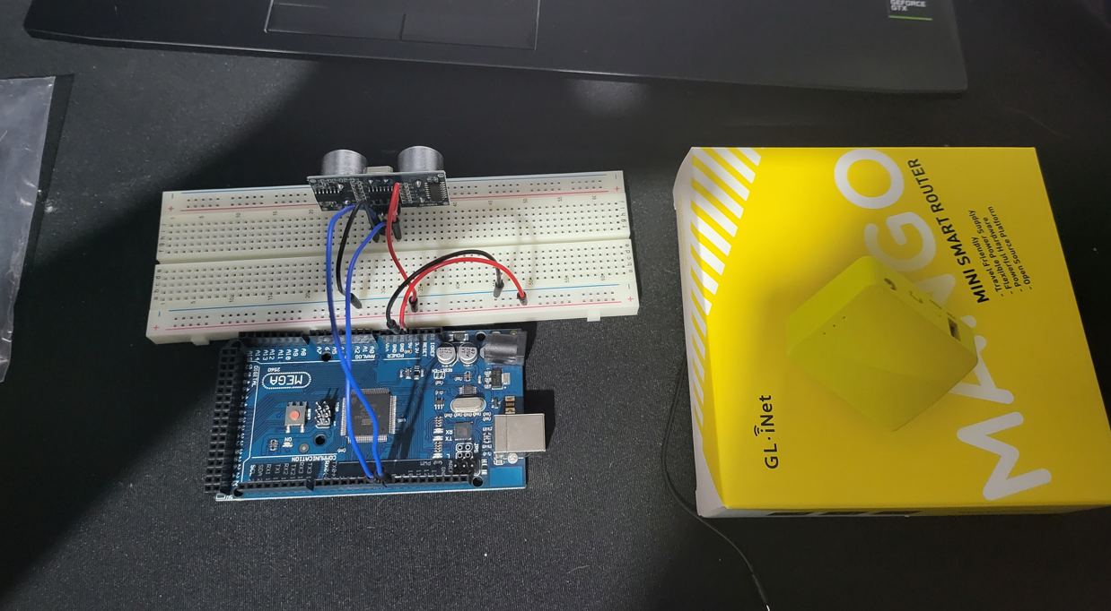
Materials List:
Mega 2560 Board
Ultrasonic sensor HC-SR04
Male to Male Wires
Breadboard
Object to undergo free fall motion

Slide 19
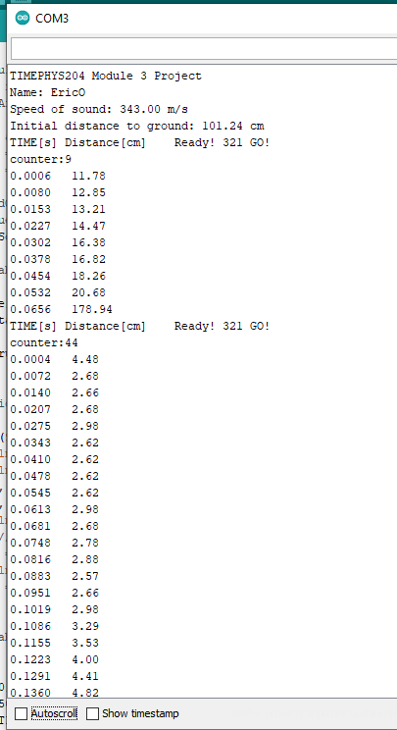
screenshot of raw data showing the start of the fall and end of the fall of one trial. Including my name displayed on the serial monitor.

Slide 20
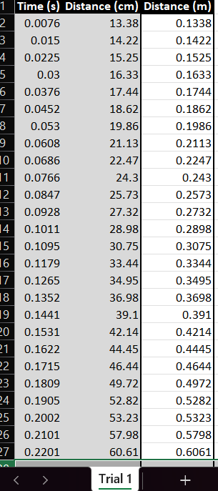
Excel Table
(Screenshot)
Including all values in the Excel table for a single trial showing the fall distance in centimeters and meters as a function of time

Slide 21
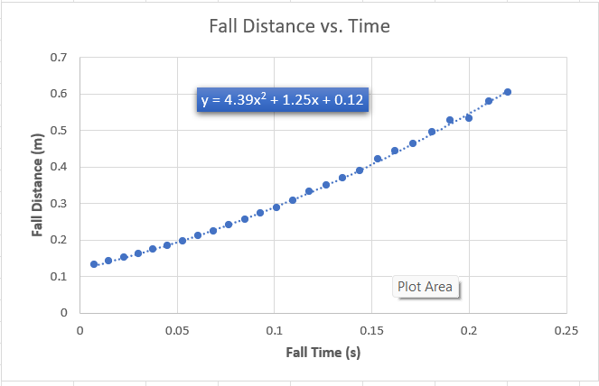
Excel Graph
(Screenshot)
Including an Excel graph for a single trial showing the fall distance as a function of time. Including an equation for curve fitting.

Slide 22
Data Collected
Trial | x² coefficient value from curve fitting | Acceleration (m/s²) = 2* (x² coefficient)
1 | 4.39 | 8.78
2 | 3.86 | 7.72
3 | 3.53 | 7.06
4 | 4.20 | 8.40
5 | 4.04 | 8.08

Slide 23


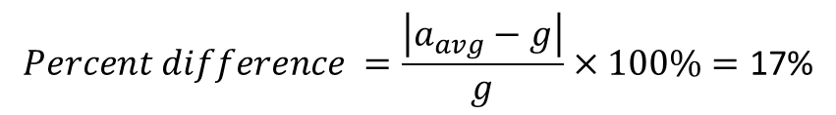
Data Analysis
Average acceleration from table
Percent difference with $g=9.8 m/s^{2}$
$$a_{avg}= \frac{a_{1}+a_{2}+a_{3}+a_{4}+a_{5}}{5}=\text{8.008}$$
$$Percent difference =\frac{\left|a_{avg}−g\right|}{g}×100\%=\text{17\%}$$

Slide 24
The results and comments on the source of errors.
  Answer: I had a hard time collecting data, but I figured it out with the time stamps on the Arduino.
How much variation is there from trial to trial? What does this indicate about the uncertainty of the result?
  Answer: The sensor would pick up the distance to the floor differently in every trial which led to deviation from the results.

Slide 25
Conservation of Energy of Free-Falling Object

Slide 26
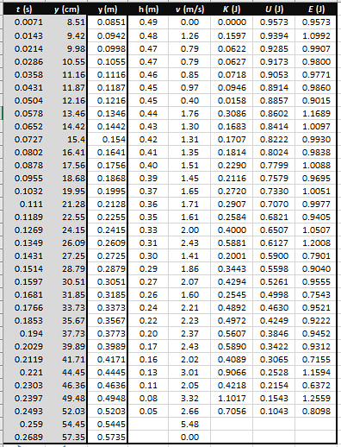
Excel Table
(Screenshot)
Includes all values in the Excel table for a single trial showing the fall distance in centimeters and meters as a function of time with the values generated for kinetic energy K, potential energy U, and total mechanical energy E.

Slide 27
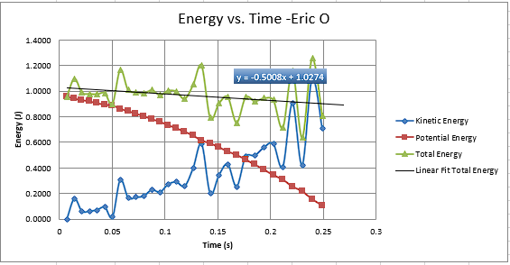
Excel Graph
(Screenshot)
Including an Excel graph for a single trial showing the plots of the kinetic energy K, potential energy U, and total mechanical energy E as a function of time. Including my name in the title of the graph.

Slide 28
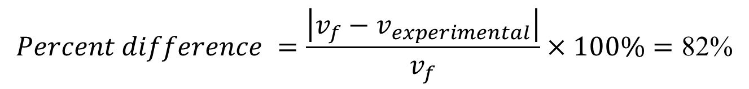
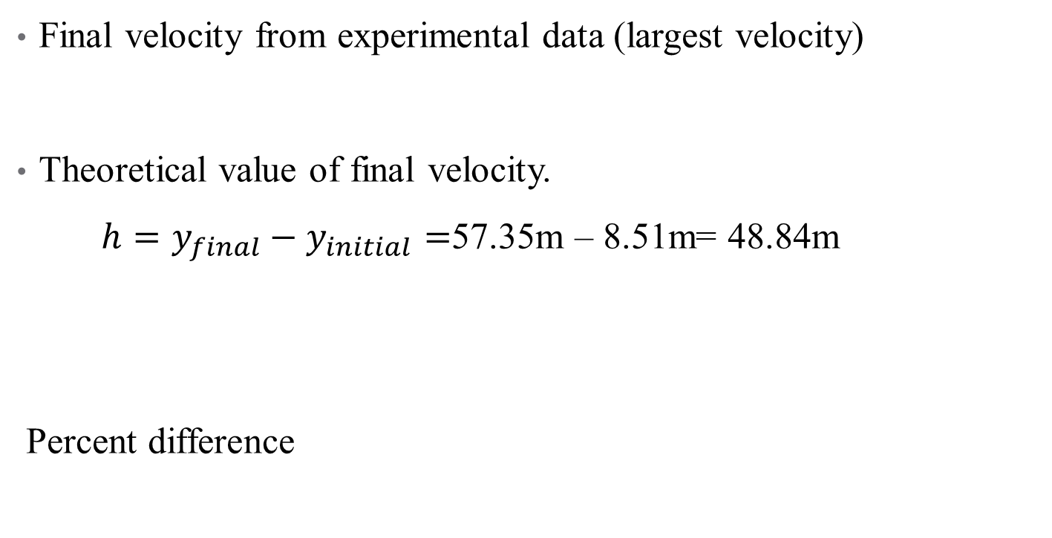

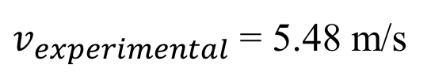
Data Validation
Final velocity from experimental data (largest velocity)
Theoretical value of final velocity.
$h=y_{final}−y_{initial}=$57.35m – 8.51m= 48.84m
Percent difference
$v_{experimental}$ = 5.48 m/s
$v_{f}=\sqrt{2gh}$ = 30.94 m/s
$$Percent difference =\frac{\left|v_{f}−v_{experimental}\right|}{v_{f}}×100\%=\text{82\%}$$

Slide 29
The key characteristics of the plot. Consider the times when U is max and min when K is max and min, and when U and K are the same value. What is the significance of these points?
  Answer: When they cross that is the Equilibrium point. That is when the energy is the lowest when Kinetic energy and Potential energy meet.
What is the trend of the best-fit line for the total energy E in your data? If the data is accurate, the total mechanical energy should decrease slightly. Why is that?
  Answer: If only conservative forces are doing work, the total mechanical energy would neither increase nor decrease. Having deviation shows the data is accurate.

Slide 30
Relationship between Linear and Rotational Motion

Slide 31
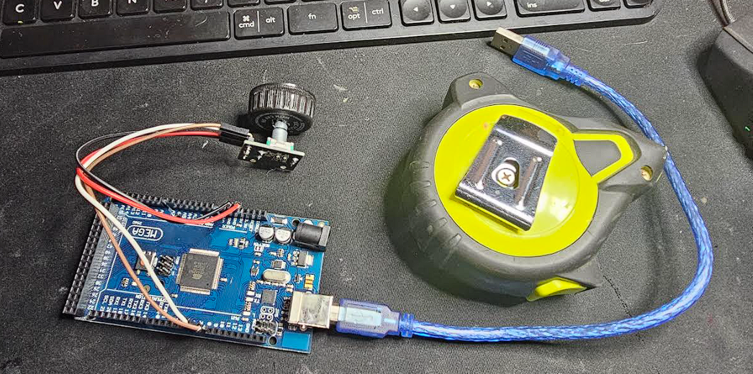
Materials List:
Mega 2560 Board
Rotary Encoder Module KY-040
Male to Female Wires
Object to attach onto rotary encoder
(e.g. cork, bottle cap, ball)
Ruler or tape measurer

Slide 32
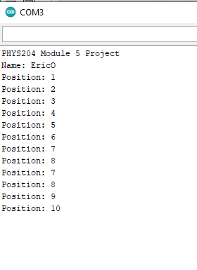
Raw Data (Screenshot)
Screenshot of Serial Monitor from Arduino IDE showing raw data. Including my name displayed on the serial monitor.

Slide 33
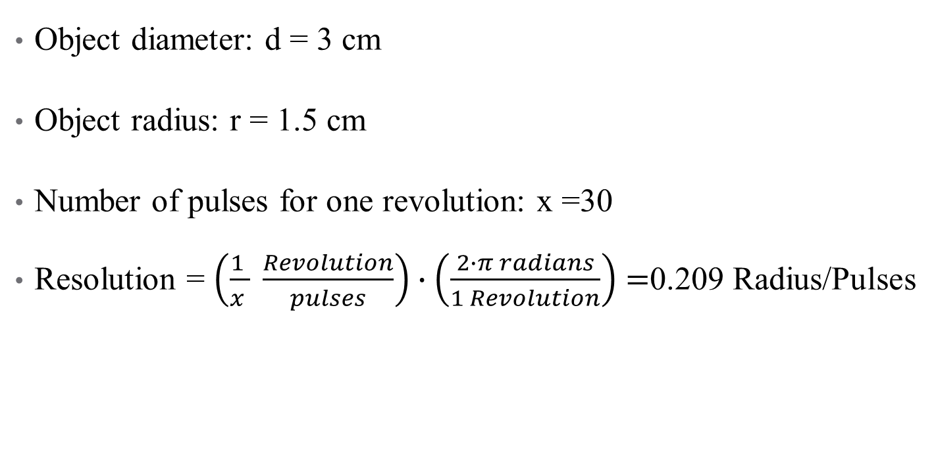
Data Collected
Object diameter: d = 3 cm
Object radius: r = 1.5 cm
Number of pulses for one revolution: x =30
Resolution = $\left(\frac{1 }{x } \frac{Revolution}{pulses}\right)∙\left(\frac{2∙π radians}{1 Revolution}\right)=$0.209 Radius/Pulses

Slide 34
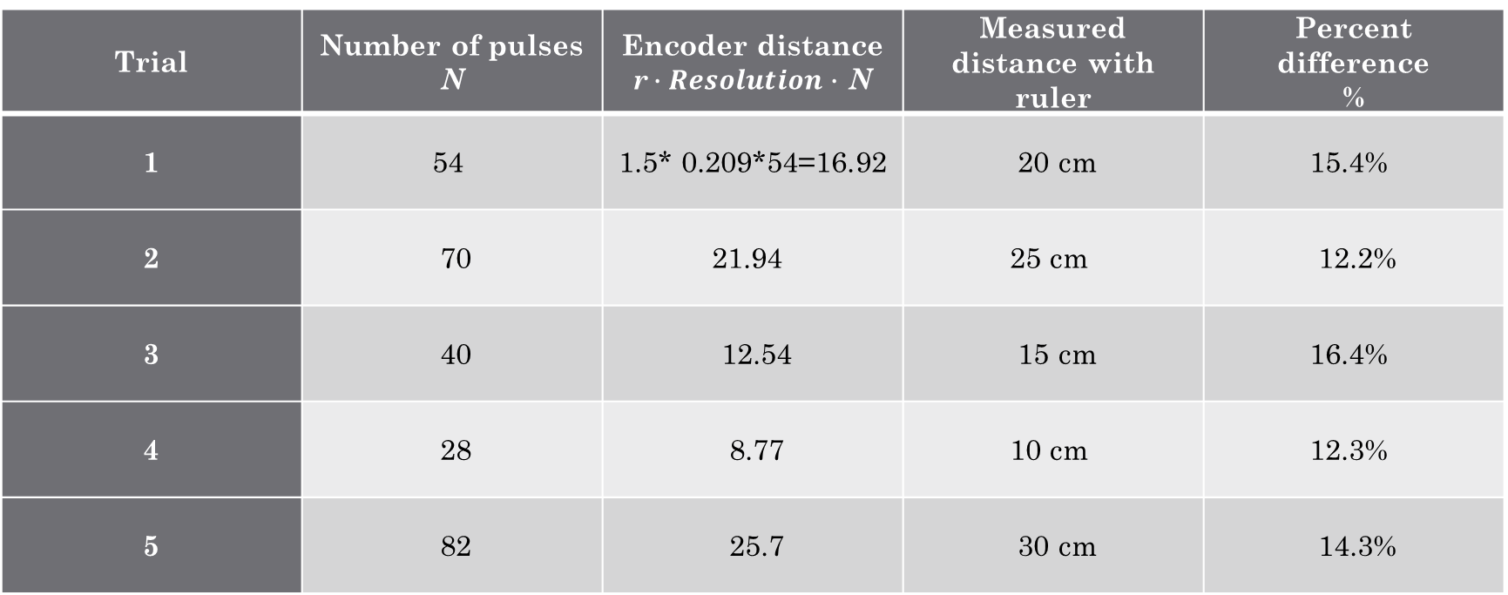
Data Analysis
Trial | Number of pulses N | Encoder distance r$∙Resolution∙$ N | Measured distance with ruler | Percent difference %
1 | 54 | 1.5* 0.209*54=16.92 | 20 cm | 15.4%
2 | 70 | 21.94 | 25 cm | 12.2%
3 | 40 | 12.54 | 15 cm | 16.4%
4 | 28 | 8.77 | 10 cm | 12.3%
5 | 82 | 25.7 | 30 cm | 14.3%

Slide 35
The results and comments on the reasons for errors.
  Answer: My results showed an increase the further I went, but it also showed a dip in percentage at a higher length which could be due to the bottle cap not finding traction and having to stop spinning more the further it had to go.
What are some applications of this measuring technique? Could this measuring system be used to measure surfaces that are not flat?
  Answer: This technique could be used to collect angular displacement as well as angular velocity and angular acceleration data. I believe this device could be used on other surfaces if there is traction for the objects being measured.

Slide 36
Observing the Hall Effect

Slide 37
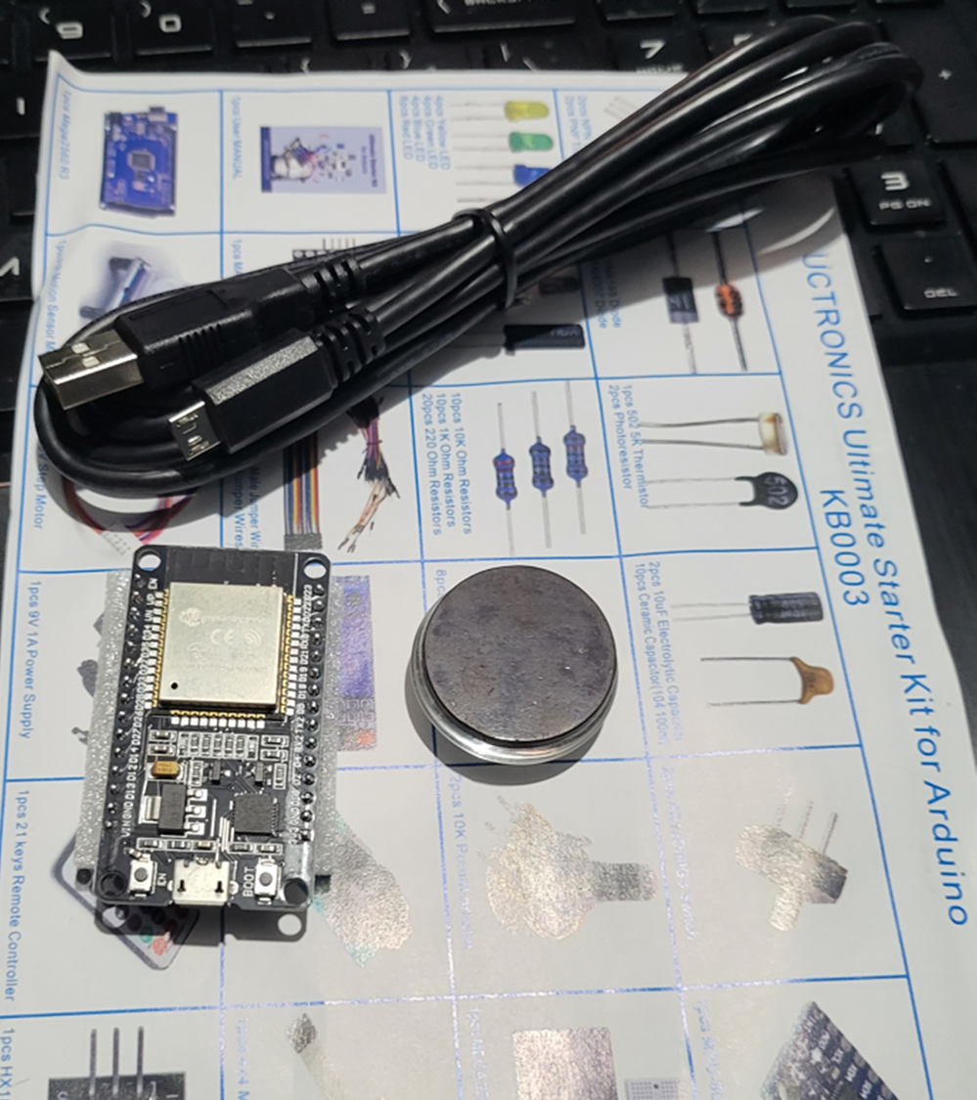
Materials List:
ESP32 microprocessor
Micro-USB cable
Magnet

Slide 38
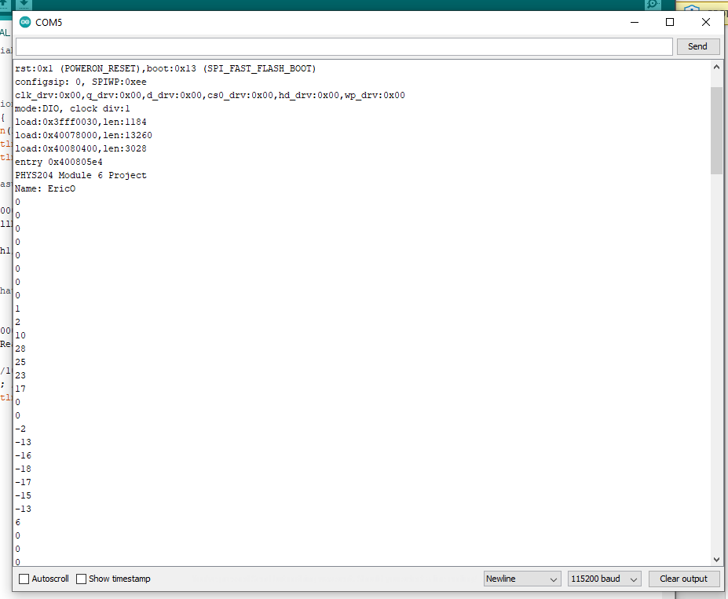
Raw Data (Screenshot)
Screenshot of Serial Monitor from Arduino IDE showing raw data. Including your name displayed in the Serial Monitor.

Slide 39
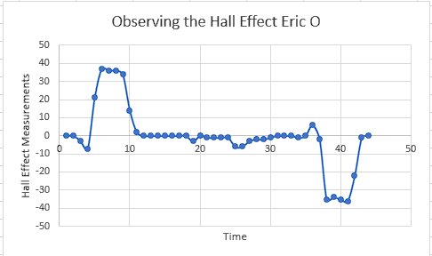
Data Analysis (Screenshot)
Screenshot data plotted in Excel.

Slide 40
The results and comments on how the Hall sensor works.
  Answer: A Hall sensor is a type of sensor that detects the presence of a magnetic field and converts it into an electrical signal. The Hall effect is a fundamental physics principle stating that when a magnetic field is applied perpendicular to the direction of current flow in a conductor, a voltage difference (Hall voltage) develops across the conductor. This voltage is proportional to both the strength of the magnetic field and the current flowing through the conductor. As I put the magnet to the sensor the sensor increased the measurement based on how close it was and when I flipped the magnet it wrote the numbers in the negatives.
What are some applications for the Hall effect sensor?
  Answer: Hall effect sensors can be used in security systems to detect the opening and closing of doors, windows, and other access points. They can trigger alarms when unauthorized access is detected. Some smartphones and electronic devices use Hall effect sensors to detect the presence of a magnetic field, which can be used to automatically lock the device when placed in a protective cover or to enable features like compass functionality.

Slide 41
Challenges
Many things went wrong such as mismatched information in the Arduino but with patience, I was able to turn everything in and work through everything in a reasonable pace.

Slide 42
Career Skills Acquired
Problem-Solving Skills
Critical Thinking Skills
Creativity

Slide 43
Conclusion
This was an amazing and interesting experience that taught me a lot about both the technical side of physics and the more mathematical side.
I liked being able to connect projects and see how they could all connect together in the end
I hope to learn more, And be able to understand even more about engineering with physics

