Slide 1
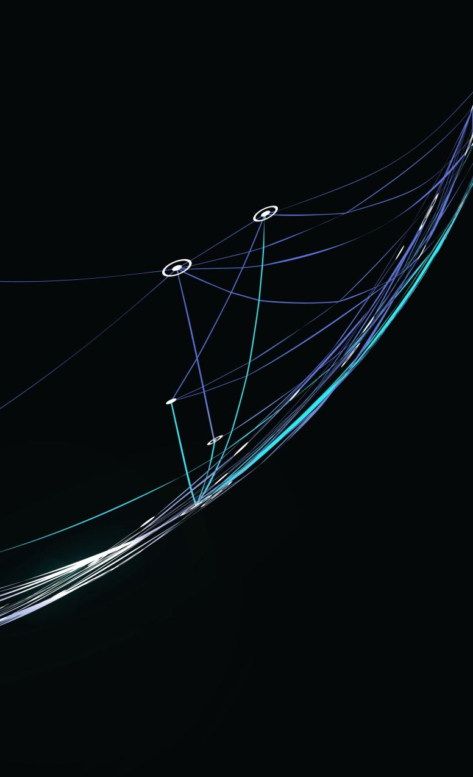
CEIS114 Course Project: Introduction to Digital Devices
Presented By: Eric O.

Slide 2
Introduction

Slide 3
In this course, we were taught about electronic, digital, and systems that are common in modern computing devices. we apply these topics, then develop a model through IoT for hands-on experience with device solutions

Slide 4
Project Plan for IoT Traffic Controller
Module 2

Slide 5
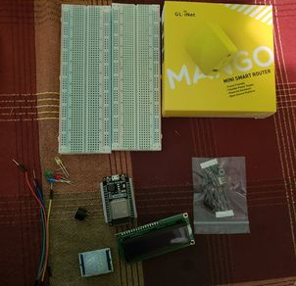
Inventory:
ESP 32 Board
Colored LEDs: Red, Yellow, Green, and Blue
Wires
Breadboard(s)
LCD Unit with I2C Adapter
Active Buzzer
Mini Router
Push Button(s)
PIR Motion Sensor

Slide 6
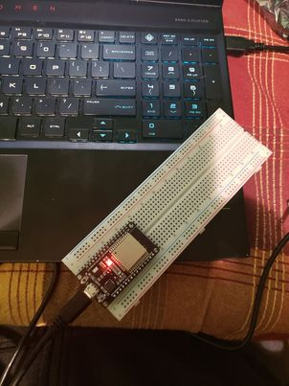
ESP32
Microcontroller mounted and powered ON

Slide 7
Installation of Arduino IDE

Slide 8
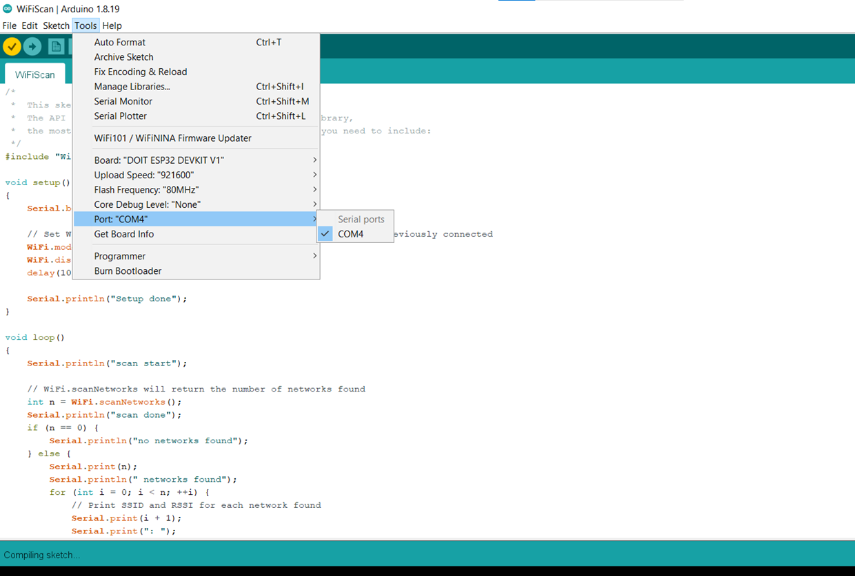

Slide 9
ESP32 Wi-Fi Scan
Serial Monitor in Arduino IDE showing the available networks

Slide 10
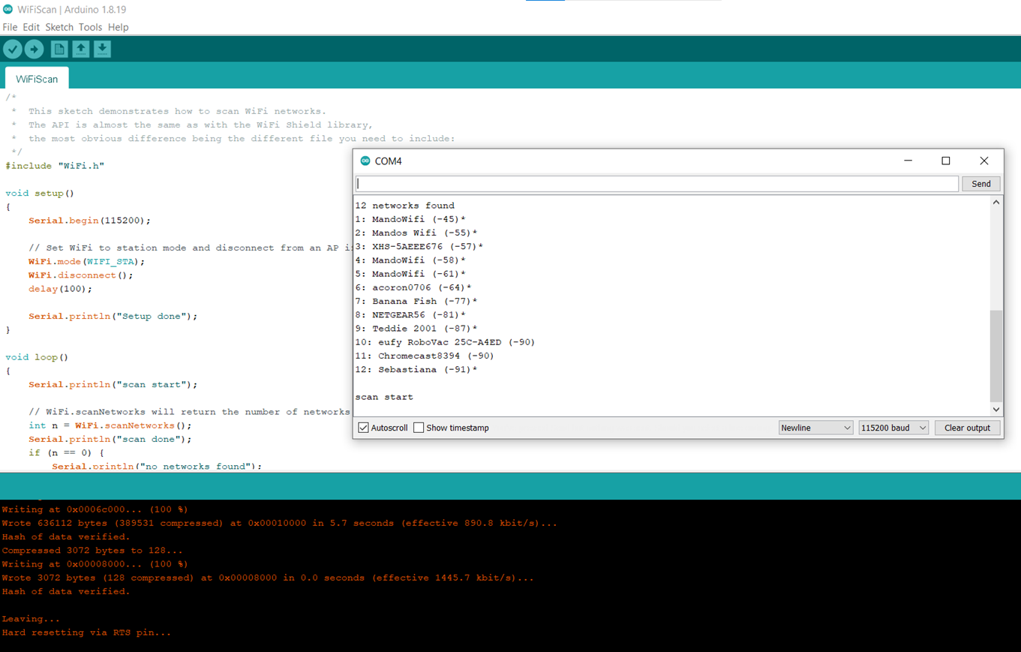

Slide 11
Module 3
Creating the Traffic Controller

Slide 12
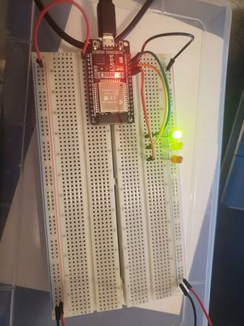
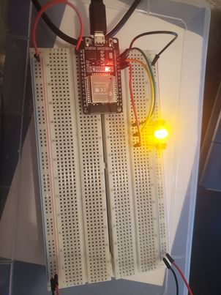
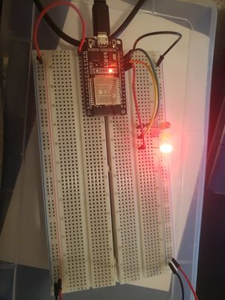
Picture of the circuit with working LEDs

Slide 13
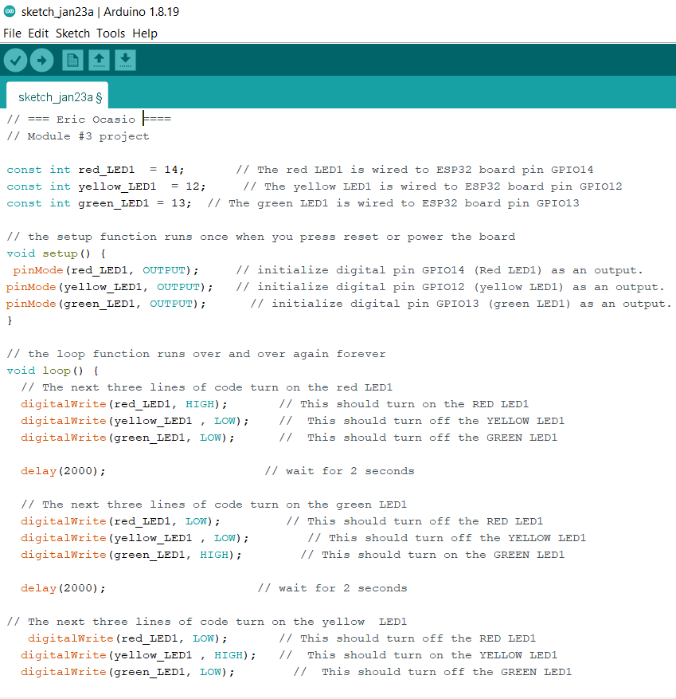
Screenshot of code in Arduino IDE

Slide 14
Module 4
Creating a Multiple Traffic Light Controller

Slide 15
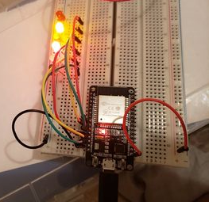
Picture of the circuit with working LEDs

Slide 16
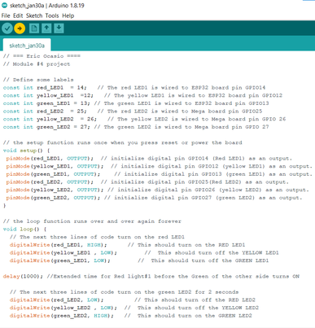
Screenshot of code in Arduino IDE

Slide 17
Module 5
Creating a Multiple Traffic Light Controller with a Cross Walk

Slide 18
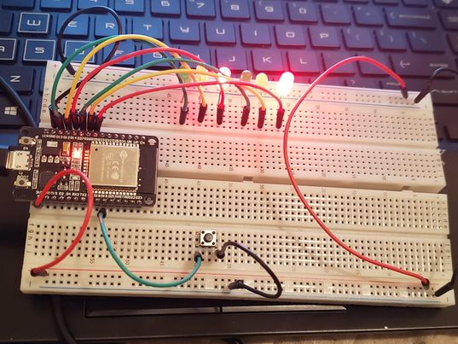
Picture of the circuit with working LEDs

Slide 19
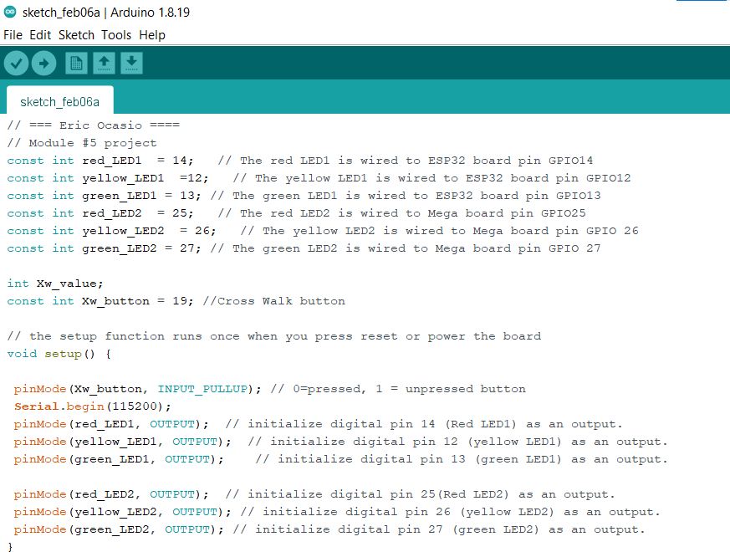
Screenshot of code in Arduino IDE

Slide 20
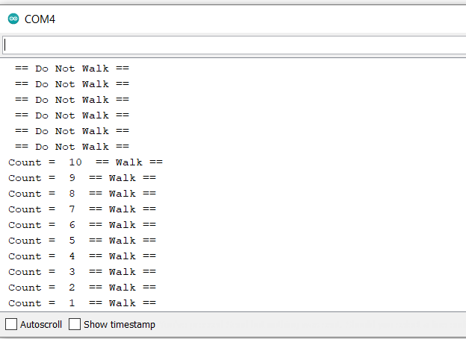
Screenshot of Serial Monitor in Arduino IDE

Slide 21
Module 6
Creating a Multiple Traffic Light Controller with a Cross Walk and an Emergency Buzzer

Slide 22
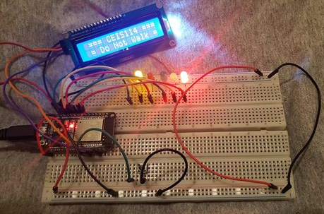
Picture of the circuit with working LEDs and LCD display

Slide 23
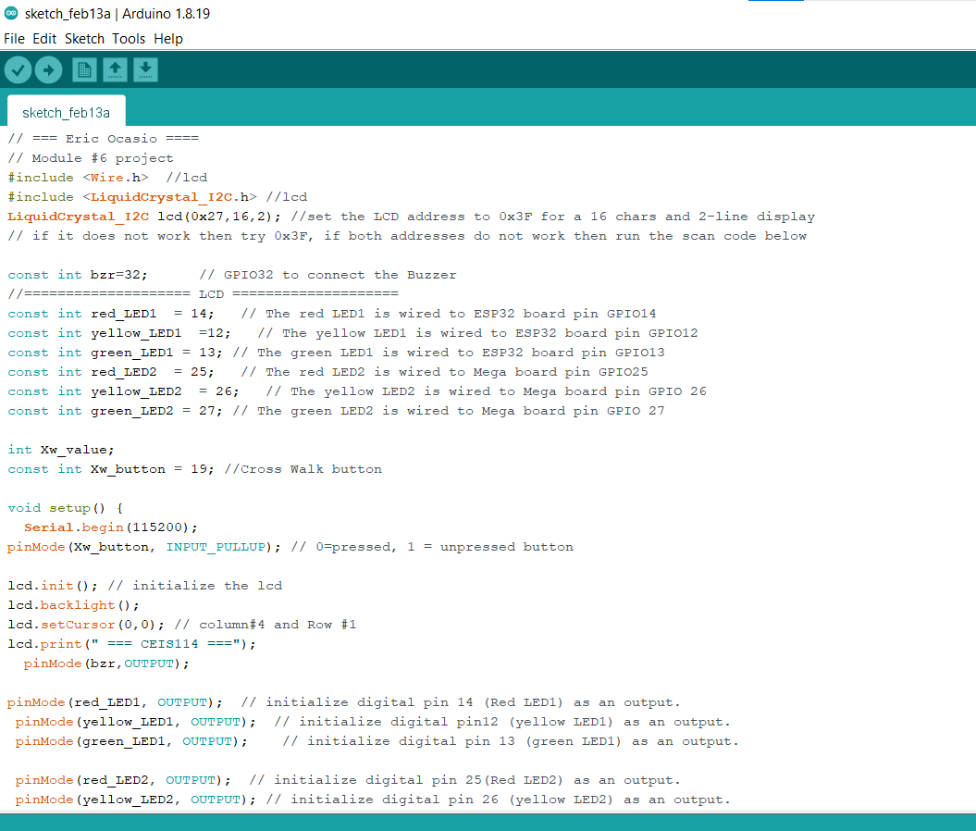
Screenshot of code in Arduino IDE

Slide 24
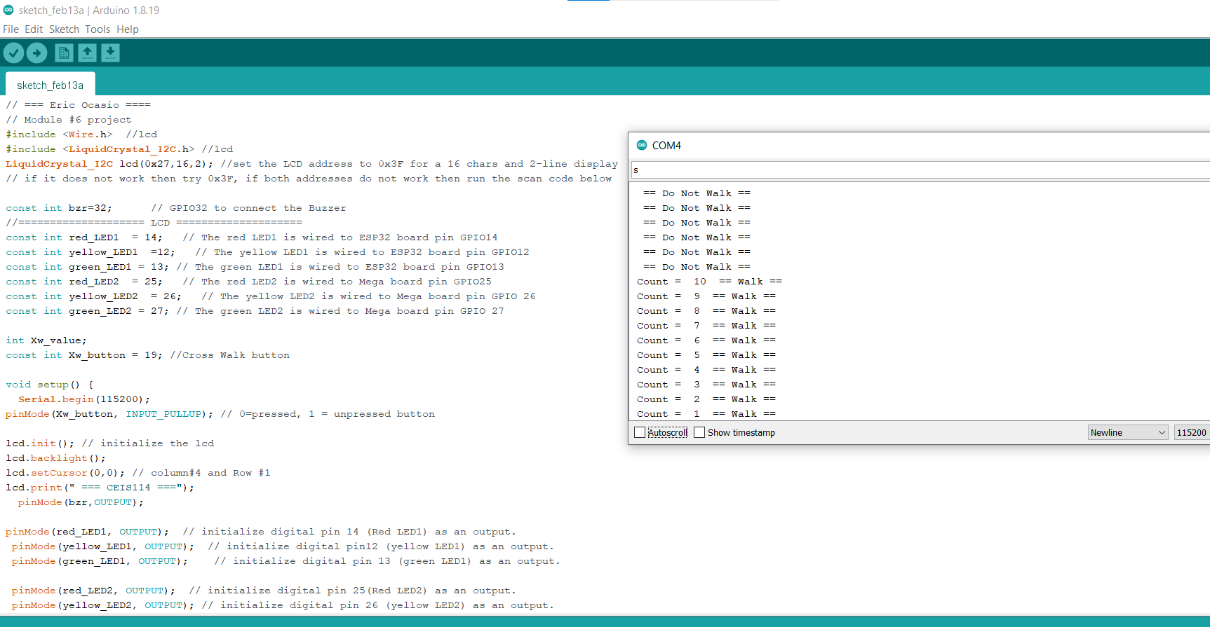
Screenshot of Serial Monitor in Arduino IDE

Slide 25
Module 7
Final Project Option 2
Creating a Multiple Traffic Light Controller with a Cross Walk and an Emergency Buzzer with SMART sensor

Slide 26
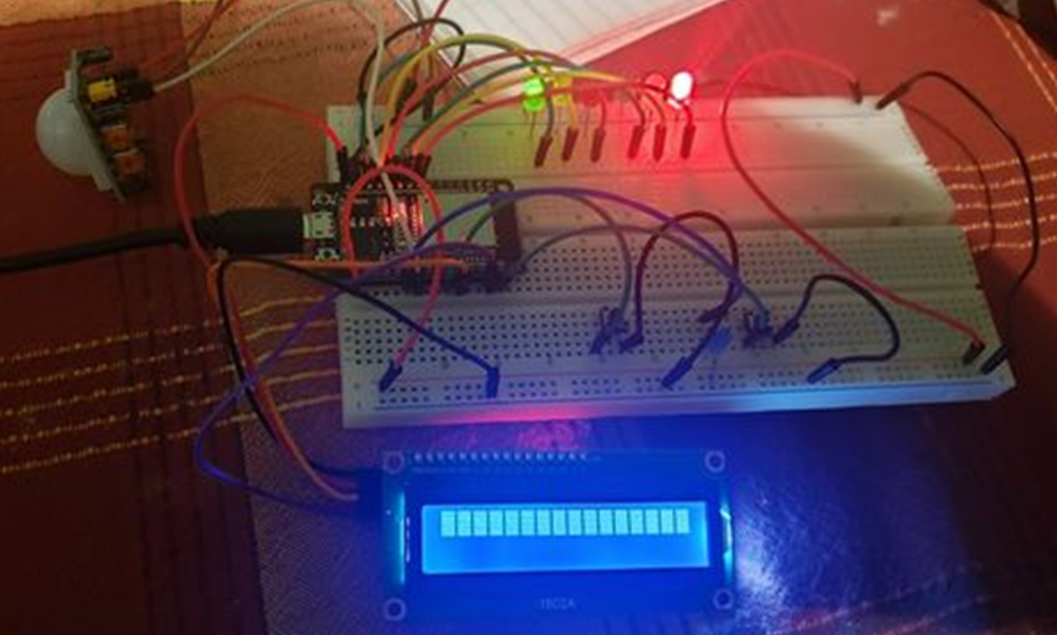
Picture of the circuit with working LEDs and LCD display

Slide 27
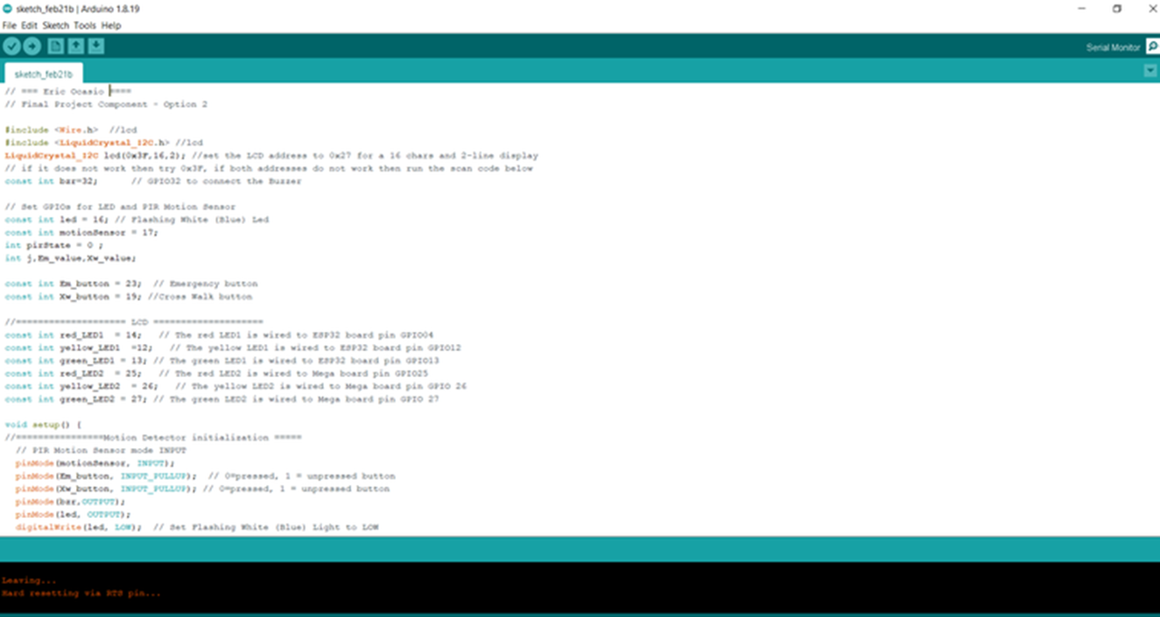
Screenshot of code in Arduino IDE

Slide 28
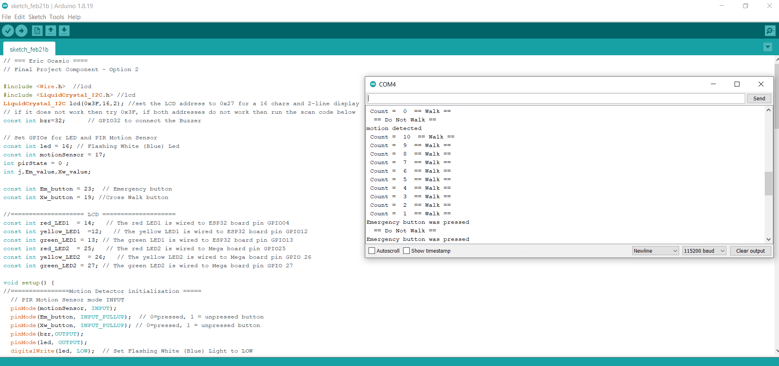
Screenshot of Serial Monitor in Arduino IDE

Slide 29
Challenges in the project

Slide 30
I couldn’t get my LCD to light up, this was then resolved when I read up through the project guide that the LCD has a brightness dial on the back that will brighten or dim the light.

Slide 31
Career skills obtained

Slide 32
I learned that motion sensors could be used not only in security but also for traffic lights.
I learned that you must be patient, or you might mess up a line of code in Arduino and must backpaddle to resolve the issue.

Slide 33
Conclusion

Slide 34
In conclusion, I have learned traffic lights could become better just by adding IoT tech to them. Also, Arduino can be as hard or as easy if you let it be when inputting codes. I also learned that we have IoT systems in play all around us down to a traffic light and all the way to a space satellite.

