Slide 1

CEIS106 Course Project: fundamentals of the Linux operating system in a virtualized environment
Presented By: Eric O.

Slide 2
Introduction

Slide 3
In this course, we were taught about navigating the Linux file system, writing shell scripts, managing users and groups, understanding IP configurations, and monitoring system performance. We learned the building blocks of emerging technologies such as Virtualization and Cloud Computing, which helps us in future careers in Information Technology

Slide 4
Operating Systems:
Linux Filesystem Hierarchy

Slide 5
The PWD command is an acronym for Print work directory
The cd command is an acronym for change directory the difference between a relative path and an absolute/full path in Linux is an Absolute path is the specific location from the root directory, the relative path is related to the current directory

Slide 6
Creating directories and files

Slide 7
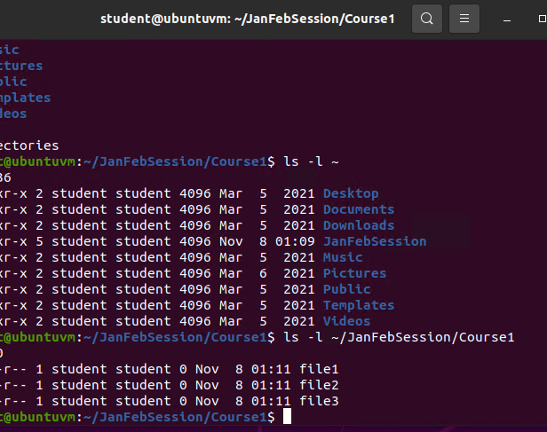

Slide 8
Copying and removing directories and files

Slide 9
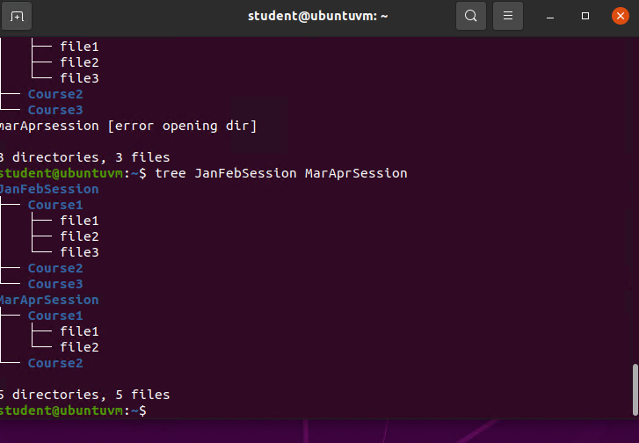

Slide 10
Locating directories and files

Slide 11
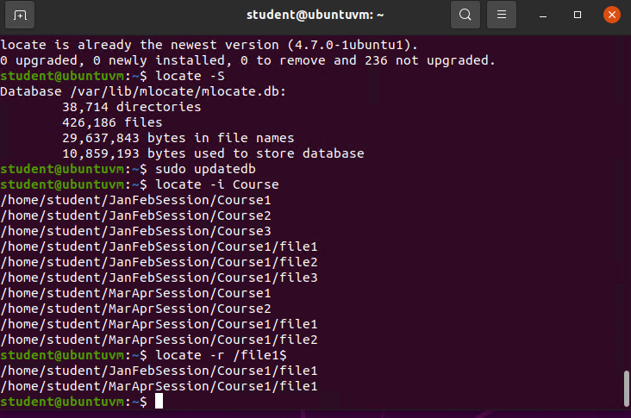

Slide 12
Linux Shell Scripts

Slide 13
The file permissions of a shell script are Bash, -l, echo, nano
The name of the user-defined variable in a script is the echo
A redirection meta-character used in a script : >> , - - . They are used to group the echo/ user-defined variable to the MyToDoList or a file in general.

Slide 14
Changing script file permissions

Slide 15
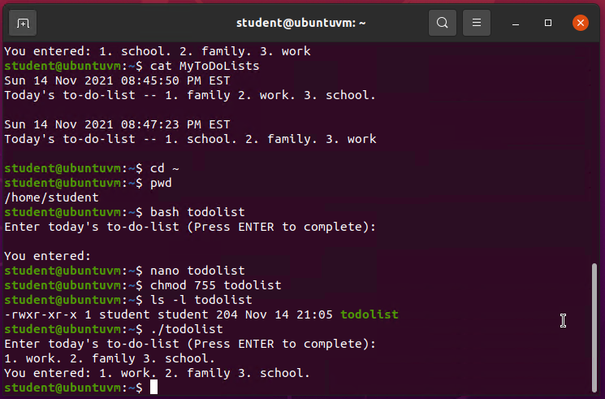

Slide 16
Setting the PATH variable

Slide 17
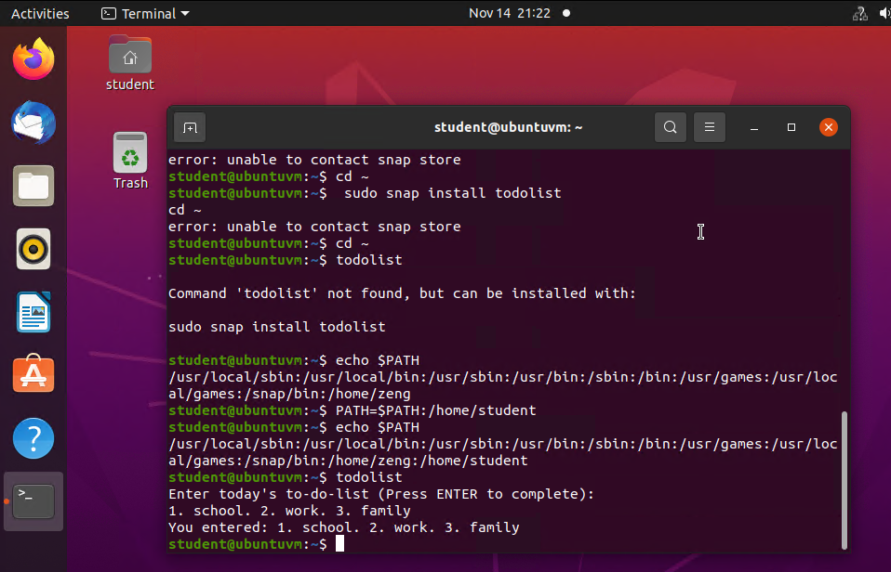

Slide 18
Making the PATH variable permanent

Slide 19
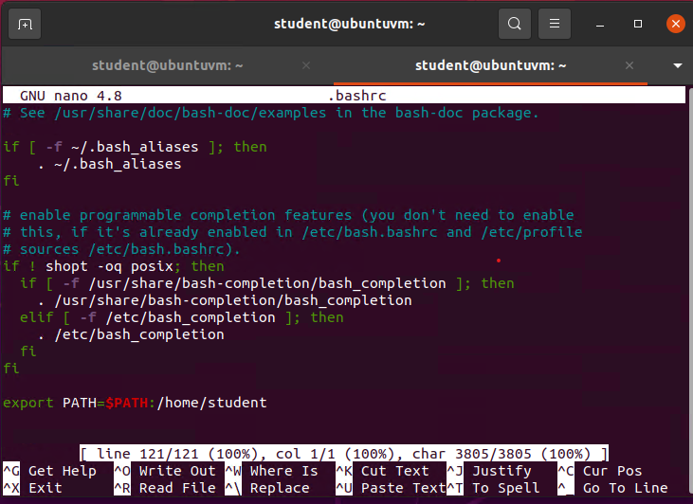
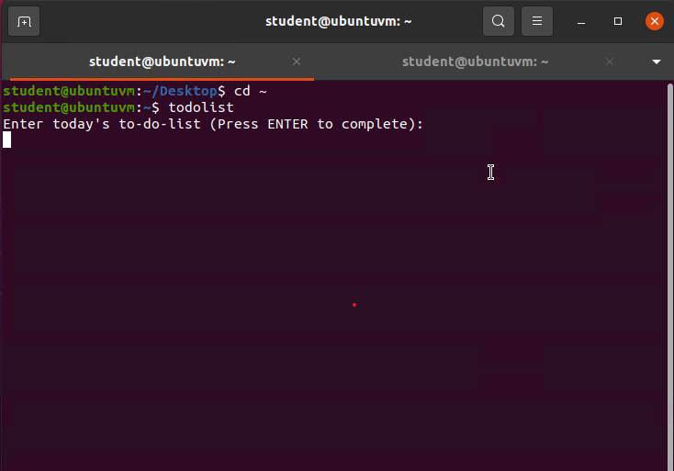

Slide 20
User and Group Management

Slide 21
The –m option in the useradd command create users without their home directories
The -3 option in the tail command shows a real-time, streaming output of a changing file source
The /etc/group file that lists members of the “students” group is: $ more /etc/group

Slide 22
Testing user and group settings

Slide 23
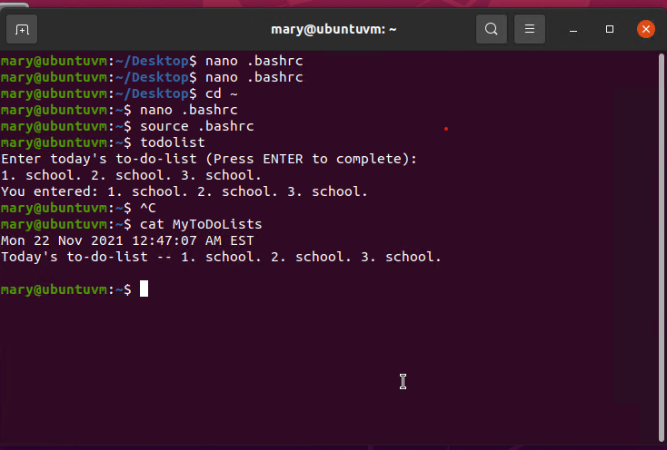

Slide 24
Adding users in GUI

Slide 25
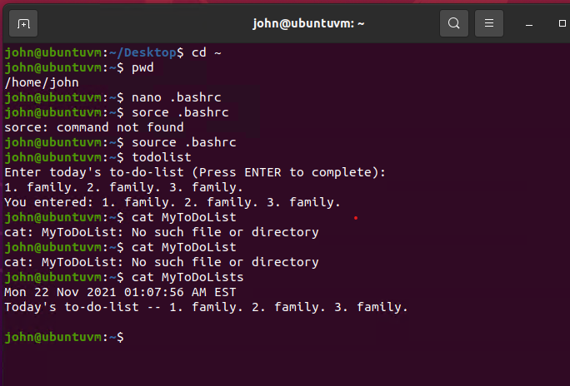

Slide 26
Network Configuration

Slide 27
The IP address of your Ubuntu machine
Inet 127.0.0.1/8
The IP address of its default gateway
Via 192.168.1.1
The IP address of its DHCP server
192.168.1.1
The IP address of its DNS server
192.168.1.1

Slide 28
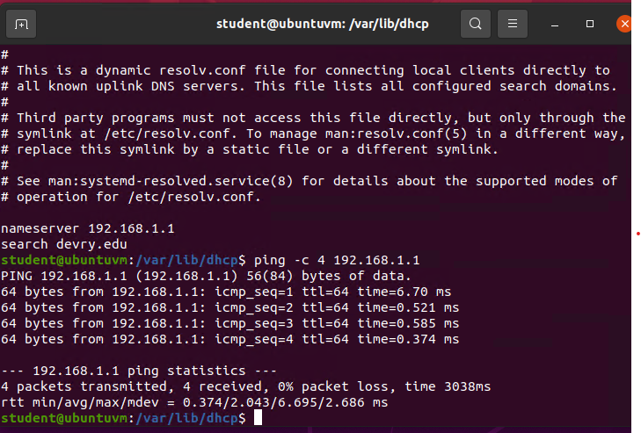

Slide 29
Managing network interfaces

Slide 30
The DHCP message that is shown in the output of the sudo dhclient –v –r eth0 command is
DHCPRELEASE
The four DHCP messages That are shown in the output of the sudo dhclient –v eth0 command are
DHCPDISCOVER
DHCPROFFER
DHCPREQUEST
DHCPACK

Slide 31
Using network utilities

Slide 32
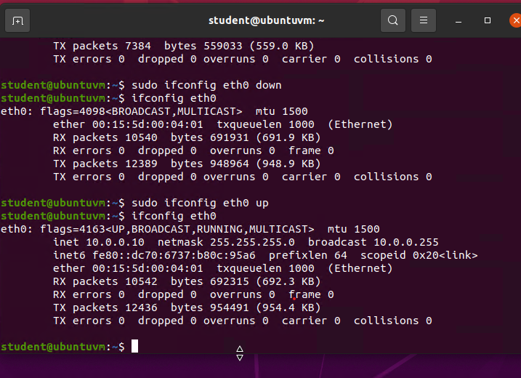

Slide 33
Operating Systems:
System Performance Monitoring

Slide 34
The default action of the 15 SIGTERM kill signal is to end a process by sending the system a signal
In the System Monitor window, using % CPU to sort the processes by CPU load. The process that shows the highest percentage of CPU usage is: /usr/bin/gnome-shell

Slide 35
Monitoring user activities

Slide 36
The flag value is displayed in the output on GNC accounting is: Root pts/0 0.17 secs fri Dec 3 21.22
The name of the user who ran the processes is shown as root, not student due to the fact that actions that affect the script affect any accounts on the script so we use root.

Slide 37
Monitoring network bandwidth usage

Slide 38
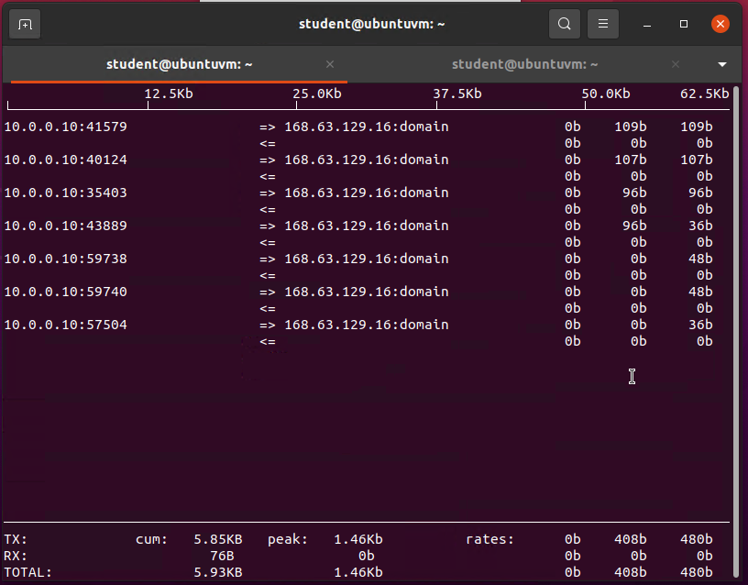

Slide 39
Challenges in the project

Slide 40
I didn’t really have challenges mostly just some miss input that didn’t get registered through Linux like a lower case when it had to be an uppercase letter.

Slide 41
Career skills obtained

Slide 42
I learned how to be resourceful and be able to fix mistakes in my codes
I learned to be levelheaded and peruse through my line of code to see what was not allowing it to run.

Slide 43
Conclusion

Slide 44
In conclusion, I have learned a lot of Linux that I normally never would have known if I didn’t take this course. This course was fun and made me think and learn clearer and I learned to code and can somewhat understand it better.

