Slide 1
ECT 301
Final Project
Presented by: Eric O.

Slide 2
Introduction

Slide 3

This class I learned the fundamental skills needed for computational engineering tools, designs, As well as dimensions, systems of units, mass, temperature, energy, and power. I also learned the ethics to make a great engineer.

Slide 4
Module 3
Unit Conversion

Slide 5
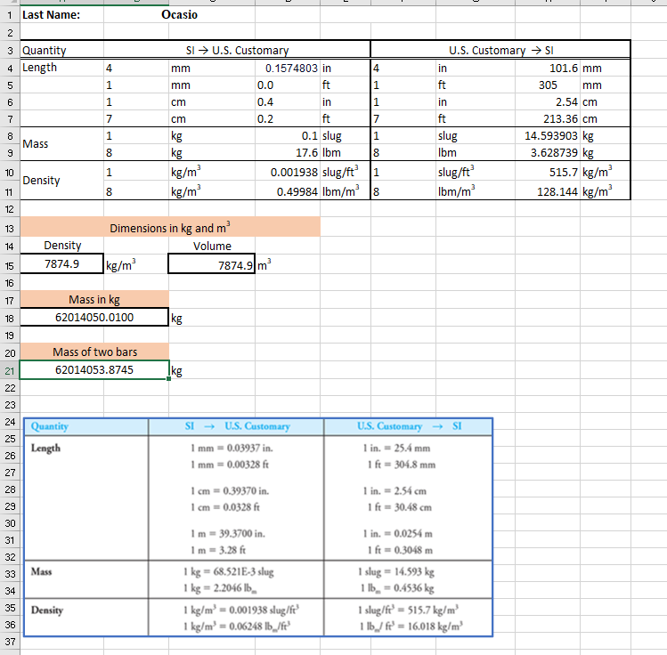
Excel Spreadsheet on Unit Conversion

Slide 6
Module 4
Specific Heat

Slide 7
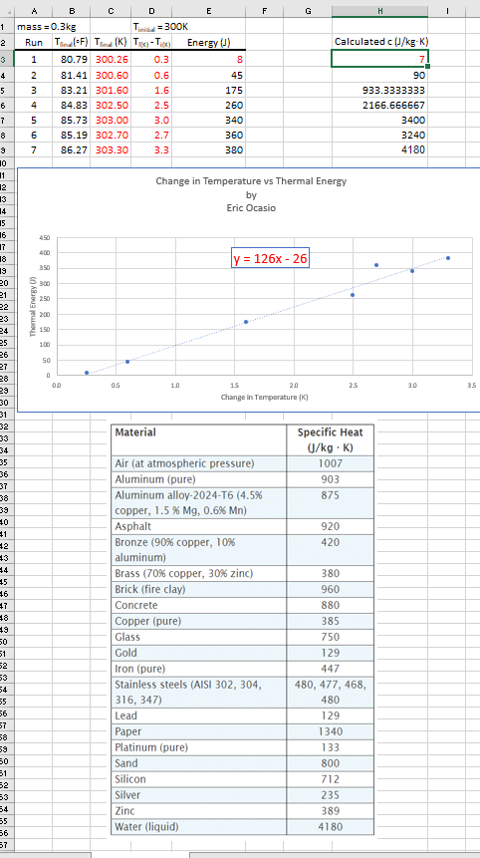
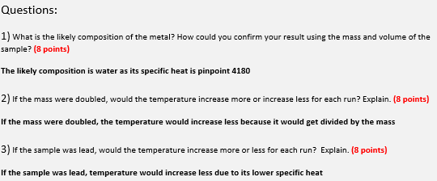
Excel Spreadsheet on Specific Heat

Slide 8
Module 5
Calculating the Height of a Free Falling Object via MATLAB

Slide 9
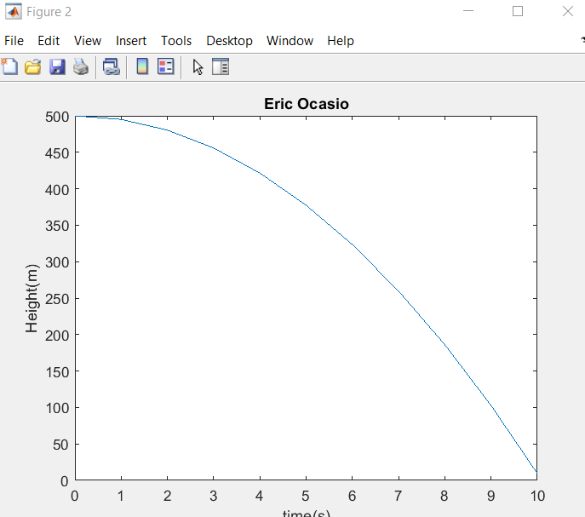
Height Versus Time MATLAB graph

Slide 10
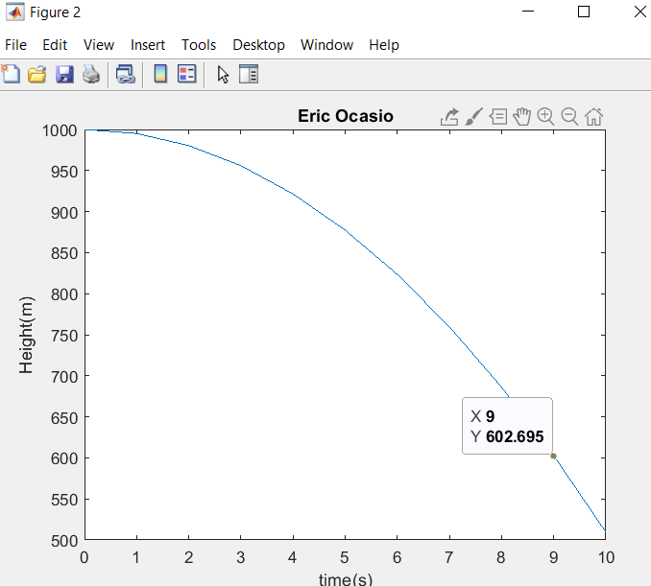
What is the height of a free-falling object from 1000m after 10 seconds?

Slide 11
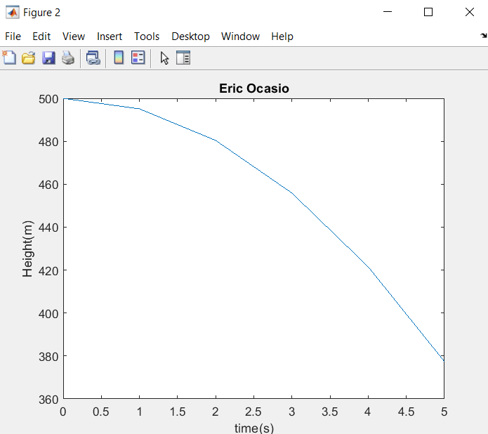
What is the height of a free-falling object from 500m after 5 seconds?

Slide 12
Module 6
Calculating Electric Power of a Resistor

Slide 13
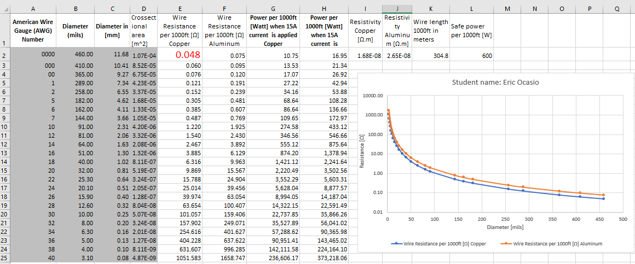
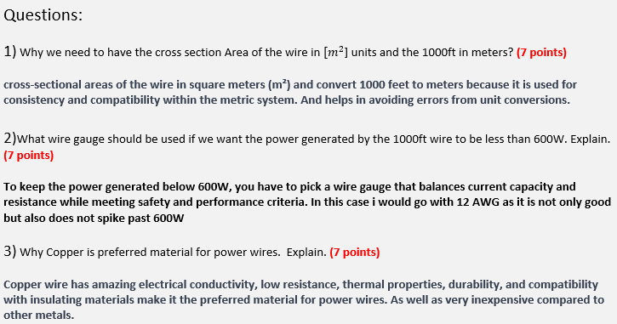
Excel Spreadsheet on Electric Power of a Resistor

Slide 14
Module 7
Plotting Elastic Region of Stress and Strain Curve via MATLAB

Slide 15
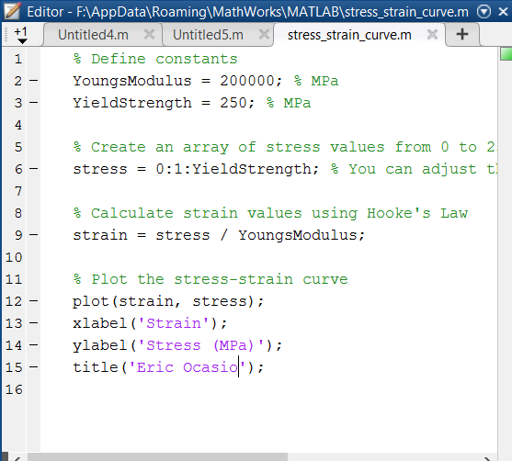
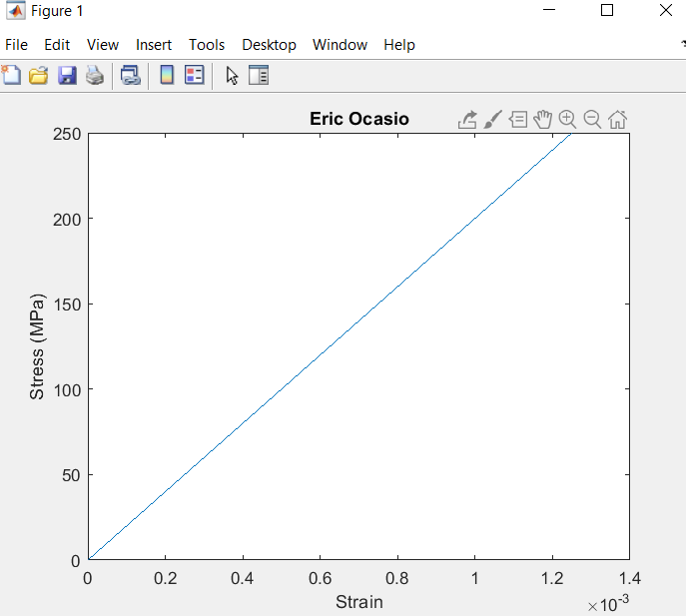
Stress versus Strain MATLAB graph

Slide 16
What is the U.S Customary Unit used for Modulus of Elasticity? What is the modulus of elasticity for A-36 steel in U.S Customary Unit?
The U.S. Customary Unit commonly used for Modulus of Elasticity is pounds per square inch (psi).
The Modulus of Elasticity for A-36 steel in U.S. Customary Units is typically reported as about 29,000,000 psi. This is equivalent to 29 million pounds per square inch.

Slide 17
What is the U.S Customary Unit used for yield strength? What is the modulus of elasticity for A-36 steel in U.S Customary Unit?
The U.S. Customary Unit commonly used for yield strength is pounds per square inch (psi).
The yield strength of A-36 steel in U.S. Customary Units is approximately 36,000 psi. This means that it can withstand a stress of 36,000 pounds per square inch before it starts to deform plastically.

Slide 18
Why did we limit the graph to stress value of 250 MPa for the elastic region of A-36 steel?
The graph is limited to a stress value of 250 MPa because that's when A-36 steel starts to deform permanently. We want to focus on the elastic region where it deforms reversibly.

Slide 19
provide one application for A-36 steel in real life
A-36 steel is often used to make beams for building structures. These beams provide support to buildings, helping them withstand their own weight and other forces like wind and earthquakes. A-36 steel's strength and ability to bend without breaking make it ideal for this purpose. So, one real-life application is using A-36 steel beams in construction to ensure buildings are strong and stable.
https://www.xometry.com/resources/materials/a36-carbon-steel/

Slide 20
Challenges in my projects

Slide 21
Some challenges I went through where how to set up my spreadsheets. My family helped me out as I just didn’t add the right columns together but once I did figure it out, I started to really enjoy using Excel.

Slide 22
Career skills obtained

Slide 23
Some career skills I learned were how to properly use Excel, learned better time management skills as well as how to organize my Excel spreadsheets. I also learned to use MATLAB a little better.

Slide 24
Conclusion

Slide 25
In conclusion I felt like I learned a lot on engineer ethic as well as how different cables would be used for cabling and what would be the places they would be used on. I also liked howe we used spreadsheets to find out the elements used in our materials.

