Slide 1

NET211 Course project:
Fundamentals of Cloud Computing
Presented by: Eric O.

Slide 2
Introduction
In this course, I learned about virtualization and cloud computing, hardware virtualization, cloud infrastructure, cloud security, cloud storage, Cloud migration, capacity planning, performance monitoring, Exploration of cloud computing platforms and services accomplished through practical application.

Slide 3
Virtual Machine (VM) Instances

Slide 4
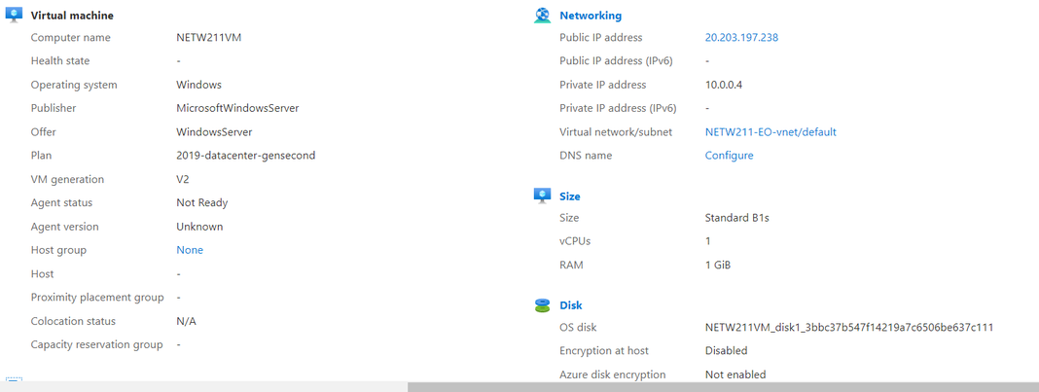
Deploying a VM in Azure
This shows the NETW211VM page with information such as the resource group name, subscription, public IP address

Slide 5
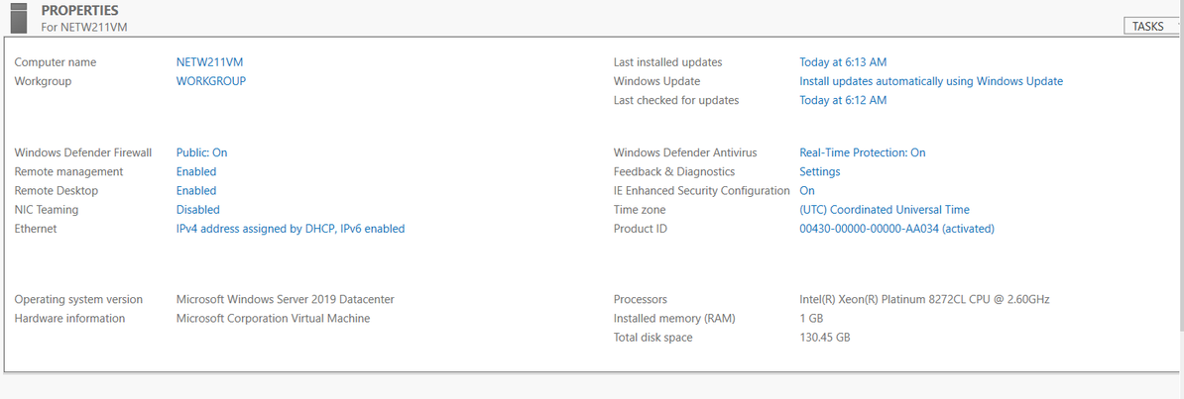
Connecting to the VM
This shows the properties for the NETW211VM page, with the computer name, operating system version, hardware information

Slide 6
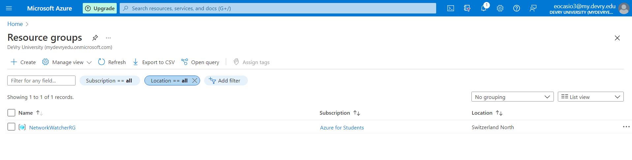
Deleting the VM
This shows the Resource groups page, with the Azure for Students subscription selection and the “No resource groups to display” message

Slide 7
Azure VNet and Subnets

Slide 8
Creating a VNet with Two Subnets
With a /24 network prefix, 2 usable IPv4 host addresses are there
2. the number of available IP addresses for Subnet0 (10.0.0.0/24) or Subnet1 (10.0.1.0/24) is shown as 251 as Azure reserves 5 IP addresses within each subnet. They have their own private IP addresses.

Slide 9
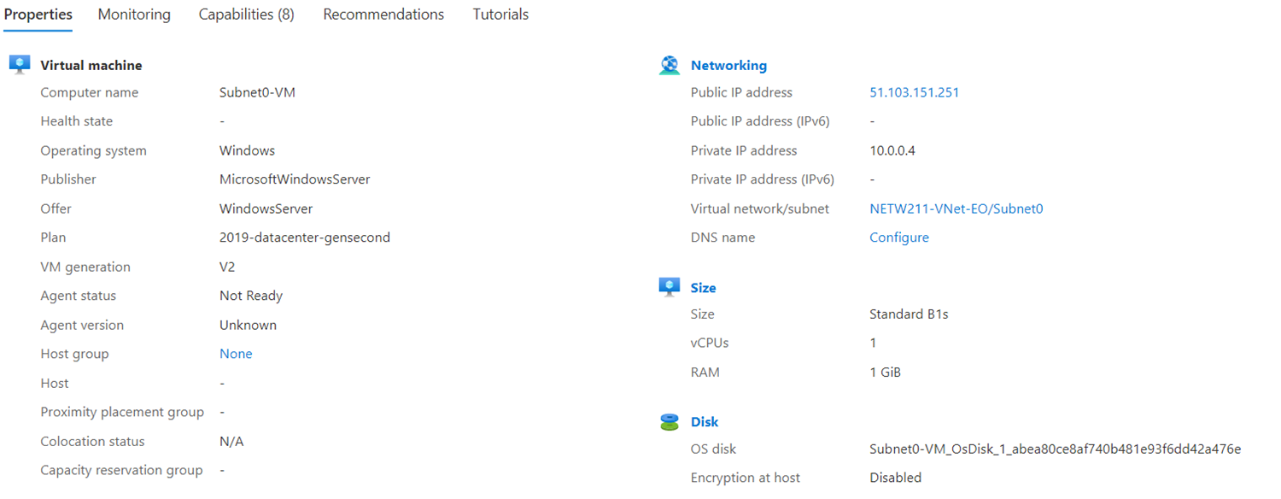
Deploying VMs into Subnets
This shows the Properties section of the Subnet0-VM page, showing the networking and size information of the VM

Slide 10
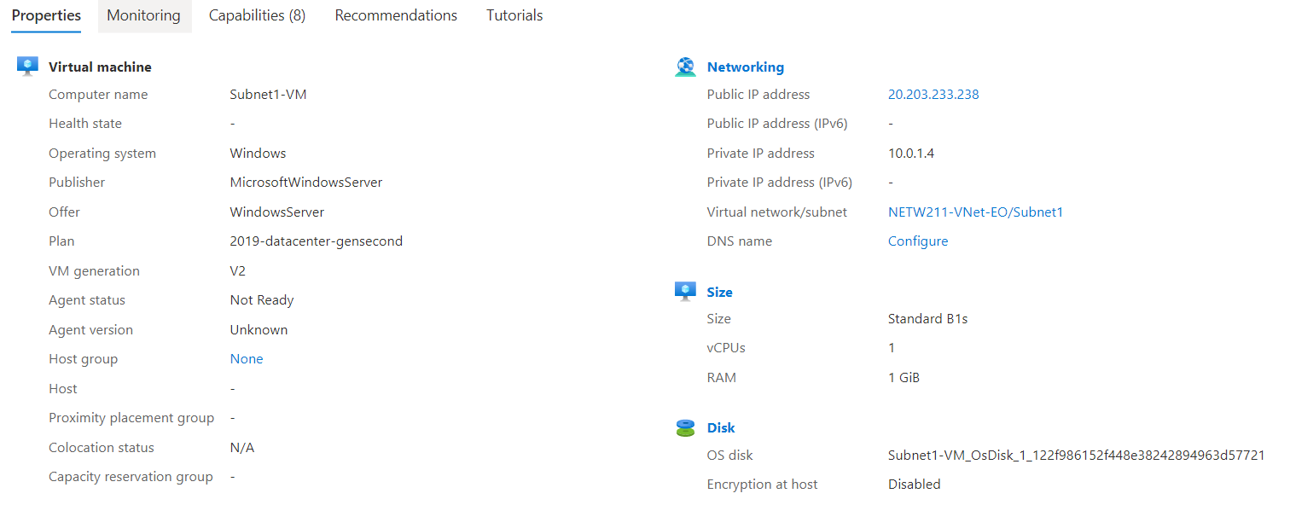
Deploying VMs into Subnets cont’d
This shows the Properties section of the Subnet1-VM page, showing the networking and size information of the VM

Slide 11
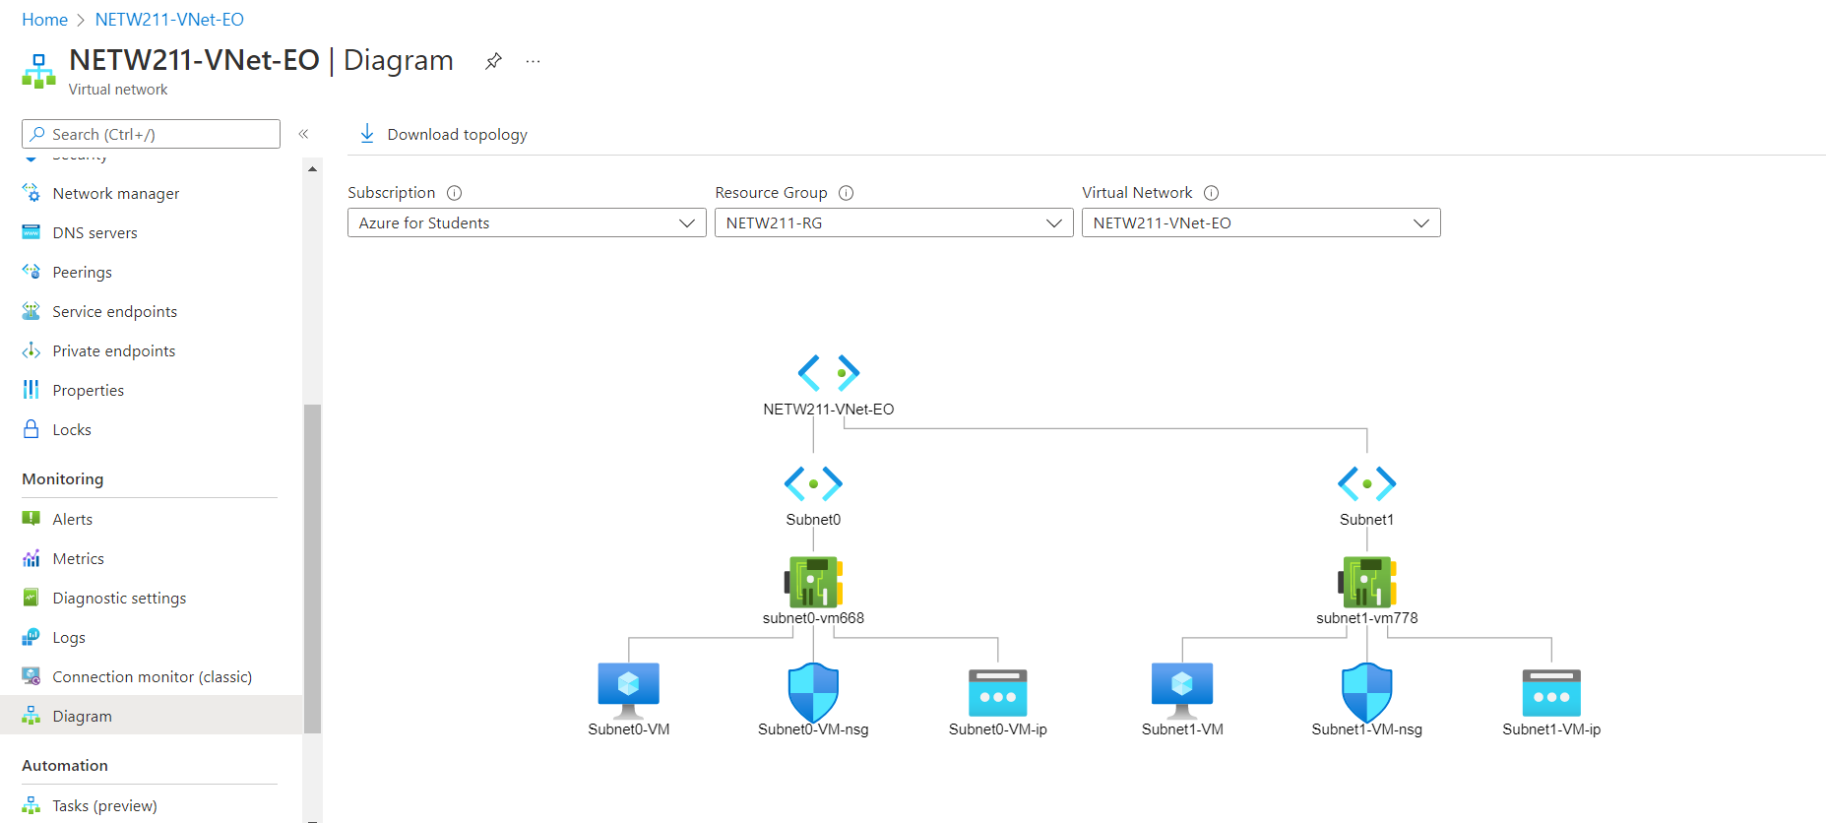
Deploying VMs into Subnets cont’d
This shows show the topology diagram of my VNet (NETW211-VNet- EO) with two subnets (Subnet0 and Subnet1) and one VM in each subnet (Subnet0-VM and Subnet1-VM)

Slide 12
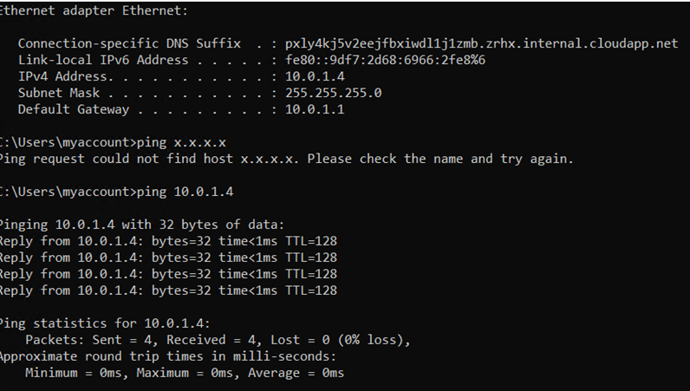
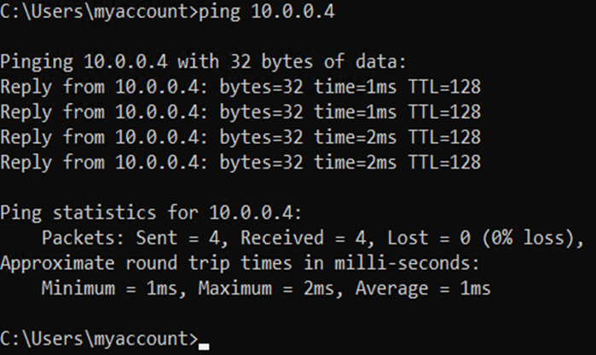
Verifying Connectivity between VMs
This shows show the ipconfig and ping x.x.x.x results in the command prompt window, including the Subnet0-VM – x.x.x.x – Romote Desktop Connection window title

Slide 13
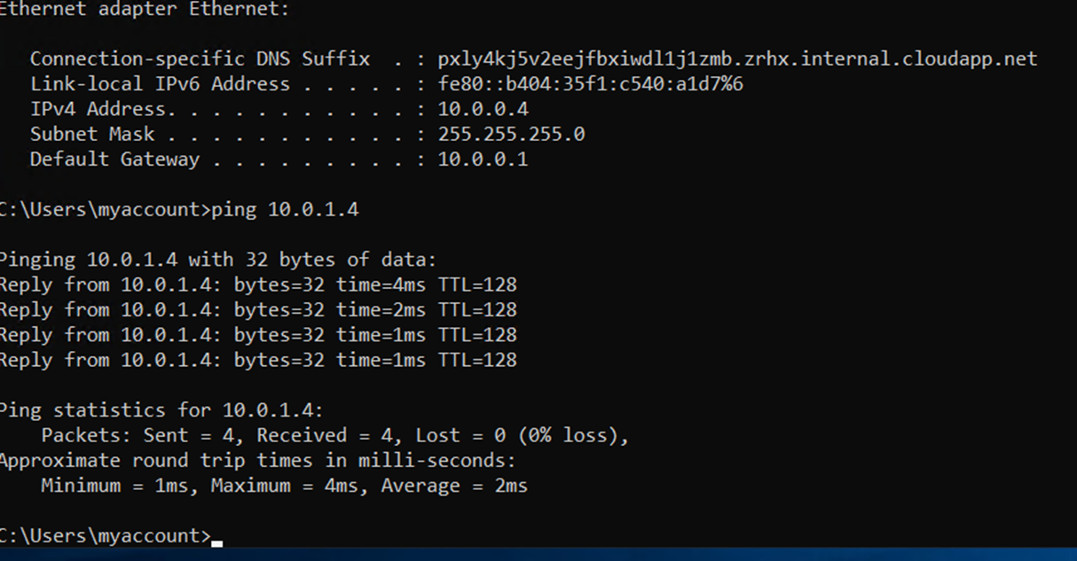
Verifying Connectivity between VMs cont’d
This shows show the ipconfig and ping x.x.x.x results in the command prompt window, including the Subnet0-VM – x.x.x.x – Romote Desktop Connection window title

Slide 14
Azure VM Security

Slide 15
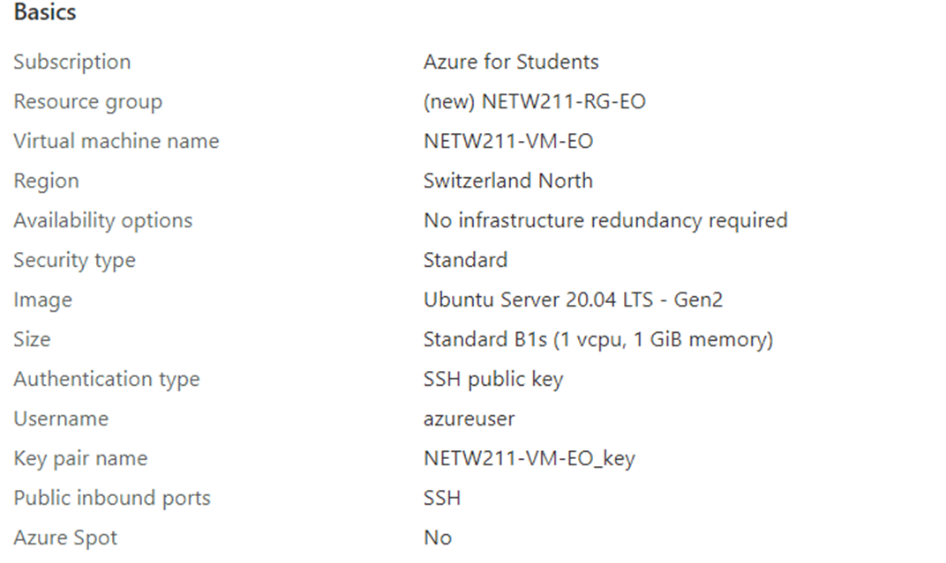
Launching a VM
This shows the NETW211-VM-EO page, with information such as the resource group name, subscription, public IP address

Slide 16
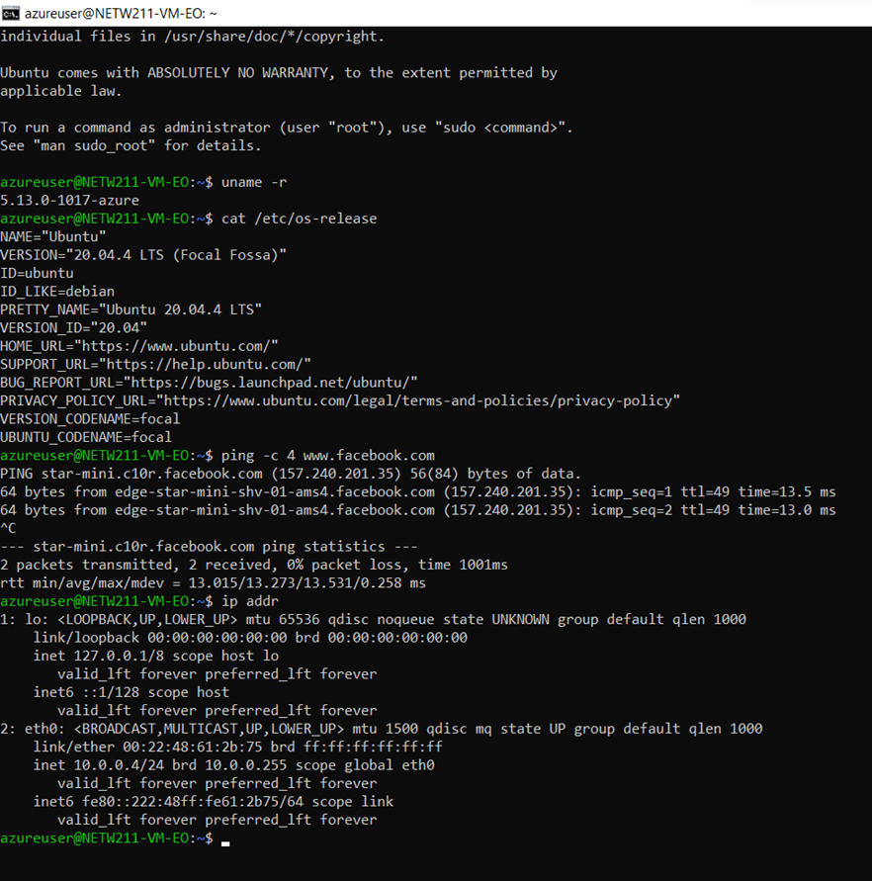
Connecting to the VM via SSH
This shows the azureuser@NETW211-VM-EO window showing the IPv4 address of the VM in the Azure cloud

Slide 17
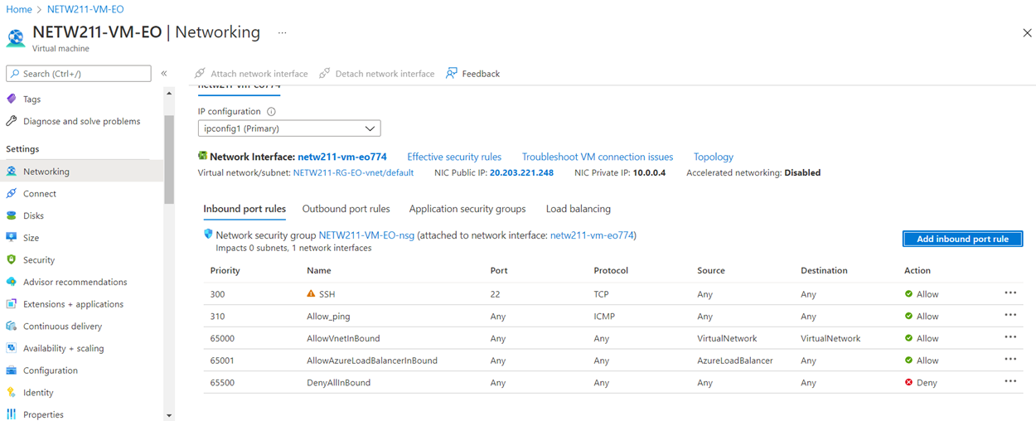
Configuring an NSG
This shows the Inbound port rules section with the newly added Allow_Ping rule

Slide 18
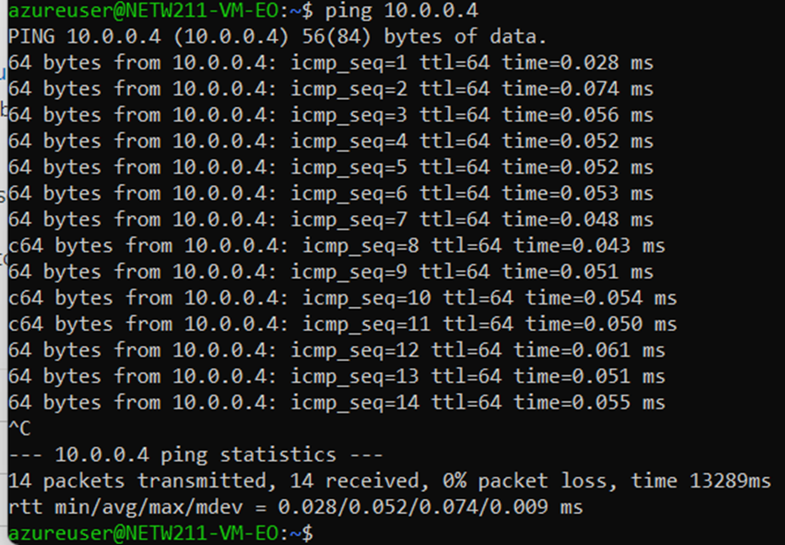
Configuring an NSG cont’d
This shows the successful ping result from your local computer to the VM in the Azure cloud

Slide 19
Cloud Storage

Slide 20
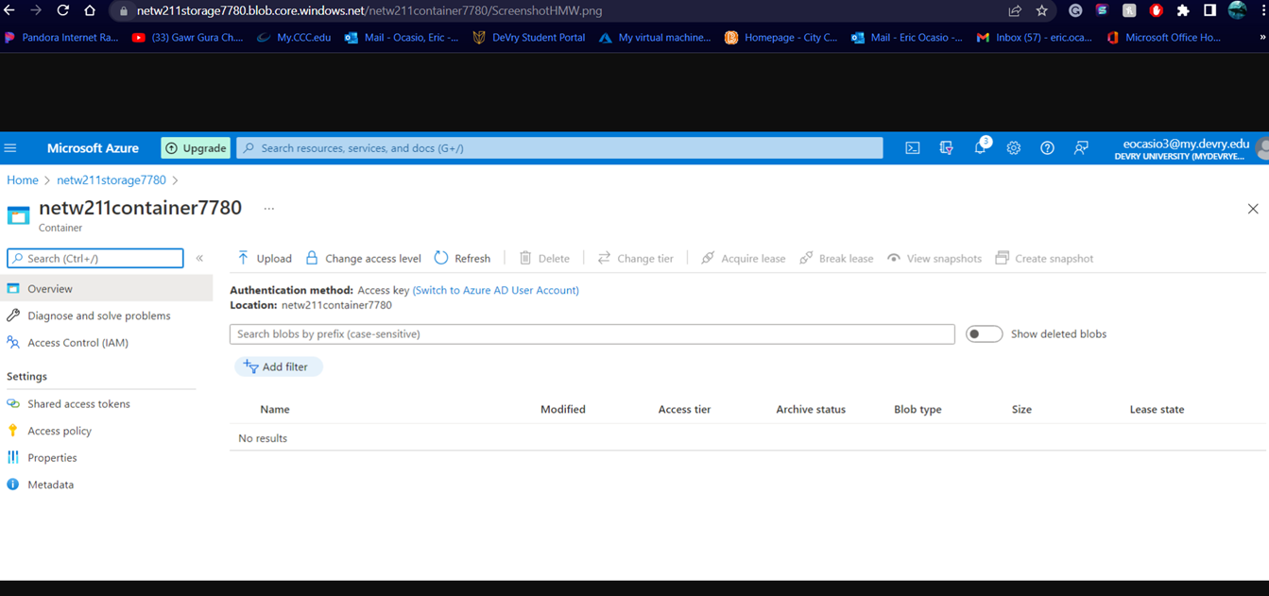
Uploading and Accessing a File
This shows the browser window with the image uploaded from your local computer and the URL on top of the window

Slide 21
The access tier setting can override the default setting for an individual blob when uploading the blob or changing its tier. To manage costs for your expanding storage needs, it can be helpful to organize your data based on how frequently it will be accessed and how long it will be retained.
The Azure blob storage access tiers are the Hot Access tier, Cool Access tier, and Archive tier

Slide 22
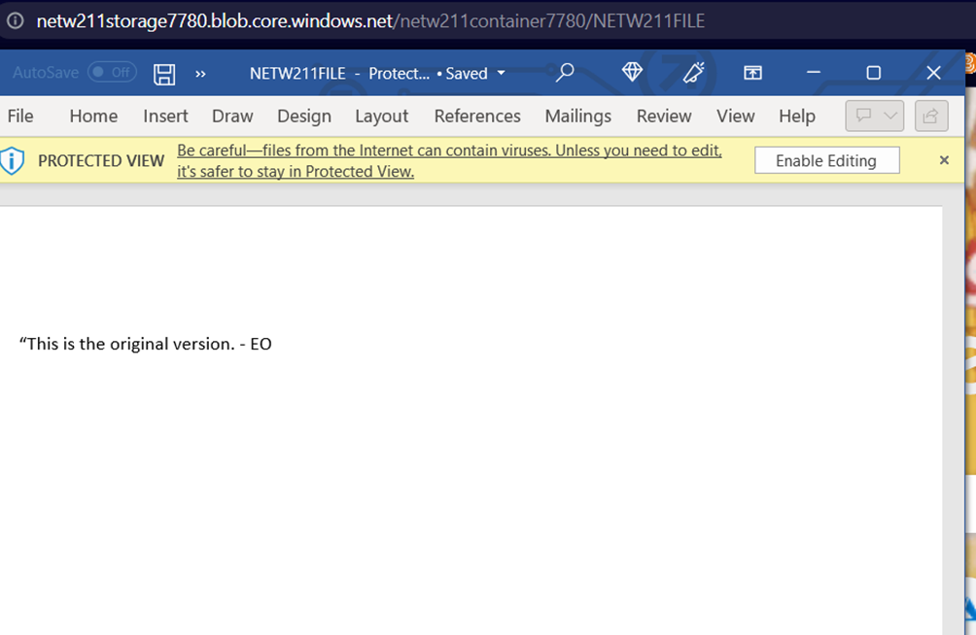
Creating Blob Snapshots
This shows the browser window with the “This is the original version. –EO” message and the URL on top of the window

Slide 23
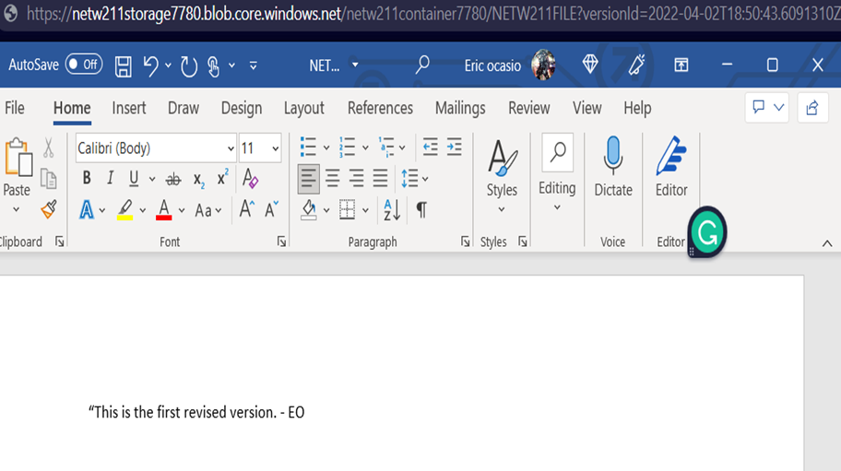
Enabling Blob Versioning
This shows the browser window with the “This is the first revised version. –EO” message and the URL on top of the window.

Slide 24
Cloud Monitoring

Slide 25
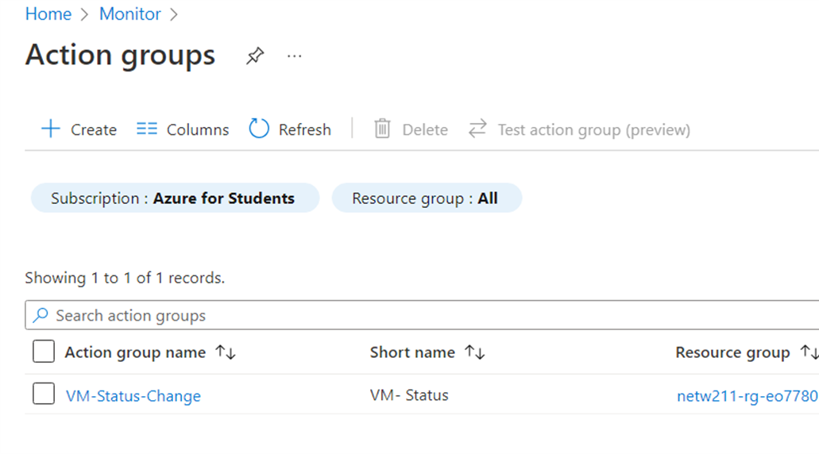
Setting up an Action Group and Notifications
This shows should show the “VM-Status-Change” action group on the Manage actions page

Slide 26
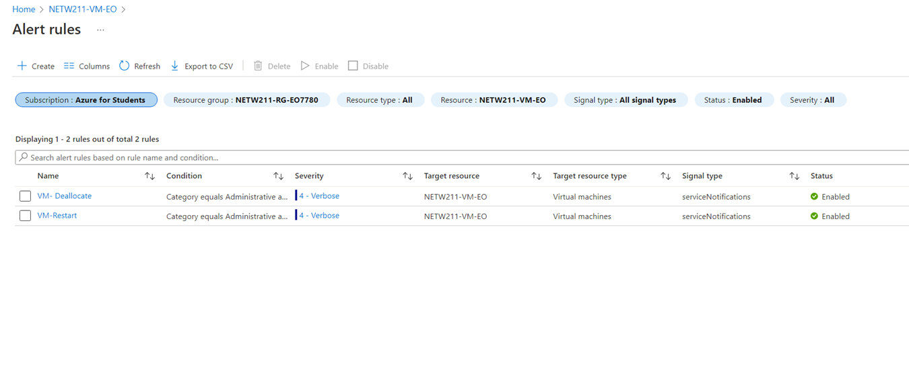
Setting up Alert Rules
This shows the Alert rules window showing the VM-Deallocate and VM-Restart rules

Slide 27
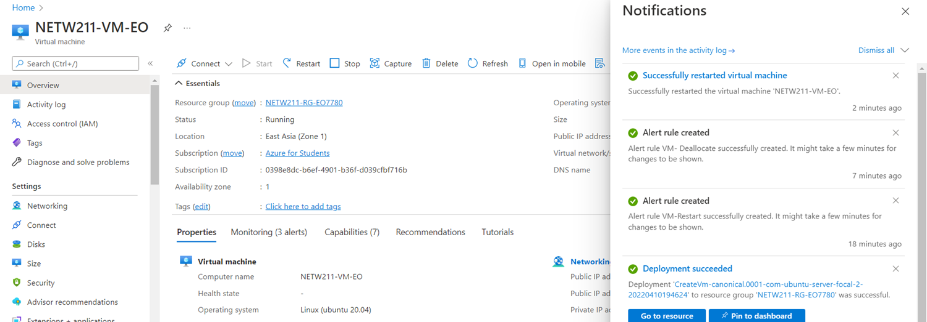
Testing Alerts
This shows the ‘VM-Restart’ was activated email message with the date and time of the alert

Slide 28
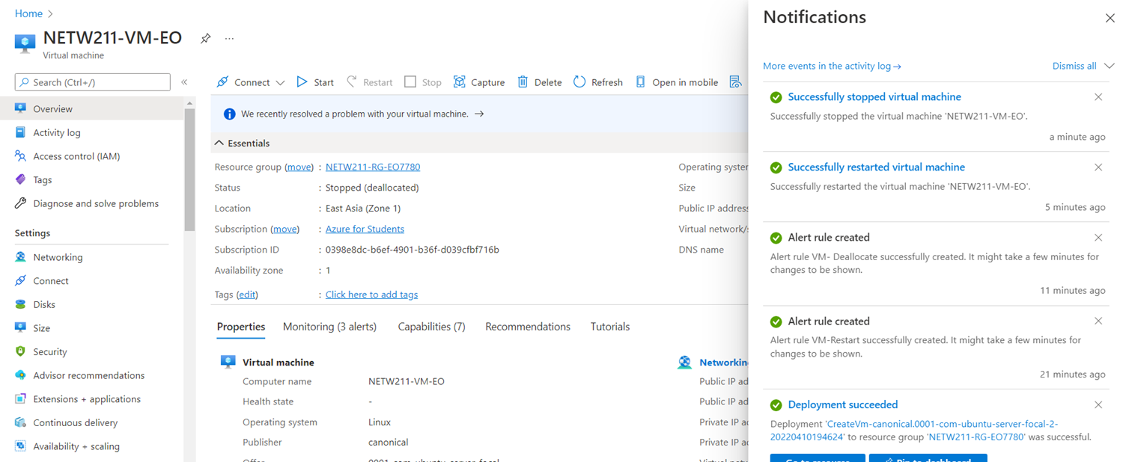
Testing Alerts cont’d
This shows the ‘VM-Deallocate’ was activated email message with the date and time of the alert

Slide 29
Challenges
These few weeks were difficult due to somethings not working on googles side but in the end of the day I pushed through and completed my work

Slide 30
Career Skills Acquired
I learned patience for whatever needs to be done
I learned that if something doesn’t work try looking at it in a new light

Slide 31
Conclusion
This was an interesting experience that taught me about Cloud systems and how it works
I liked how organized and easy it was to make an Azure server

