Slide 1

CEIS191 Course Project:
Fundamentals of Information Technology and Networking
Presented By: Eric O.

Slide 2
Introduction

Slide 3
Throughout this course, I was introduced to local area networks (LANs), wide area networks (WANs), and the Internet. I learned about Open Systems Interconnection (OSI) model, Internet Protocol (IP) addressing, Transmission media, Transmission Control Protocol/Internet Protocol (TCP/IP) suite, and an overview of routing and switching, network troubleshooting, and network security.

Slide 4
Module 2 - Project: IPv4 Addressing

Slide 5
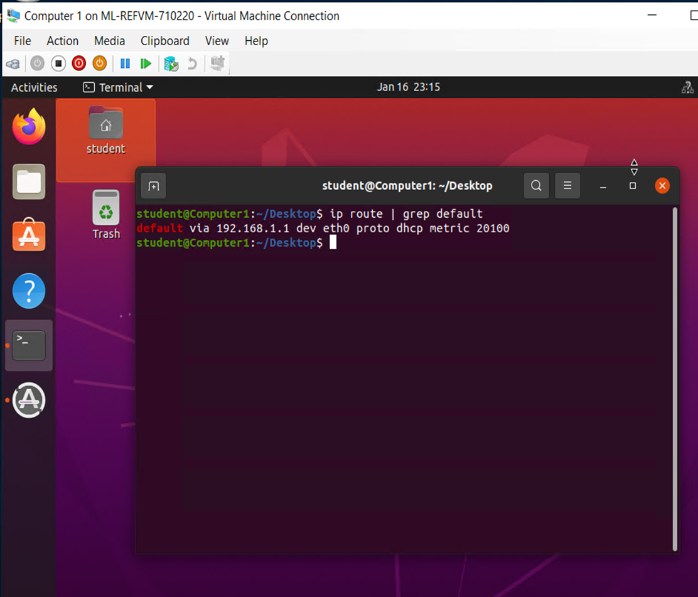
the terminal window that shows the default gateway IP address.

Slide 6
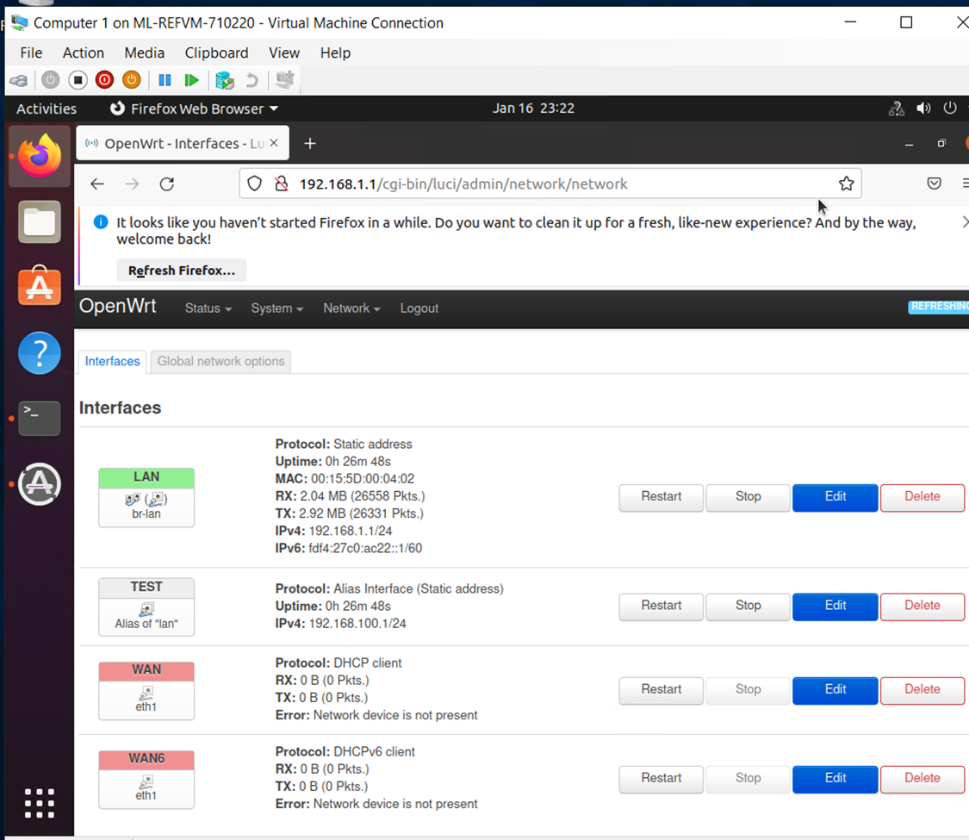
the Interfaces page that shows the new IPv4 address on the LAN interface.

Slide 7
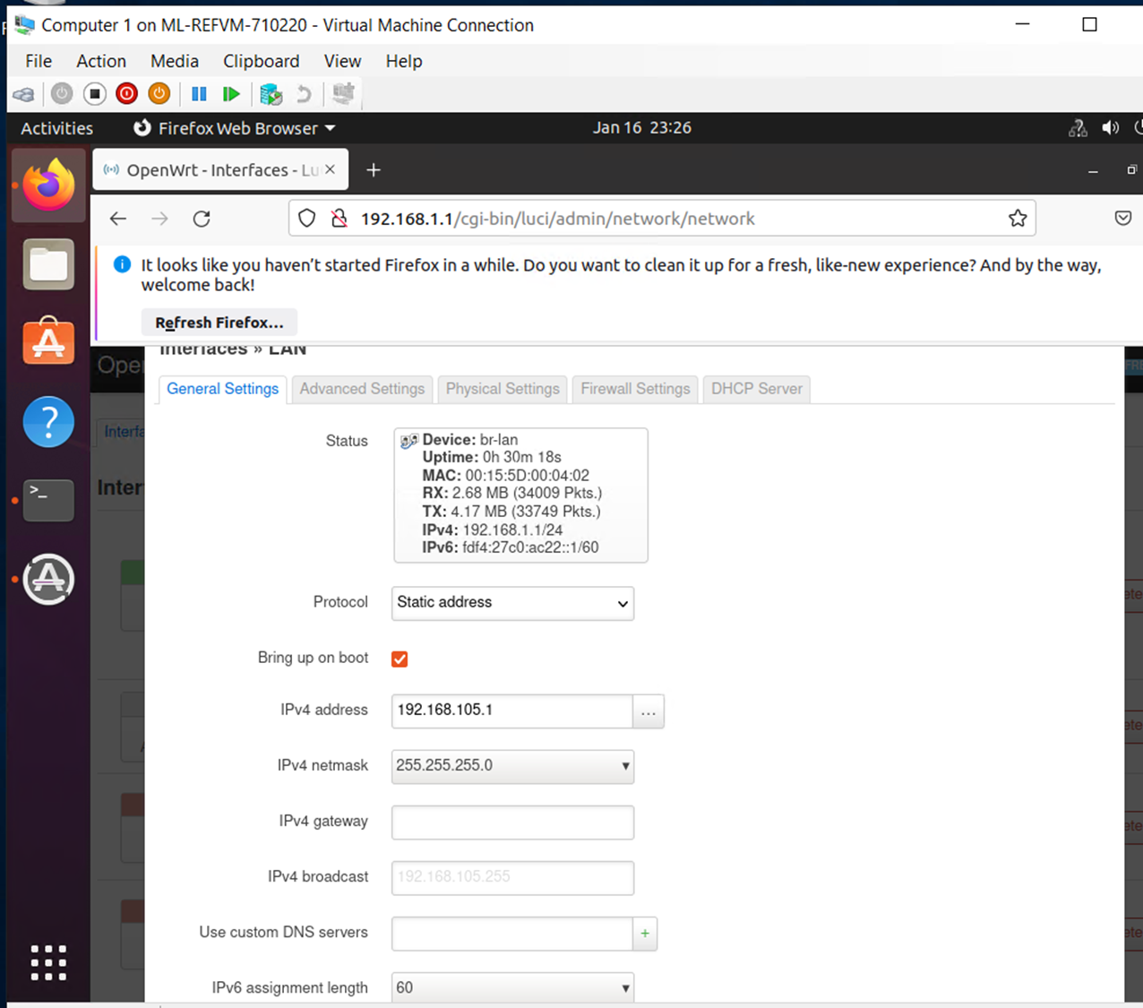

Slide 8
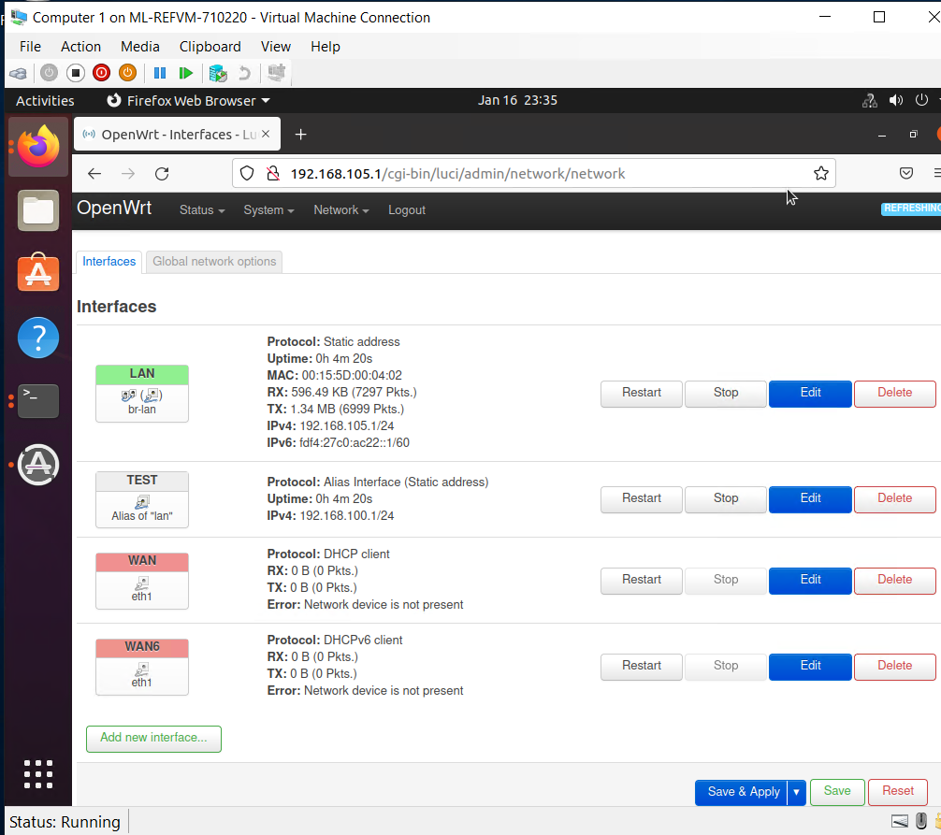

Slide 9
Module 3: Project - Connectivity Test

Slide 10
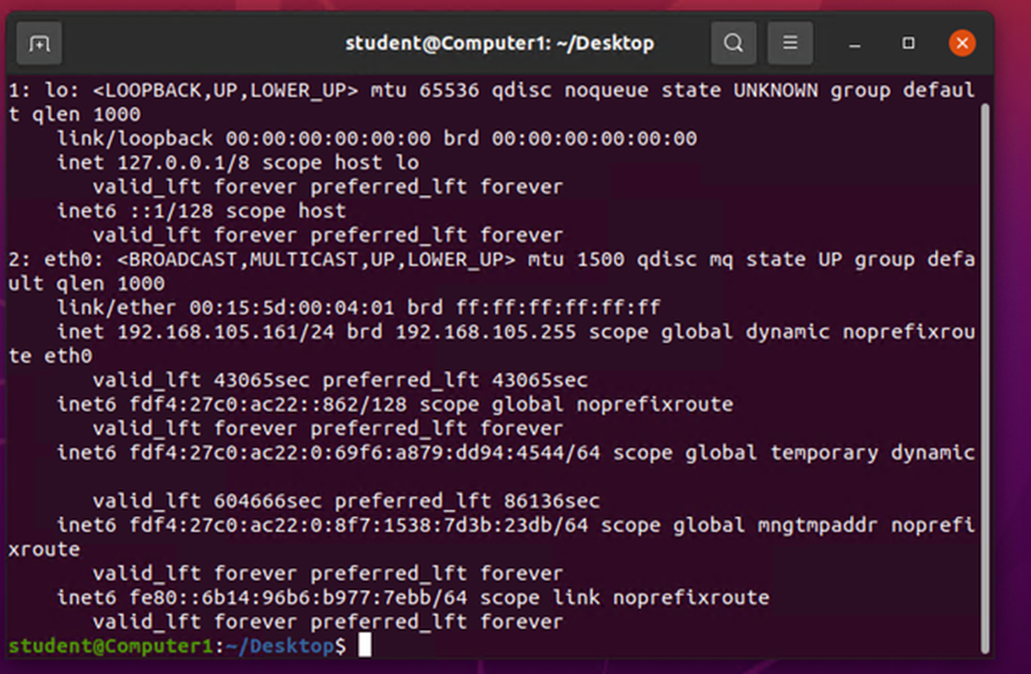
Dynamic IP Address Assignment
the IPv4 address of the Computer 1 VM

Slide 11
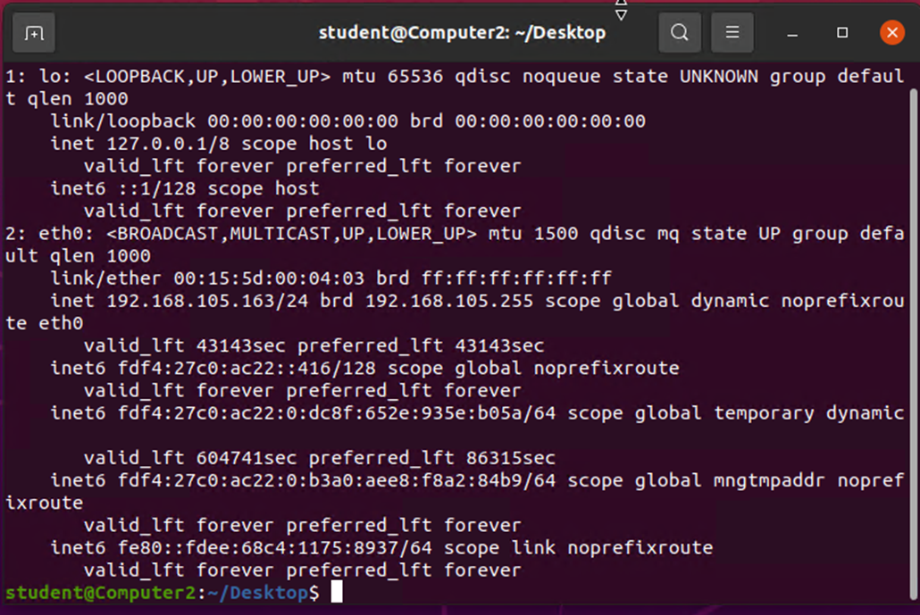
Dynamic IP Address Assignment
the IPv4 address of the Computer 2 VM

Slide 12
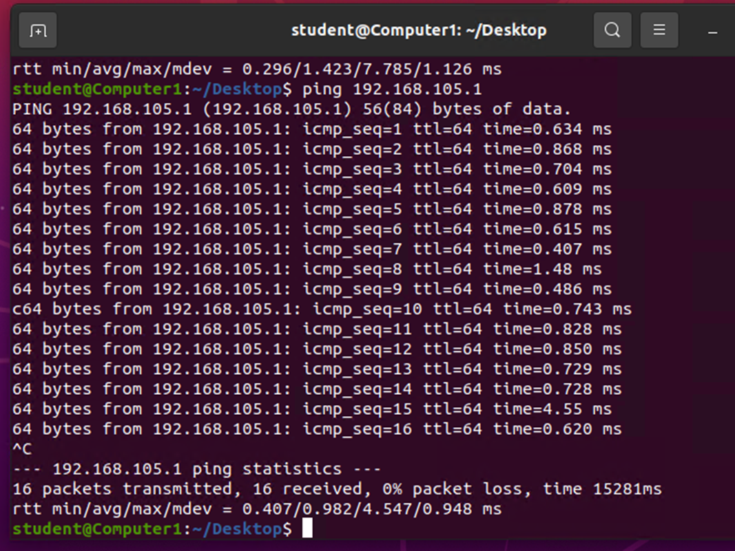
Connectivity Test
the connectivity tests between the Computer 1 VM and the other two devices (i.e., the SOHO Router VM and Computer 2 VM).

Slide 13
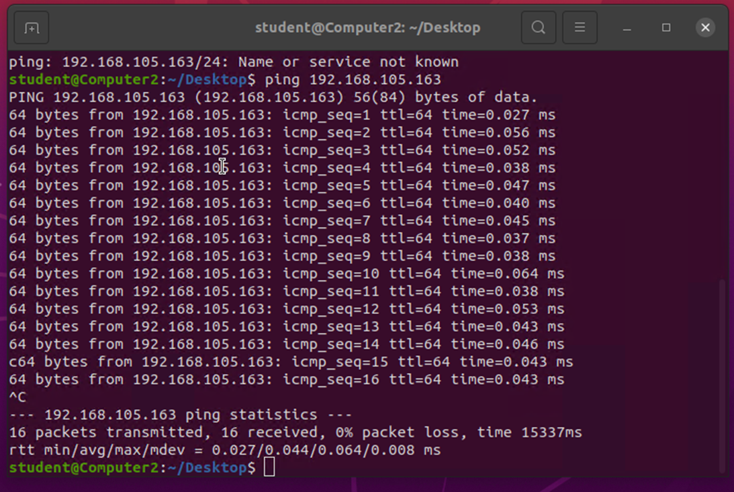
Connectivity Test
the connectivity tests between the Computer 2 VM and the other two devices (i.e., the SOHO Router VM and Computer 1 VM).

Slide 14
Module 4: Project - IP Subnetting and Loopback Interfaces

Slide 15
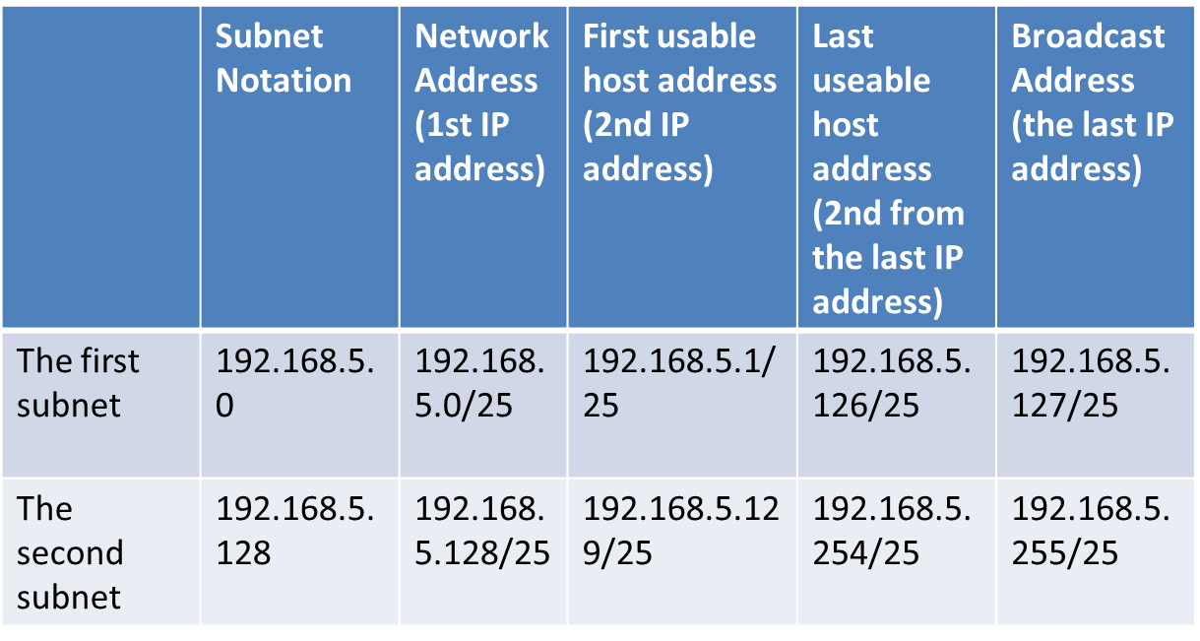
Subnetting Table
includes two /25 subnets, listing the subnet notation, network address, first usable host address, last usable host address, and broadcast address of each subnet.

Slide 16
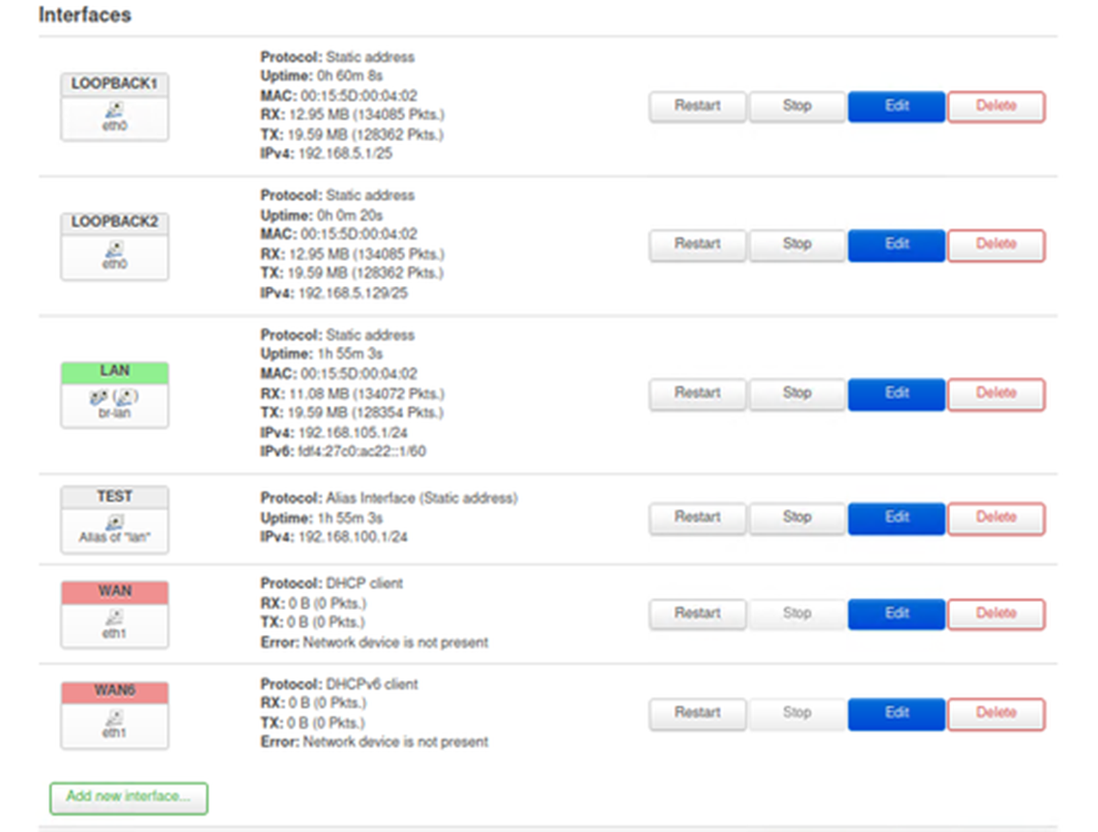
Shows both Loopback1 and Loopback2 interfaces and their correct IPv4 addresses code

Slide 17
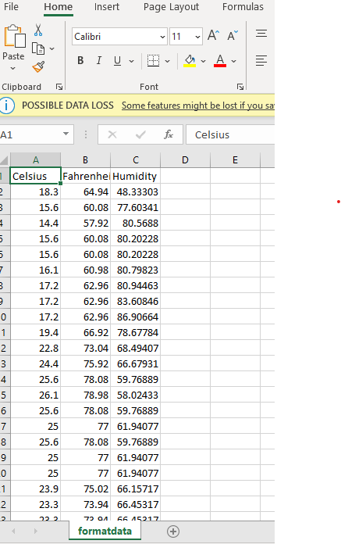
Retrieving and Converting Data to CSV Format

Slide 18
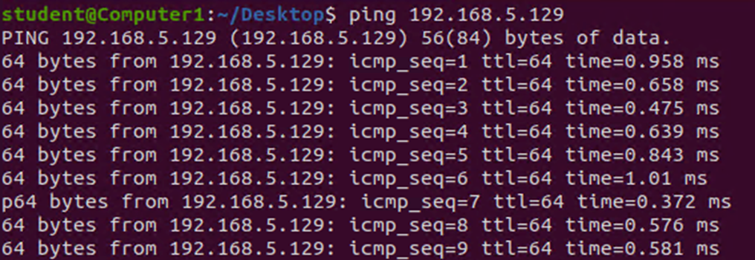
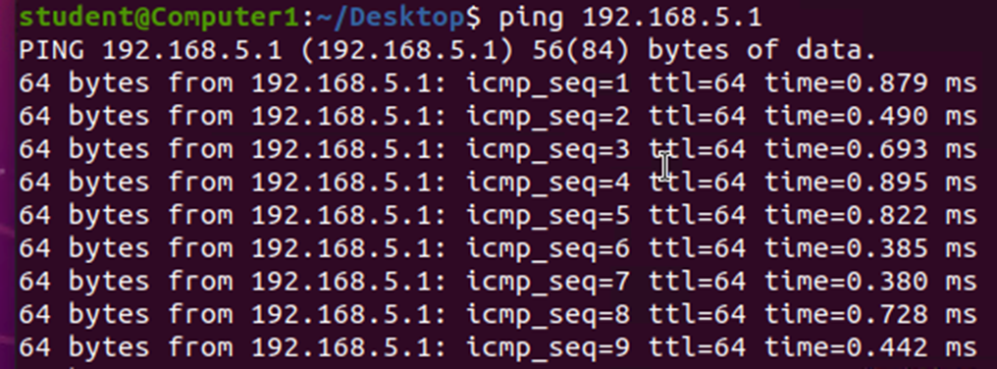
Connectivity Tests
shows two successful ping tests from the Computer 1 VM to the Loopback 1 and Loopback 2 interfaces

Slide 19
Module 5: Project - Visio Network Diagram

Slide 20
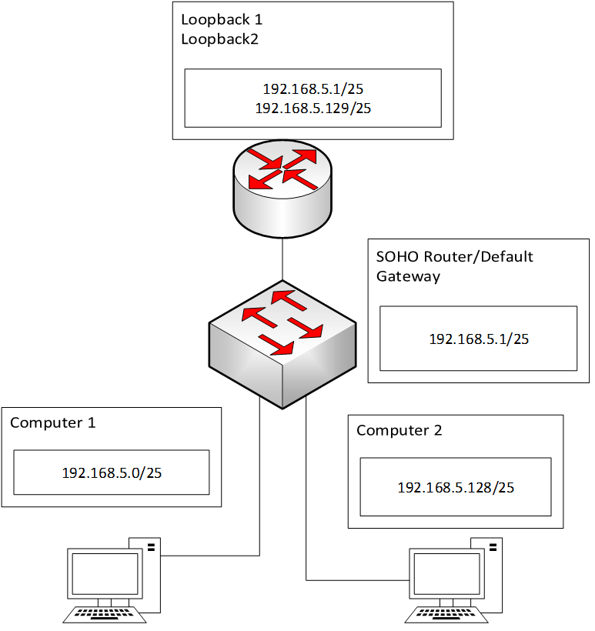
Microsoft Visio Network Diagram
This diagram illustrates the interconnection of the Computer 1 VM, the Computer 2 VM, and the SOHO Router VM.

Slide 21
Module 6: Project - SOHO Wireless Network Security

Slide 22
SOHO Wireless Network Security
1. What are the factory default username and passwords of a TP-Link router? Why is it important to change the default username and password of a SOHO router?
Answer: Admin, it is important because there are websites that show people the factory default user and password of servers, etc.
2. To protect a SOHO wireless network with a small number of devices, which address management method provides more control, configuring the device IP addresses manually (static IP) or using a DHCP server (dynamic IP)? Why?
Answer: A DHCP server because it configures the IP address on the computer automatically unlike a static IP that has to be manually inputted.
3. What does MAC filtering do? If needed, when would you use deny filtering rules and when would you use allow filtering rules? What happens to devices that want to connect, if the “Allow the stations specified by any enabled entries in the list to access” function is enabled but there are no entries in the list?
Answer: MAC filtering allows you to block or permit access to the network. You wouldn’t use MAC filtering with your Wi-Fi router because any device could copy your address, can be used on a public network to filter unknown networks.

Slide 23
SOHO Wireless Network Security
1. What wireless security settings are displayed on the Wireless Security page? Which one is recommended by the vendor? Why?
Answer: Firewall, VPN, ALG
They recommend using ALG because it allows customized NAT traversal filters to be plugged into the gateway to support address and port translation for certain app layers.
2. Among the configurations you explored in this module, which one is a true security function? Why?
Answer: Firewall because it helps prevent cyberattacks and protects the LAN from the outside world.
3. What would you do to protect your wireless network at home? Why?
Answer: I would use a VPN so my IP address would not be located on my home

Slide 24
Challenges in project

Slide 25
My challenge was trying to figure out my different IP addresses, but I looked them up and double checked before moving on

Slide 26
Career Skills

Slide 27
I leared how to check up your own IP address and how to hide it from potential hackers and protect it overall.

Slide 28
Conclusion

Slide 29
In conclusion I found this class to be very interesting and thought me about network security and how unsafe it is not to have your own VPN and good passwords.

