Slide 1
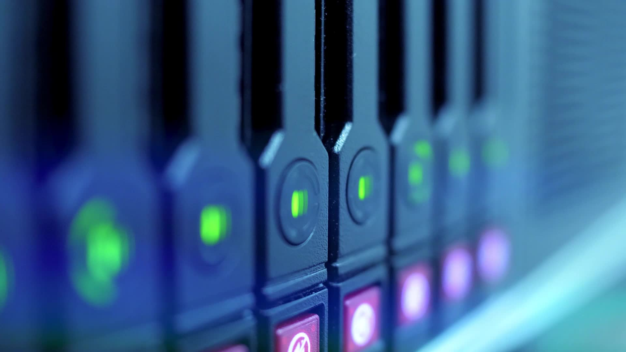
CEIS101 Course project smart home automation and security system
Presented by: Eric O.

Slide 2
Introduction
I developed a smart home automation and security system which I prototyped in Tinker Cad, I built with a tech core kit, and programed within a Arduino IDE
The smart home system will be able with various device tell how close an intruder is and be able to notify through a loud alarm, it also automates turning on the lights when in dim lighting

Slide 3
Circuit Simulation In TinkerCad

Slide 4
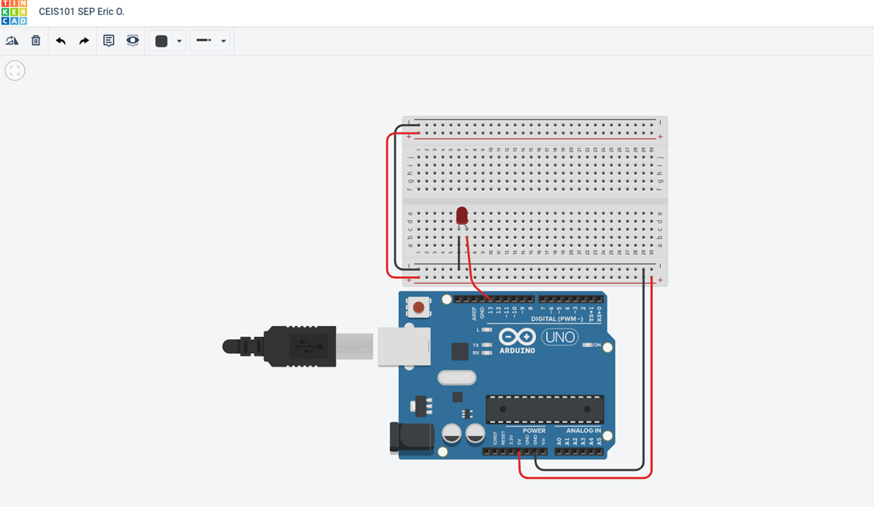

Slide 5
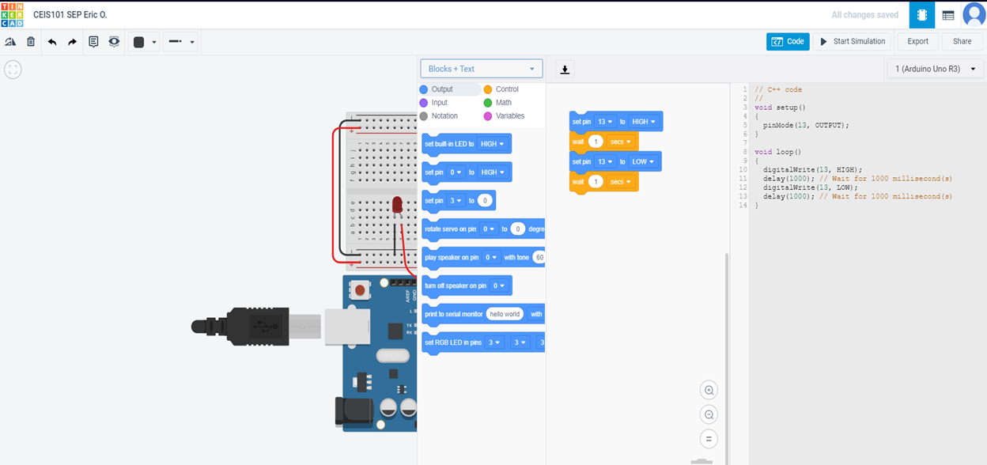

Slide 6
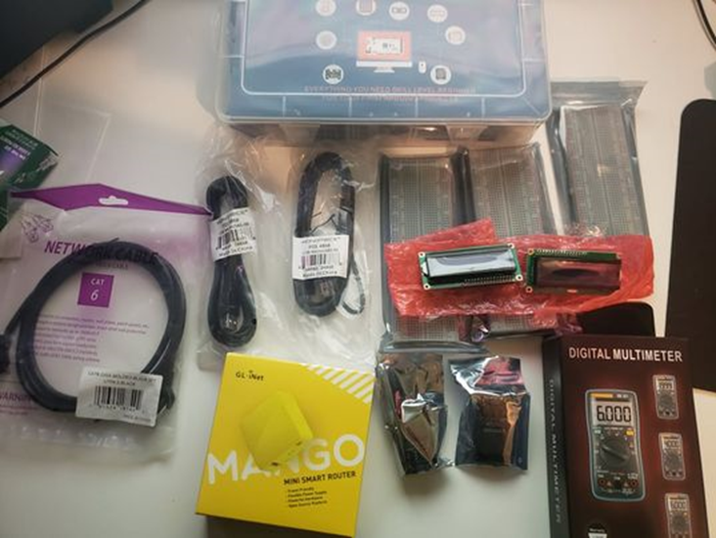
Inventory Of Parts, Circuit building, And displaying Messages
• UCTRONICS Kit
• ESP32 (2)
• LCD Modules (2)
• Breadboards (3)
• Mini Router
• Patch Cable
• Digital Multi Meter
• USB to Micro USB (2)

Slide 7
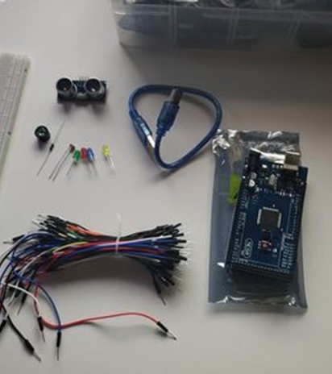
Project Components
• Arduino Mega 2560
• Breadboard
• Resistor 10kΩ
• LEDs
• Ultrasonic Sensor
• Active Buzzer
• Photoresistor
• Wires
• USB Type B cable

Slide 8
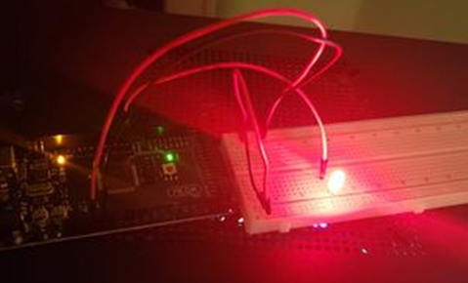
Circuit with red LED on

Slide 9
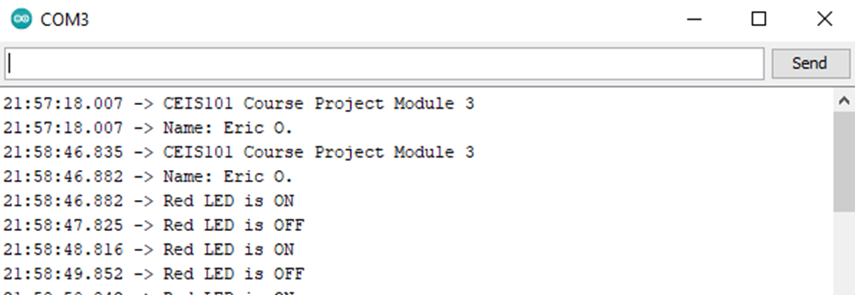
Serial Monitor (screenshot)

Slide 10
Adding Door Sensor To Smart Home System

Slide 11
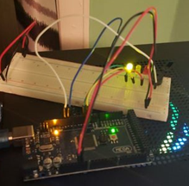
Circuit of door closed with Green LED ON

Slide 12
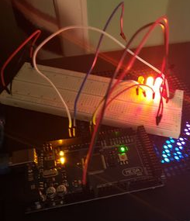
Circuit of door open with Green LED OFF

Slide 13
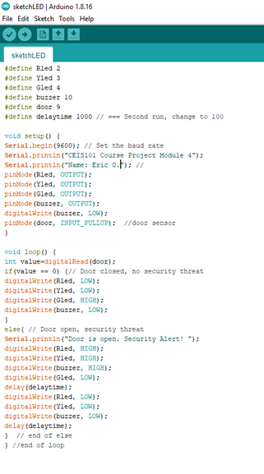
Arduino Code

Slide 14
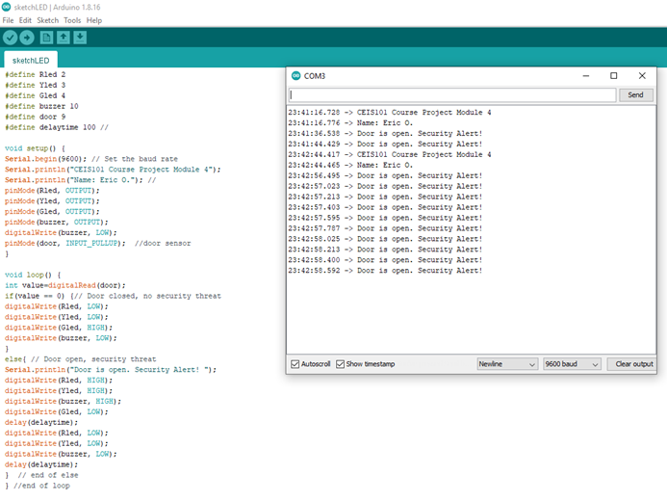
Serial Monitor

Slide 15
Adding Distance Sensor To Smart Home System And Conducting Data Analysis

Slide 16
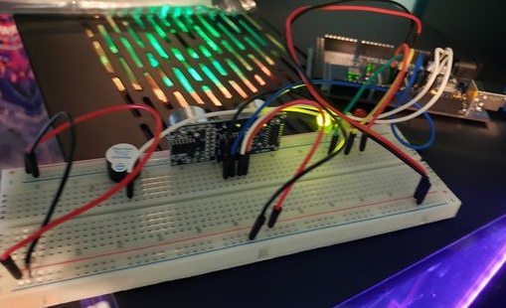
Circuit with green LED on

Slide 17
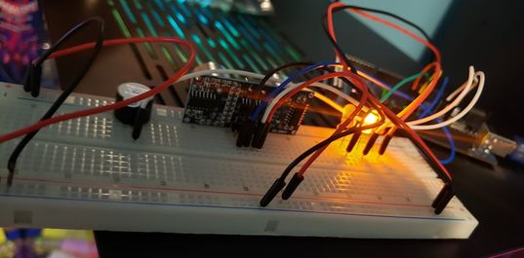
Circuit with yellow LED on

Slide 18
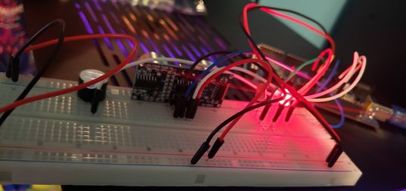
Circuit with red LED on

Slide 19
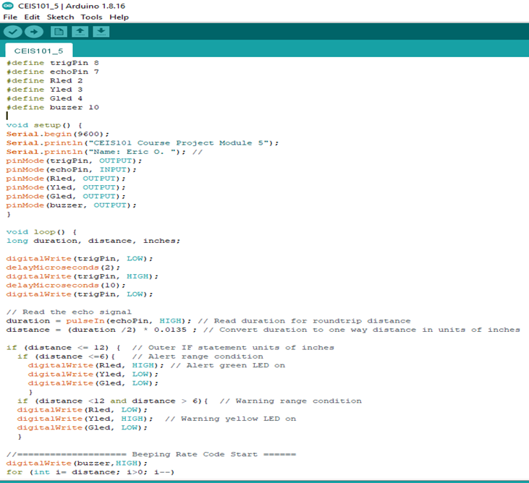
Arduino Code

Slide 20
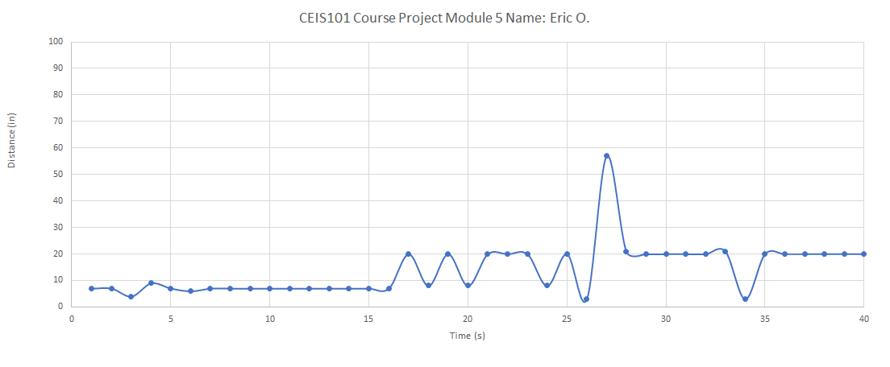
Plot of data (graph from Excel)

Slide 21
Adding Automated Light To Smart Home Security System

Slide 22
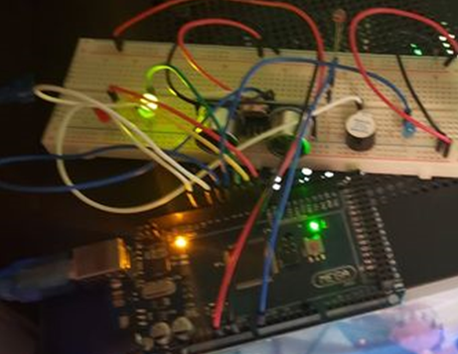
Circuit with automated LED off

Slide 23
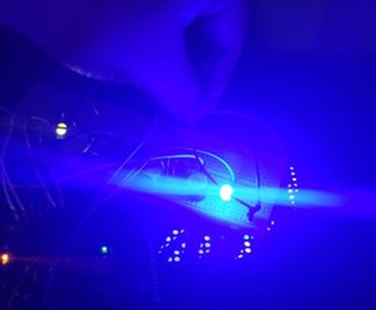
Circuit with automated LED on

Slide 24
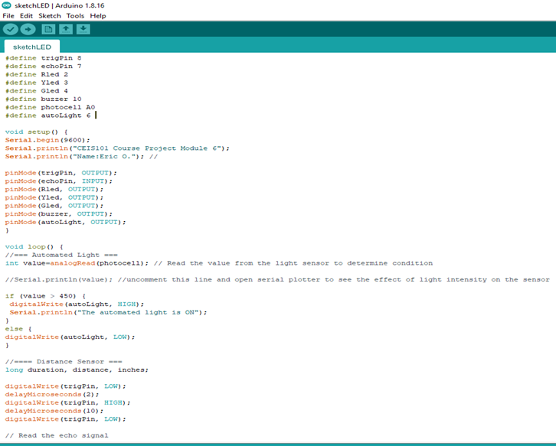
Arduino Code

Slide 25
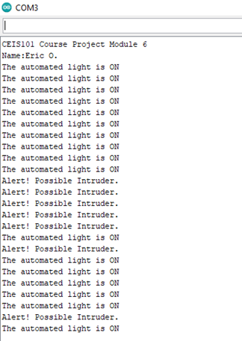
Serial Monitor

Slide 26
Challenges
One of my Active Buzzers did not work so I switched it out and the code worked perfectly for Automating the lights.
I pullled on a black ground cable too hard and striped off the rubber ends.
My LEDs were too long and had some metal showing off the breadboard.

Slide 27
Career Skills Acquired
Coding / Programming
Understanding of the IoT
Automation of lights and sensors
Operating System Fundamentals

Slide 28
Conclusion
This was an amazing and interesting experience that taught me a lot about system connectivity and how all these parts work together to make a system work
I liked being able to touch all my tools and see how they could all connect together with cables and coding
Im hoping to learn more, And be able to understand even more complex sets of code

