Slide 1

CEIS110 Course Project: data analysis using Python
Presented By: Eric O.

Slide 2
Introduction

Slide 3
Throughout this course, we analyzed weather data downloaded from a cloud data source, stored in a database, extracted, and processed. We examined the design and development process of the system which includes planning, software setup, programming, and data analysis. And gave us an inside look at many aspects of the software development process.

Slide 4
Design and Library setup

Slide 5
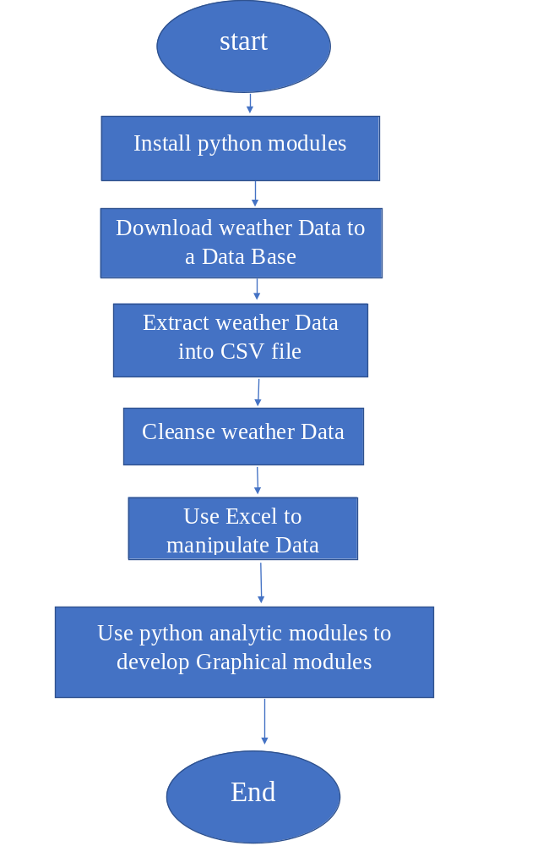
Flow Chart

Slide 6
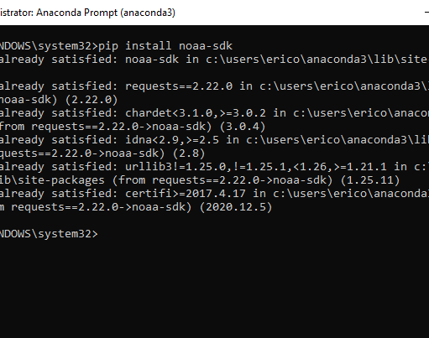
Software Inventory

Slide 7
Downloading weather data

Slide 8
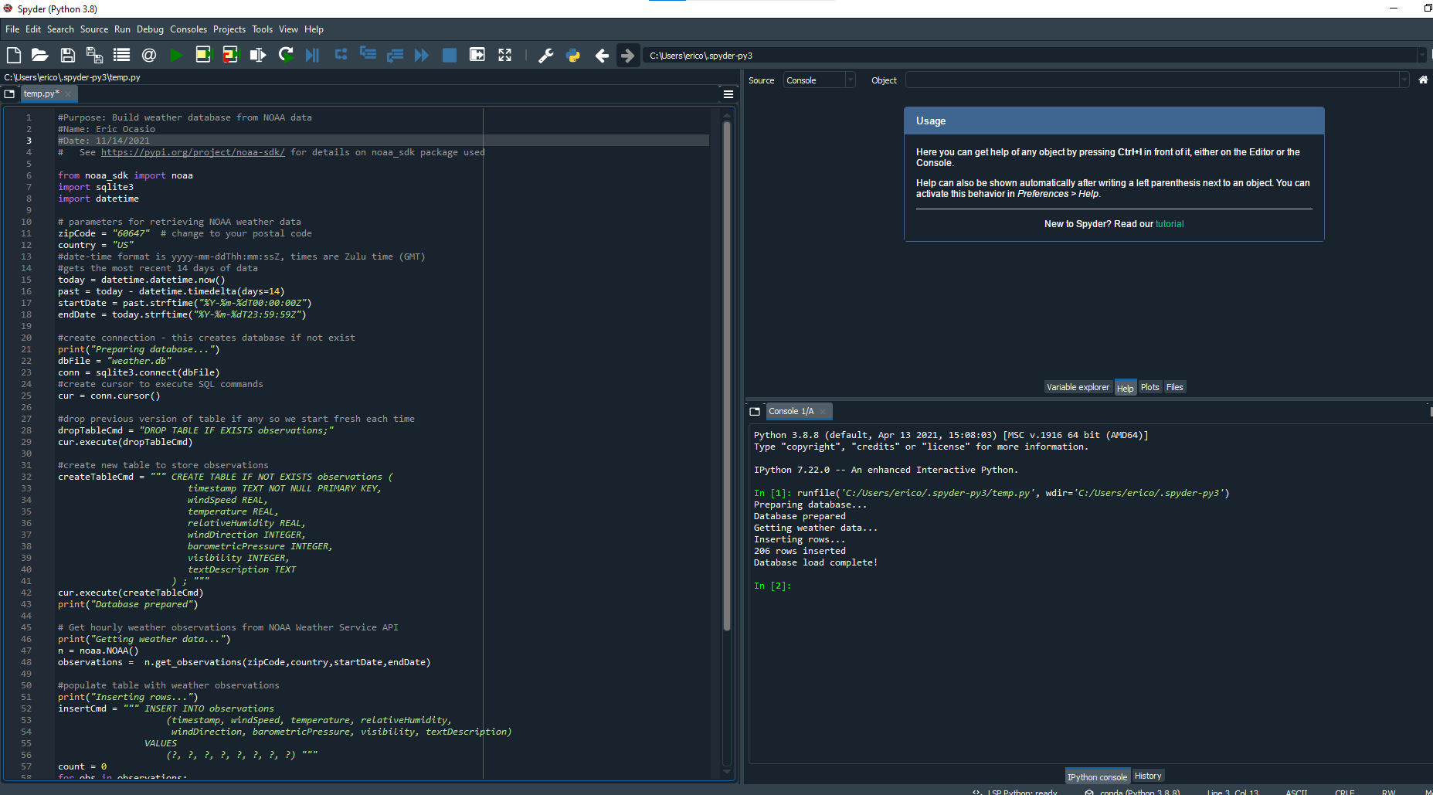
WeatherDb.py Code

Slide 9
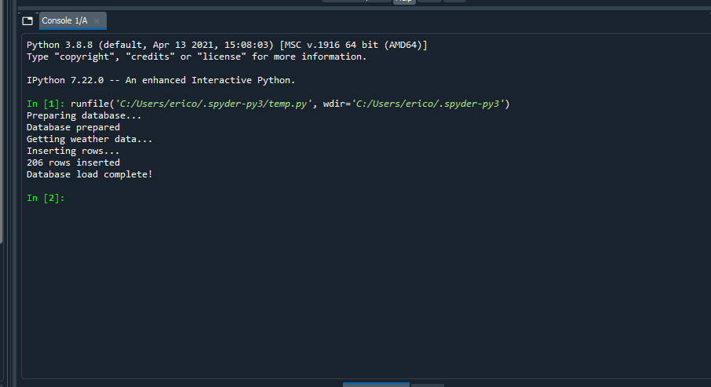
Python Console

Slide 10
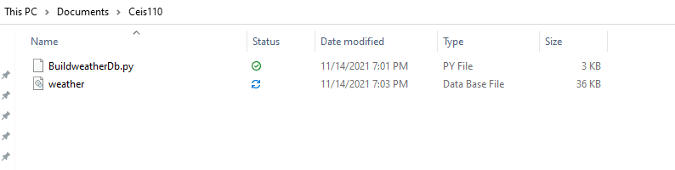
Weather.db File

Slide 11
Querying the database with SQL

Slide 12
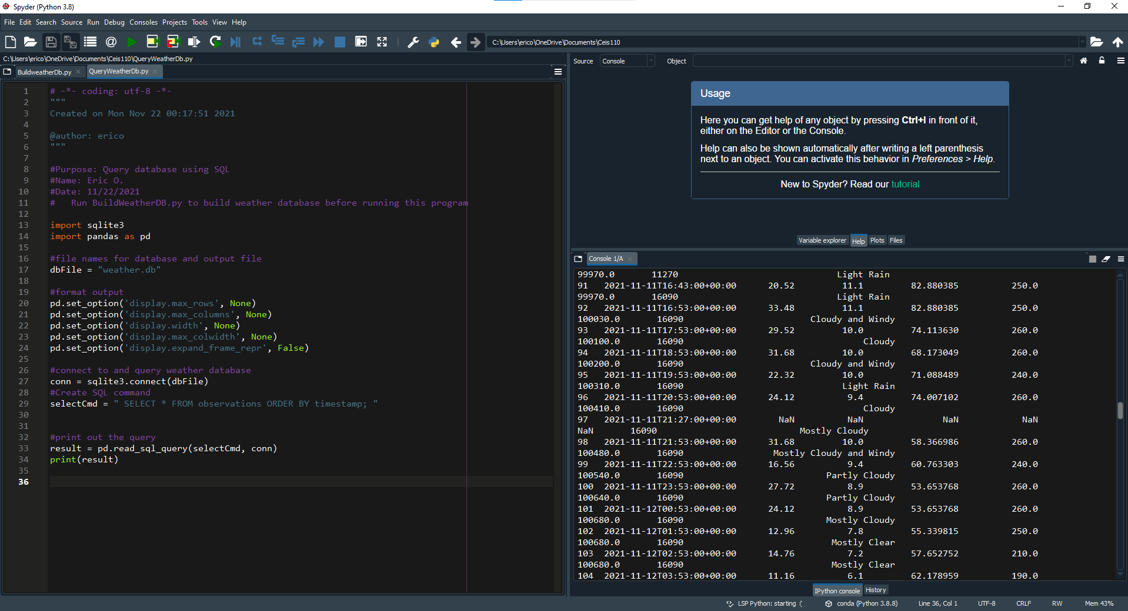
Query to retrieve all columns and all rows

Slide 13
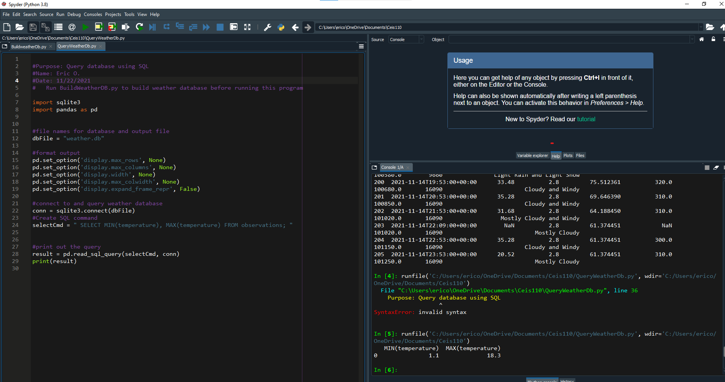
Query to retrieve lowest and highest temperatures

Slide 14
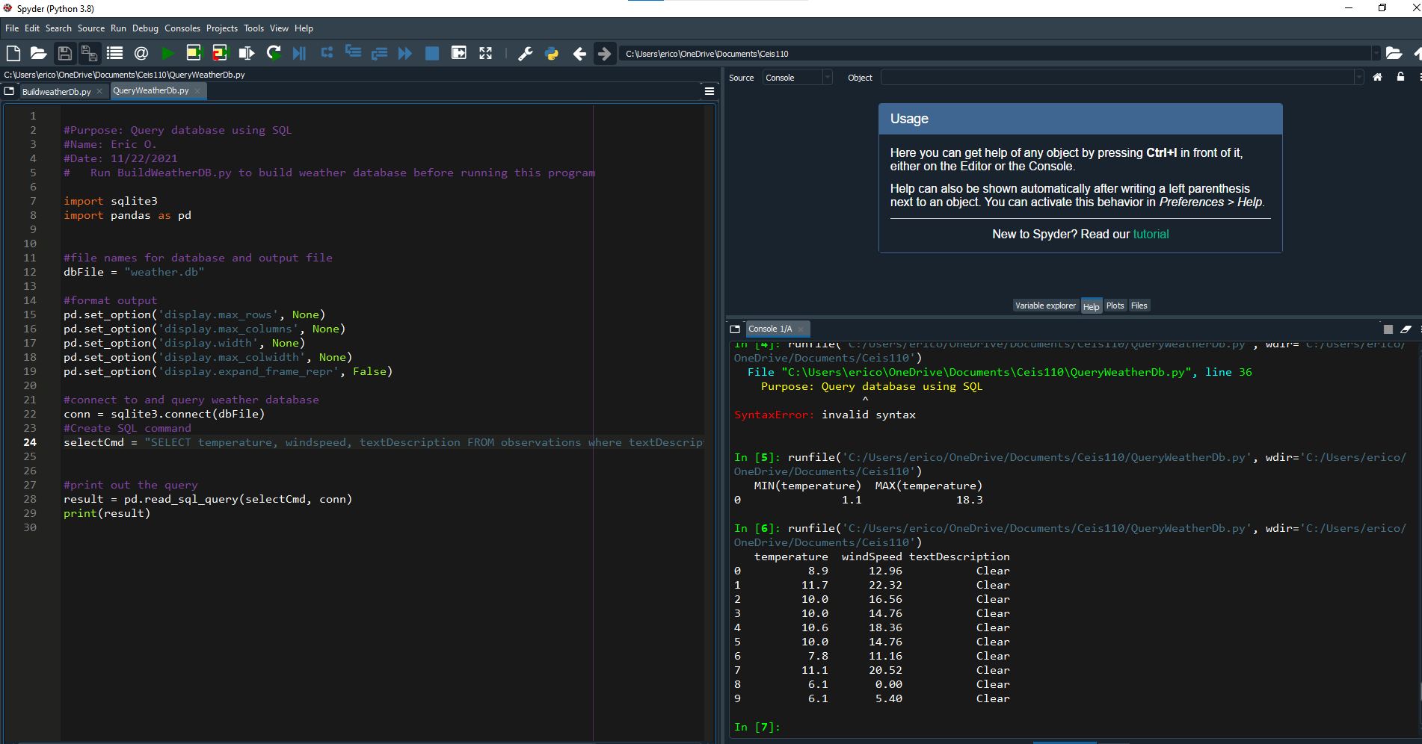
Query to retrieve all clear days

Slide 15
Querying and Manipulating Data with SQL and Python

Slide 16
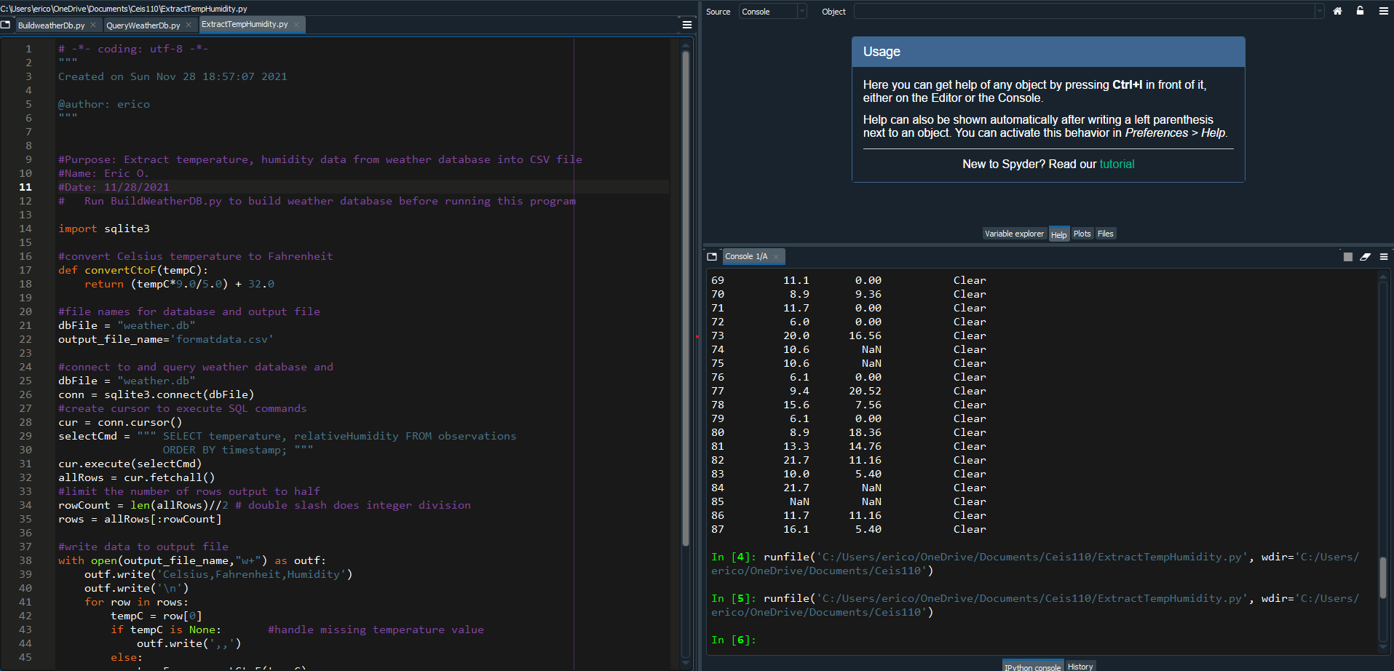
Python code

Slide 17
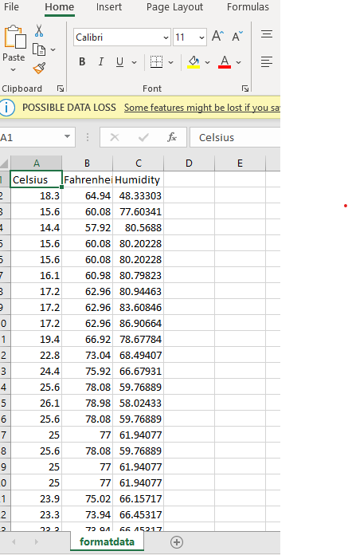
Retrieving and Converting Data to CSV Format

Slide 18
Temperature and Humidity Chart on temperature and humidity data from database

Slide 19
Developing Graphical Models and Interpret Results

Slide 20
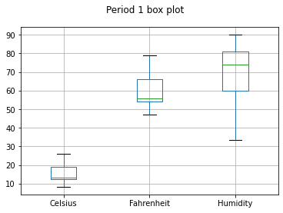

Slide 21
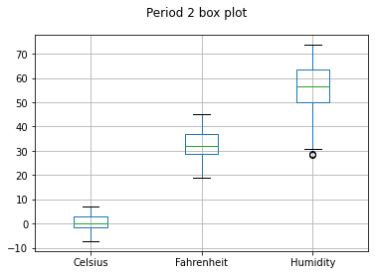

Slide 22
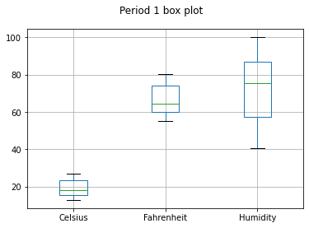
Analysis of the weather in Florida

Slide 23
Prediction

Slide 24
Prediction
I think Dallas will more than likely have rain or windy week due to the data on the chart
Humidity will go up, the temperature will go up as well.

Slide 25
Challenges in project

Slide 26
I downloaded data from my city but didn’t really have good data to produce a graph with viable results, I had to collect data from Dallas Texas.
I had to find a way to remove add ons on Linux because it affected another program I needed for files

Slide 27
Career Skills

Slide 28
Problem-solving
Resourceful
Communication
Open-Minded
Team player
Adaptability

Slide 29
Conclusion

Slide 30
In conclusion through the results and data, I collected I can say that humidity plays a critical role in upcoming storms or dips in temperature

